Slide 1


Asthma in Children and Adolescents
Katedra i Klinika Pediatrii, Alergologii i Gastroenterologii CM w Bydgoszczy UMK

Slide 2
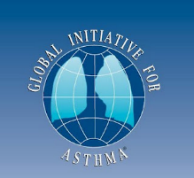
Definition of Asthma
Asthma is a heterogeneous disease, usually characterized by chronic airway inflammation and a set of symptoms such as:
wheezing
shortness of breath
a feeling of chest tightness
cough
The symptoms vary in intensity and over time, and are accompanied by varying degrees of variable airflow limitation, which resolves either spontaneously or after the use of medication.

Slide 3
Most Common Asthma Phenotypes According to GINA
Allergic asthma: the easiest phenotype to recognize, often beginning in childhood and associated with a positive personal and/or family history of allergic diseases (e.g., atopic dermatitis, allergic rhinitis, food allergy or drug allergy). Induced sputum collected before treatment often shows eosinophilic airway inflammation. Allergic asthma usually responds well to inhaled corticosteroids (ICS).
Non-allergic asthma: in some patients, asthma is not associated with allergy. The cellular profile of sputum may be neutrophilic, eosinophilic, or paucigranulocytic. The short-term response to ICS in these patients may be weaker.
Cough-variant asthma and asthma with predominant cough: in some children and adults, cough may be the only symptom of asthma, and evidence of airflow limitation may be absent except during bronchial provocation tests. In some patients, wheezing and bronchodilator reversibility develop later. Treatment with ICS is effective.

Slide 4
Most Common Asthma Phenotypes According to GINA
Adult-onset asthma (late onset): some adults, especially women, present with their first episode of asthma in adulthood. This phenotype tends to be non-allergic and often requires higher doses of ICS or is relatively resistant to corticosteroid treatment. In patients with adult-onset asthma, occupational asthma (i.e., related to workplace exposure) should be excluded.
Asthma with fixed airflow limitation: in some patients with long-standing asthma, airflow limitation develops that is fixed or not fully reversible. This is thought to result from airway wall remodeling.
Obesity-related asthma: in some patients with obesity, respiratory symptoms are prominent, and the inflammatory pattern differs — usually with a low eosinophil count.

Slide 5
Medical History
Has the patient had an episode or recurrent episodes of wheezing within the past year? Does the patient experience bothersome nighttime cough not related to infection? Do wheezing, shortness of breath, or cough occur after physical exertion? Do wheezing, shortness of breath, or cough occur after exposure to allergens or irritants? Does the patient complain that colds “go down to the chest” or last longer than 10 days? Does the patient have, or has the patient had, symptoms of atopic dermatitis or allergic rhinitis/conjunctivitis? Has the patient had bronchitis or pneumonia more than 3 times in a year? Has the patient received antibiotics more than 3 times in a year for respiratory infections? Do the symptoms improve with asthma treatment or fail to improve after antibiotic therapy?

Slide 6
Medical History
Typical, variable respiratory symptoms
wheezing
shortness of breath
chest tightness
cough
Variability in timing and intensity. Often more severe at night or upon waking. Triggered by exercise, laughter, allergens, cold air. Worsening after exercise (characteristic). Often occur or worsen during viral infections.

Slide 7




Physical Examination
No abnormalities Wheezing Expiratory dyspnea
Additionally, atopic phenotype may include:
atopic dermatitis
allergic rhinitis, allergic salute
conjunctivitis
Wheezing appears only when bronchial obstruction reaches a decrease in FEV₁ of approximately 27–30%.

Slide 8
Pulmonary Function Testing
They allow assessment of the degree, reversibility, and variability of airflow in the airways, and they support the diagnosis of asthma.
Advantage: objective and quantitative, highly reproducible Disadvantage: low specificity
A normal result does not exclude asthma, and an abnormal result does not confirm asthma.

Slide 9
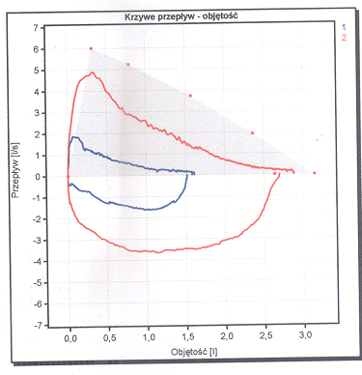
Bronchodilator Reversibility Test
Assessment of airway reversibility after SABA administration (rapid-acting β₂-agonist – 400 µg salbutamol)
Increase in FEV₁ of at least 12% from baseline or ≥ 200 mL
Causes of a negative bronchodilator test:
Too low a dose of SABA
Incorrect inhalation technique
Mild degree of obstruction
Mechanisms other than bronchial smooth-muscle constriction
Positive test

Slide 10
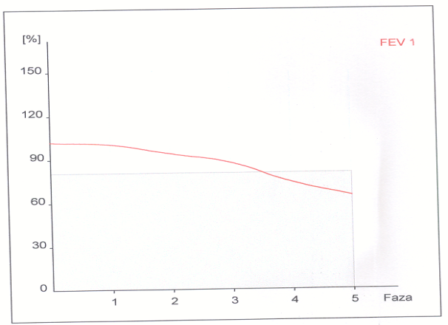
Non-specific Bronchial Provocation Tests
physical factors chemical factors, e.g. methacholine exercise
These tests have high sensitivity but low specificity for the diagnosis of asthma.
A negative test result may help exclude chronic asthma in a patient who is not taking inhaled corticosteroids, whereas a positive result does not always mean that the patient has asthma.
FEV1 20%
FEV1 10%

Slide 11
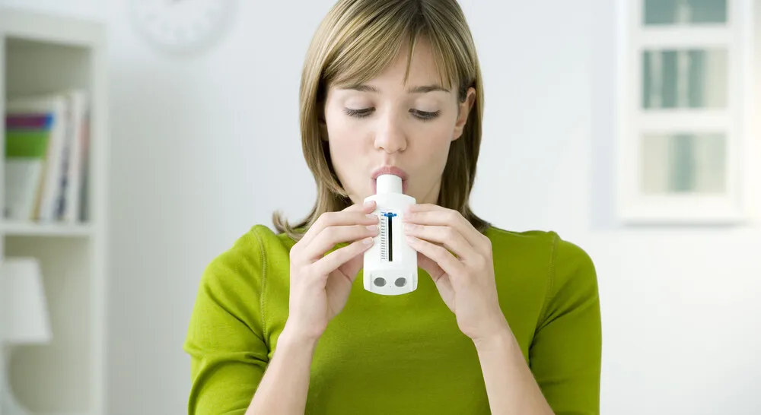

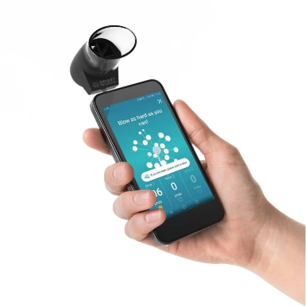
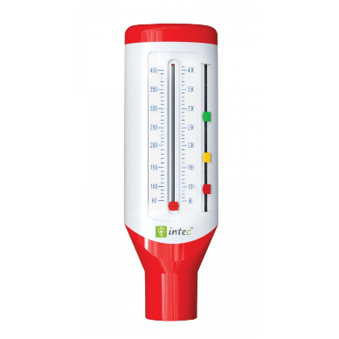
Measurement of Peak Expiratory Flow (PEF) using a peak flow meter
Measurement twice daily, in the morning and evening, before taking medications – assessment of PEF variability → variability of airway obstruction Significance in diagnosing asthma and in monitoring disease control
Improvement in PEF after administration of SABA – equivalent of a bronchodilator reversibility test (less sensitive, but useful when spirometry is not available)

Slide 12
FENO – fractional concentration of nitric oxide in exhaled air
Aim: assessment of the intensity of type 2 airway inflammation by measuring the concentration of nitric oxide in exhaled air.
Principle: the patient exhales at a constant, low flow through the device mouthpiece; the device measures ppb NO from the terminal portion of the exhalation originating from the bronchi (the nose is “excluded” thanks to resistance in the mouthpiece).
Preparation (minimum 1 hour before): – no smoking/e-cigarettes, no intense physical exercise, no meals rich in nitrates (beetroot, spinach), no energy drinks; – before spirometry (spirometry may lower FeNO); – take medications as usual, but remember: ICS lower FeNO.

Slide 13
FENO – fractional concentration of nitric oxide in exhaled air
Exhalation at a steady flow through the mouthpiece Two consistent measurements are usually performed (devices display quality messages). Duration: 3–5 minutes in total.
What can distort the result: poor technique (unstable flow), recent spirometry/hyperventilation, viral infection, smoking, allergen exposure (↑ after approx. 24 h), corticosteroids (↓ depending on dose).
Safety / contraindications: non-invasive, safe test; practically no contraindications (caution in severe dyspnea — treat first).
Result: expressed in ppb; interpret together with symptoms, eosinophilia, IgE and spirometry (high → suggests T2 inflammation and good response to ICS; low does not exclude asthma).

Slide 14
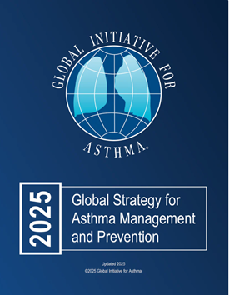
Biomarkers in asthma
Peripheral blood eosinophilia
Eosinophilia in adults/adolescents:
≥ the upper limit of the population reference range (according to the laboratory).
In severe asthma on high-dose ICS:
≥150/µl → suggests type 2 inflammation.
≥300/µl → typical threshold for qualification for anti-T2 biologics.
Effect on the result (↑ / ↓):
↑: males, morning, smoking, parasitic infections, allergic diseases (AD/AR), allergen exposure in sensitized individuals, other conditions (e.g., eosinophilic bronchitis, EGPA).
↓: certain asthma phenotypes, use of corticosteroids (mainly systemic; also inhaled/intranasal).

Slide 15
Biomarkers in asthma
FeNO (NO concentration in exhaled air)
Thresholds for an abnormal result (adults/adolescents):
Without ICS: >50 ppb
Medium-dose ICS: ≥25 ppb
High-dose ICS: ≥20 ppb
Effect on the result (↑ / ↓):
↑: males, afternoon, allergic diseases (AD/AR), ~24 h after allergen exposure in sensitized individuals; also dependent on device/measurement site.
↓: smoking, bronchoconstriction and reduced lung function, early phase of the allergic reaction, use of corticosteroids (inhaled — dose dependent; also oral/intranasal).

Slide 16
Biomarkers in asthma diagnostics, phenotyping
Initial diagnosis of asthma
adults with typical symptoms, no positive bronchodilator reversibility test
Peripheral blood eosinophilia:
high eosinophilia → supports the diagnosis of T2-high asthma
low eosinophil count does not exclude asthma
strong evidence for the diagnosis is clinical improvement after treatment
FeNO:
high FeNO → supports the diagnosis of T2-high asthma (non-asthmatic causes also exist)
low FeNO does not exclude asthma
strong evidence for the diagnosis is clinical improvement after treatment

Slide 17
Biomarkers in asthma diagnostics, phenotyping
Asthma phenotyping (mild–moderate):
High eosinophilia in a patient with confirmed asthma
indicates a phenotype consistent with eosinophilic asthma.
High FeNO in a patient with confirmed asthma
consistent with type 2 asthma.
Total serum IgE / specific IgE (or SPT):
≥1 positive, clinically relevant result consistent with allergic asthma (if it correlates with symptoms after exposure).

Slide 18
Biomarkers in Asthma prognosis
In patients with ≥1 exacerbation in the past year
Blood eosinophilia
High eosinophilia → higher risk of future exacerbations,
Particularly in patients on medium/high-dose ICS or using systemic corticosteroids.
FeNO
In patients treated with ICS, high FeNO → higher risk of future exacerbations.
Peripheral blood eosinophilia + FeNO together:
Complementary prognostic information.
Highest risk when both markers are elevated.

Slide 19
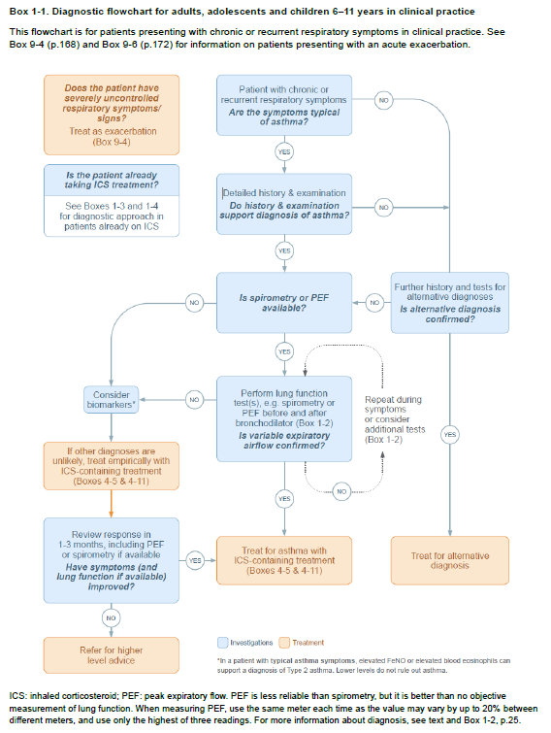
Diagnostic algorithm in children >6 years of ageaccording to GINA

Slide 20
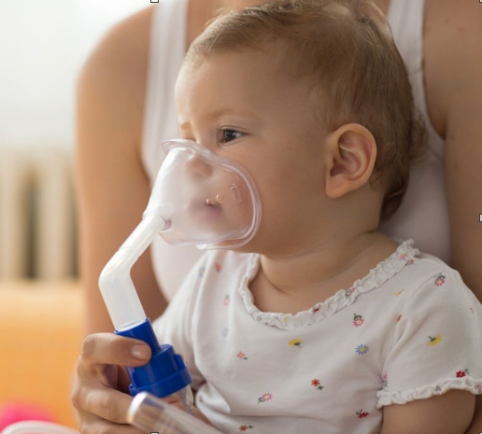

Diagnosis of asthma in children <5 years of age
50% of asthma casesstart in the first year of life.
80% of asthma casesstart before the age of 6 years.

Slide 21
Diagnosis of asthma in children <5 years of age according to GINA
Clinical presentation:
Recurrent acute episodes of wheezing or ≥1 acute episode of wheezing plus “asthma-like” symptoms between episodes (e.g., dry cough or wheeze after running/laughing/crying, at night)
No other probable explanation for the respiratory symptoms.
Rapid response to asthma medications:
Rapid improvement after SABA during an acute episode (up to 3–4 h in more severe cases),
Improvement after SABA at home (within minutes),
Reduced severity/frequency of wheezing episodes and/or interval symptoms during 2–3 months of daily ICS therapy.
All three elements are required for diagnosis!

Slide 22
Diagnosis of asthma in children <5 years — according to GINA
If only 1–2 criteria are met → classify as “suspected asthma” and continue observation/reassessment.
A personal or family history of atopy may support the diagnosis, but it is neither required nor specific.
Always rule out alternative causes (foreign body aspiration, infections, congenital anomalies, primary ciliary dyskinesia, GERD, etc.).
During the treatment trial: document the response to SABA and the effects of daily ICS over 2–3 months (symptom diary).

Slide 23
Differential Diagnosis of Asthma
Congenital Diseases and Disorders
Tracheomalacia
Cystic fibrosis
Bronchopulmonary dysplasia
Congenital malformations causing intrathoracic airway narrowing
Primary ciliary dyskinesia
Immunodeficiency disorders
Congenital heart defects
Infections
Upper airway cough syndrome (postnasal drip)
Chronic rhinosinusitis
Tuberculosis, pertussis
Other
Airway foreign body aspiration
Gastroesophageal reflux disease (GERD)
Pulmonary embolism
Psychosomatic disorders
Heart failure
Drug-induced cough

Slide 24
Symptoms suggesting a disease other than asthma
Onset in the neonatal period
Feeding difficulties – faltering weight and height gain
Vomiting accompanied by respiratory symptoms
Lack of association with the most common exacerbating factors in children (viral infections)
Focal lung changes, heart disease, clubbing
Elevated inflammatory markers in laboratory tests
No response to asthma treatment

Slide 25
Verification of an asthma diagnosis in children <5 years of age
Therapeutic trial supporting the diagnosis of asthma
Rapid improvement – resolution of bronchial obstruction after SABA
Improvement in the number and severity of obstruction episodes after 2–3 months of treatment with ICS
Worsening after discontinuation of ICS

Slide 26
PERSONALISATION OF ASTHMA TREATMENT
Choice of controller treatment — shared decision with the patient/parent
Preferred medication Which medicine best controls symptoms and reduces risk?
Patient characteristics / phenotype Risk/response-modifying factors: smoking, SABA overuse, history of exacerbations, high FeNO/eosinophils, environmental exposures, comorbidities.

Slide 27
PERSONALISATION OF ASTHMA TREATMENT
Patient perspective Goals, beliefs, and concerns about asthma and its treatment.
Practical issues
Which inhalers are available for this patient?
After training, will the patient be able to use the inhaler correctly?
Can they afford the treatment?
Adherence — how often will they realistically take the medication?
If several options are equivalent, which inhaler has the lower environmental impact?

Slide 28
Developing a partnership relationship between the child/parent and the doctor
Joint setting of treatment goals and methods
Written development of an individualized self-management plan covering asthma treatment and monitoring
Periodic review of treatment and level of asthma control
Education
Information about the disease and treatment methods (verbal + written)
Rationale for each therapeutic intervention and strategies for avoiding triggers
Personal action plan – long-term treatment + asthma exacerbations
Scheduled routine follow-up visits (the child brings the inhaler, PEF diary, current asthma control test results, etc.)

Slide 29
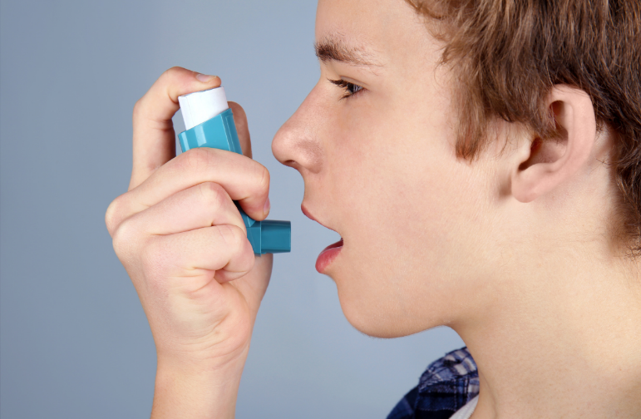
Goal of asthma treatment Asthma control
Control of asthma symptoms
Assessment of risk factors for poor treatment outcomes
risk of exacerbations
risk of irreversible airflow limitation
risk of adverse drug effects

Slide 30
Control of asthma symptoms
QUESTION | Well controlled | Partly controlled | Uncontrolled
Do asthma symptoms occur >2× per week? | no | 1–2 answers YES | 3–4 answers YES
Do you wake up at night because of asthma? | no
Do you use SABA more often than 2× per week? | no
Does asthma limit your activity? | no

Slide 31
Medications Used in the Treatment of Asthma
Controller medications Goal: reducing inflammation, controlling symptoms, reducing risk (exacerbations, decline in lung function).
AIR/MART: low-dose ICS–formoterol as an anti-inflammatory reliever (AIR) + maintenance therapy (MART) as needed.
Optimize the dose and regimen to minimize adverse effects and systemic corticosteroid exposure.
Examples:
Inhaled corticosteroids (ICS)
Long-acting β2-agonists (LABA) + inhaled corticosteroids (LABA/ICS)
Leukotriene receptor antagonists (LTRA)
Slow-release theophylline

Slide 32
Medications used in the treatment of asthma
Rescue medications
Every patient should have access to an inhaler.
Used to stop exacerbations and worsening symptoms; also short-term before exercise.
Rescue options: ICS–formoterol (anti-inflammatory reliever), ICS–SABA, SABA.
Short- and long-acting inhaled beta-2 agonists: SABA, formoterol
SABA/formoterol + ICS (AIR)
Short-acting inhaled anticholinergics (SAMA)
Systemic corticosteroids
Immediate-release theophylline

Slide 33
Medications used in the treatment of asthma
Add-on therapies
Long-acting inhaled anticholinergics (LAMA)
Anti-IgE antibodies and other biological drugs

Slide 34
Inhaled corticosteroids (ICS)
Examples of medications Beclomethasone, budesonide, ciclesonide, fluticasone propionate, fluticasone furoate, mometasone, triamcinolone.
Administration pMDI or DPI (in children: pMDI with a spacer).
Indications / benefits The most effective anti-inflammatory medications in asthma: ↓ symptoms, ↑ lung function, ↓ bronchial hyperreactivity, ↑ quality of life. ↓ risk of exacerbations, hospitalisation, and asthma-related death. Different potency/bioavailability between molecules, but most benefits occur already at low doses.

Slide 35
Inhaled corticosteroids (ICS)
Note about adherence Patients do not feel immediate relief → education is essential.
Adverse effects Local:
Oral candidiasis
Dysphonia → Use a spacer with pMDI, rinse mouth and spit after inhalation.
With long-term high doses:
↑ risk of systemic effects (e.g., osteoporosis, cataract, glaucoma)
CYP3A4 interactions (Ketoconazole, ritonavir, itraconazole, erythromycin, clarithromycin) → ↑ risk of systemic side effects (e.g., adrenal suppression)

Slide 36
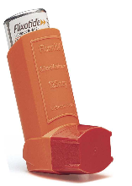
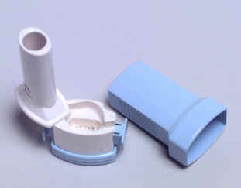
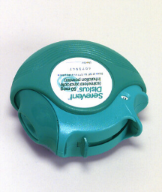
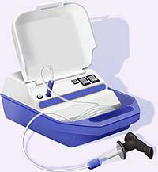
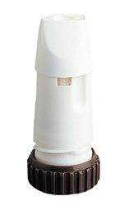
Inhalation Therapy
MDI (metered dose inhalers) pressure metered-dose inhalers
DPI (dry powder inhalers) dry-powder inhalers
turbuhaler
aerolizer
diskus
Nebulizers

Slide 37
ICS–LABA — inhaled corticosteroid combined with a long-acting β₂-agonist
Example preparations: beclomethasone–formoterol, budesonide–formoterol Administration: pMDI or DPI.
Indications: When a low dose of inhaled corticosteroid (ICS) does not provide good control: adding a LABA to maintenance therapy improves symptoms, lung function, and reduces exacerbations faster than simply doubling the ICS dose.
Two main regimens in adults and adolescents:
MART: low-dose beclomethasone or budesonide with formoterol used as both maintenance and reliever therapy in one — preferred because it reduces exacerbations and simplifies treatment.
Alternatively: maintenance therapy with ICS–LABA, and SABA or ICS–SABA used as needed.

Slide 38
ICS–LABA — inhaled corticosteroid combined with a long-acting β₂-agonist
Adverse effects / safety:
LABA: possible tachycardia, headache
LABA is safe when used together with ICS, but should not be used as monotherapy in asthma (risk of severe complications).
Interactions with other CYP3A4-metabolized drugs (ketoconazole, ritonavir, itraconazole, erythromycin, clarithromycin) may increase ICS adverse effects (e.g., adrenal suppression).

Slide 39
SABA – short-acting inhaled β₂-agonists
Examples: salbutamol (albuterol), terbutaline Routes of administration: pMDI, DPI; rarely nebulized solution or injection
Indications (how to use):
Rapid relief of symptoms and bronchospasm; exercise prophylaxis
Use only as needed, in the lowest effective dose
SABA monotherapy is not recommended → ↑ risk of severe exacerbations and death compared with any ICS use
Most commonly used in exacerbations requiring urgent care / ER visits

Slide 40
SABA – short-acting inhaled β₂-agonists
Adverse effects / warnings:
Tremor, tachycardia at the beginning of therapy
Tolerance develops quickly with regular use (1–2 weeks) → ↑ airway hyper-responsiveness, ↓ bronchodilator effect, ↑ airway inflammation
Excessive use or weak response = a sign of poor asthma control and higher exacerbation risk
Dispensing ≥3 canisters/year (200 doses each) → ↑ risk of exacerbations
Dispensing ≥12 canisters/year → markedly ↑ risk of asthma-related death

Slide 41
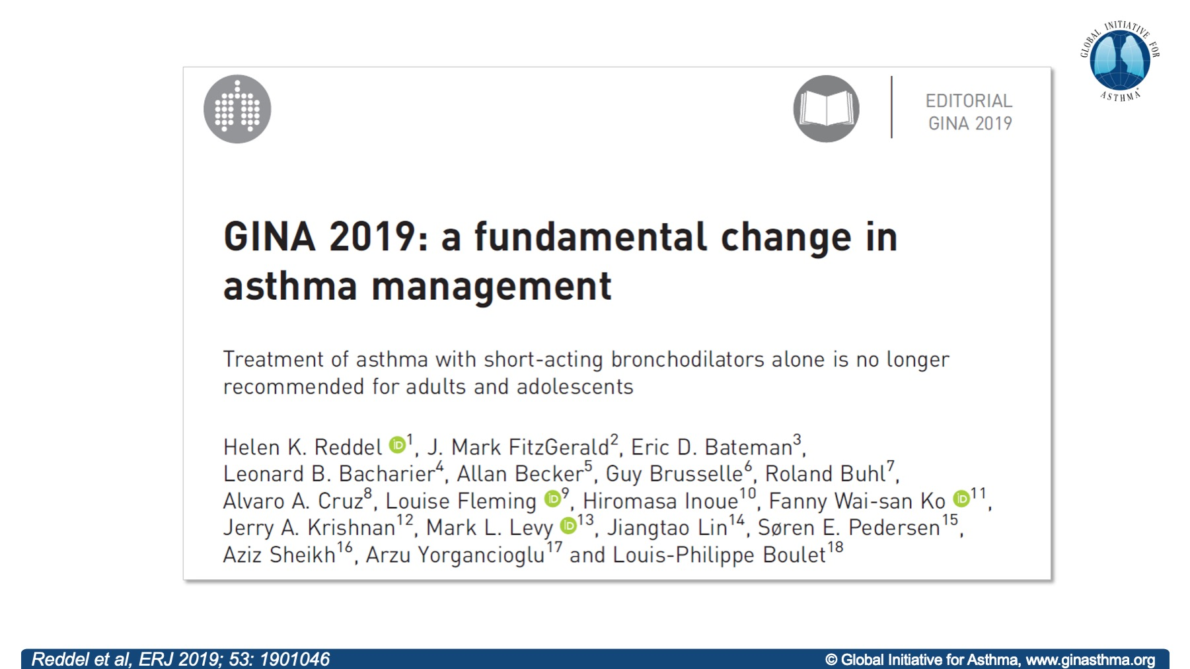
Already since 2019…
GINA does not recommend SABA alone for Step 1 asthma treatment.
Frequent or regular SABA use = increased risk of severe exacerbations (> 3 SABA inhalers/year)and asthma-related death (> 12 SABA inhalers/year).

Slide 42
AIR – “a new category” of reliever medication
What is it?
A reliever inhaler containing a low-dose ICS + a fast-acting bronchodilator.
Example combinations: budesonide–formoterol, beclometasone–formoterol.
How to use it?
As needed for symptoms.
Also preventively before exercise or allergen exposure.
Evidence of anti-inflammatory effect:
As-needed ICS–formoterol lowers FeNO in studies, confirming an anti-inflammatory effect.

Slide 43
Leukotriene receptor antagonists (LTRA)
Drugs: montelukast, pranlukast, zafirlukast, zileuton Form: tablets
Indications / role in therapy:
Act on a single element of the inflammatory pathway in asthma.
Sometimes used as an optional maintenance treatment (mainly in children).
Monotherapy: less effective than low-dose ICS.
Add-on to ICS: less effective than ICS–LABA.

Slide 44
Allergen Immunotherapy
When to consider it?
Adults and children with asthma and clinically significant sensitization to inhalant allergens. Allergic rhinitis often coexists.
What does it involve?
Identification of clinically relevant allergens
Administration of standardized extracts in precisely calculated doses → desensitization/tolerance
The only method that modifies the immune response with long-term effectiveness against allergic reactions

Slide 45
Allergen Immunotherapy
Evidence / Limitations
Few comparative studies with pharmacotherapy; endpoints often non-standardized (e.g., exacerbations)
Most data come from patients with mild asthma
Most frequently studied allergens: house dust mites and grass pollens
Insufficient evidence for patients sensitized to molds
Routes of administration
SCIT – subcutaneous immunotherapy
SLIT – sublingual immunotherapy

Slide 46
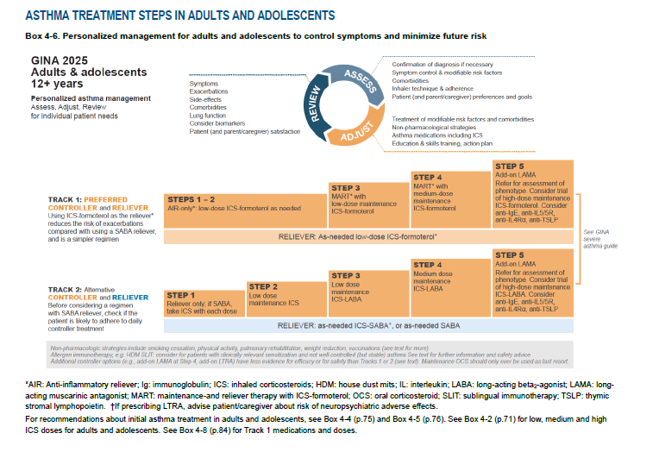

Slide 47
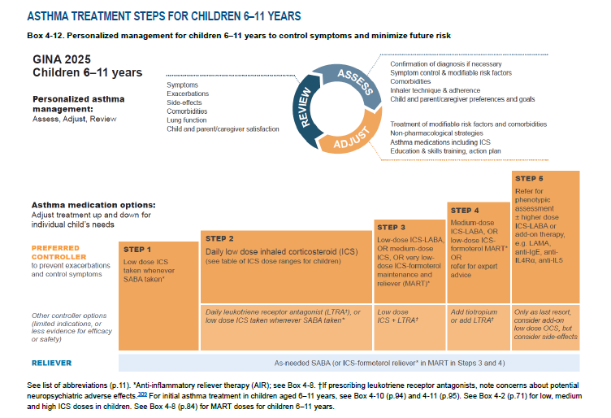

Slide 48
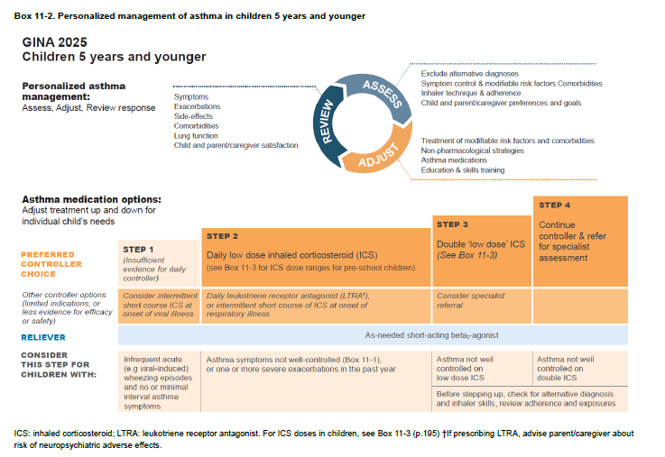

Slide 49
Exacerbations of asthma in children
Katedra i Klinika Pediatrii, Alergologii i Gastroenterologii CM w Bydgoszczy UMK

Slide 50
Risk factors for asthma exacerbations
Uncontrolled asthma symptoms → a major risk factor for exacerbations.
Factors that increase risk (even with few symptoms):
Excessive SABA use: ≥3 canisters of 200 doses/year (especially risky ≥1 canister/month).
Inadequate ICS: no ICS prescribed, poor adherence, incorrect inhaler technique.
Comorbidities: obesity, chronic rhinosinusitis (CRS), GERD, confirmed food allergy, pregnancy.
Exposures: smoking (including e-cigarettes), allergen exposure in sensitized individuals, air pollution.
Psychosocial factors: significant psychological or socioeconomic problems.
Lung function: low FEV₁ (especially <80% predicted), high bronchodilator reversibility.
Type 2 inflammation markers: elevated blood eosinophils, high FeNO.
History of severe exacerbations: ever intubated/ICU due to asthma; ≥1 severe exacerbation in the past year.

Slide 51
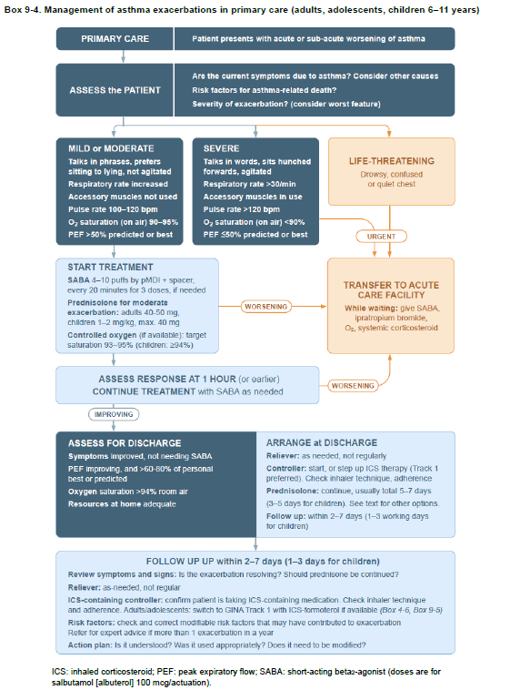

Slide 52
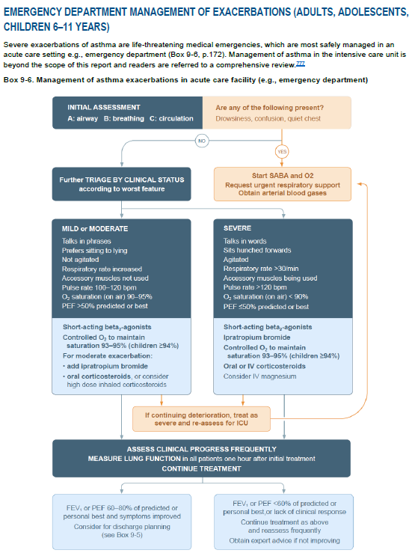

Slide 53
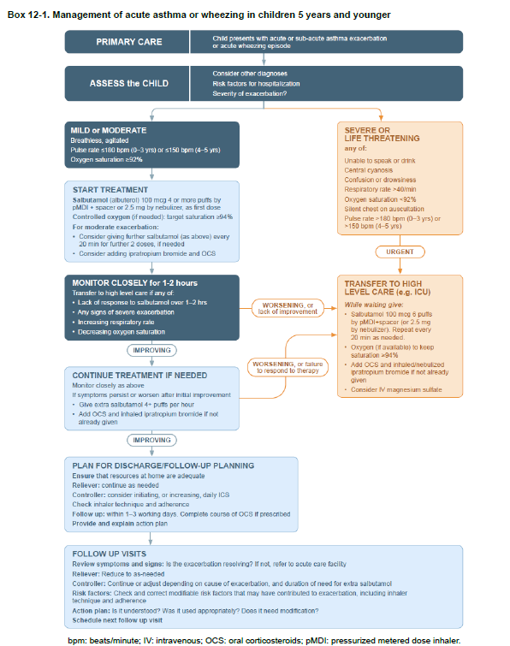

Slide 54
Systemic steroids in severe asthma exacerbation
When to consider oral corticosteroids:
PEF or FEV₁ <80% of personal best/predicted, or no response to current treatment for 2–3 days.
After the first dose, prefer morning administration (less insomnia).
Inform about possible adverse effects.

Slide 55
Systemic corticosteroids in severe asthma exacerbation
Dosing of systemic corticosteroids:
Adults/adolescents: prednisolone 40–50 mg/day for 5–7 days.
Children: 0.5 mg/kg/day (maximum 40 mg/day) for 3–5 days.
No tapering required if treatment lasts <2 weeks.
After every exacerbation – assess triggers and risk factors.

Slide 56
Criteria for severity of asthma exacerbations in children under 5 years of age
Symptom / parameter | Mild | Severe
Consciousness | Normal | Agitation / confusion / drowsiness
Oxygen saturation (SaO₂) at presentation | > 94% | < 92%
Speech | Speaks in sentences | Speaks in single words
Heart rate | < 100/min | > 180/min (0–3 years); > 150/min (4–5 years)
Respiratory rate | ≤ 40/min | > 40/min
Use of accessory muscles (intercostal/suprasternal retractions, nasal flaring) | Absent | Present
Central cyanosis | Absent | Likely/present
Wheeze intensity | Variable | “Silent chest” possible (alarming sign)

Slide 57
Indications for Immediate Referral of a Child with an Asthma Exacerbation to Hospital
severe asthma exacerbation
no improvement after initial treatment of a moderate asthma exacerbation
tachycardia with cyanosis
inability to tolerate oral fluids and medications (steroids)
lack of cooperation from the child’s caregivers
social concerns
serious comorbid conditions

Slide 58
Prevention of asthma in children
Children should not be exposed to tobacco smoke during pregnancy or after birth.
Identifying and correcting vitamin D deficiency in pregnant women with asthma (or those planning pregnancy) may reduce the risk of early-childhood wheezing episodes.
Vaginal delivery is recommended when possible.
Broad-spectrum antibiotics should be avoided during the first year of life whenever possible.
Breastfeeding is recommended — not specifically to prevent allergy or asthma, but because of other health benefits.

Slide 59
Caring for a chronically ill student at school
Goal: ensuring the student receives appropriate care, nutrition, and developmental-level-appropriate support.
1) Information provided by the parent to the school principal
Health information about the student that the parent considers important.
Information about the diet being followed.
Data regarding psychophysical development (needs, limitations, recommendations).
2) Administration of medication during school hours
Based on written authorization issued by the parent.

