Slide 1

Allergic Rhinitis
Department and Clinic of Pediatrics, Allergology and Gastroenterology, Collegium Medicum in Bydgoszcz, Nicolaus Copernicus University

Slide 2
Allergic Rhinitis – Definition
A clinical syndrome caused by an IgE-mediated inflammatory reaction of the nasal mucosa to an allergen, which clinically manifests as:
watery nasal discharge,
nasal obstruction (blockage),
nasal itching,
sneezing.
Symptoms should persist for more than one hour per day on most days, depending on the nature and duration of allergen exposure.

Slide 3
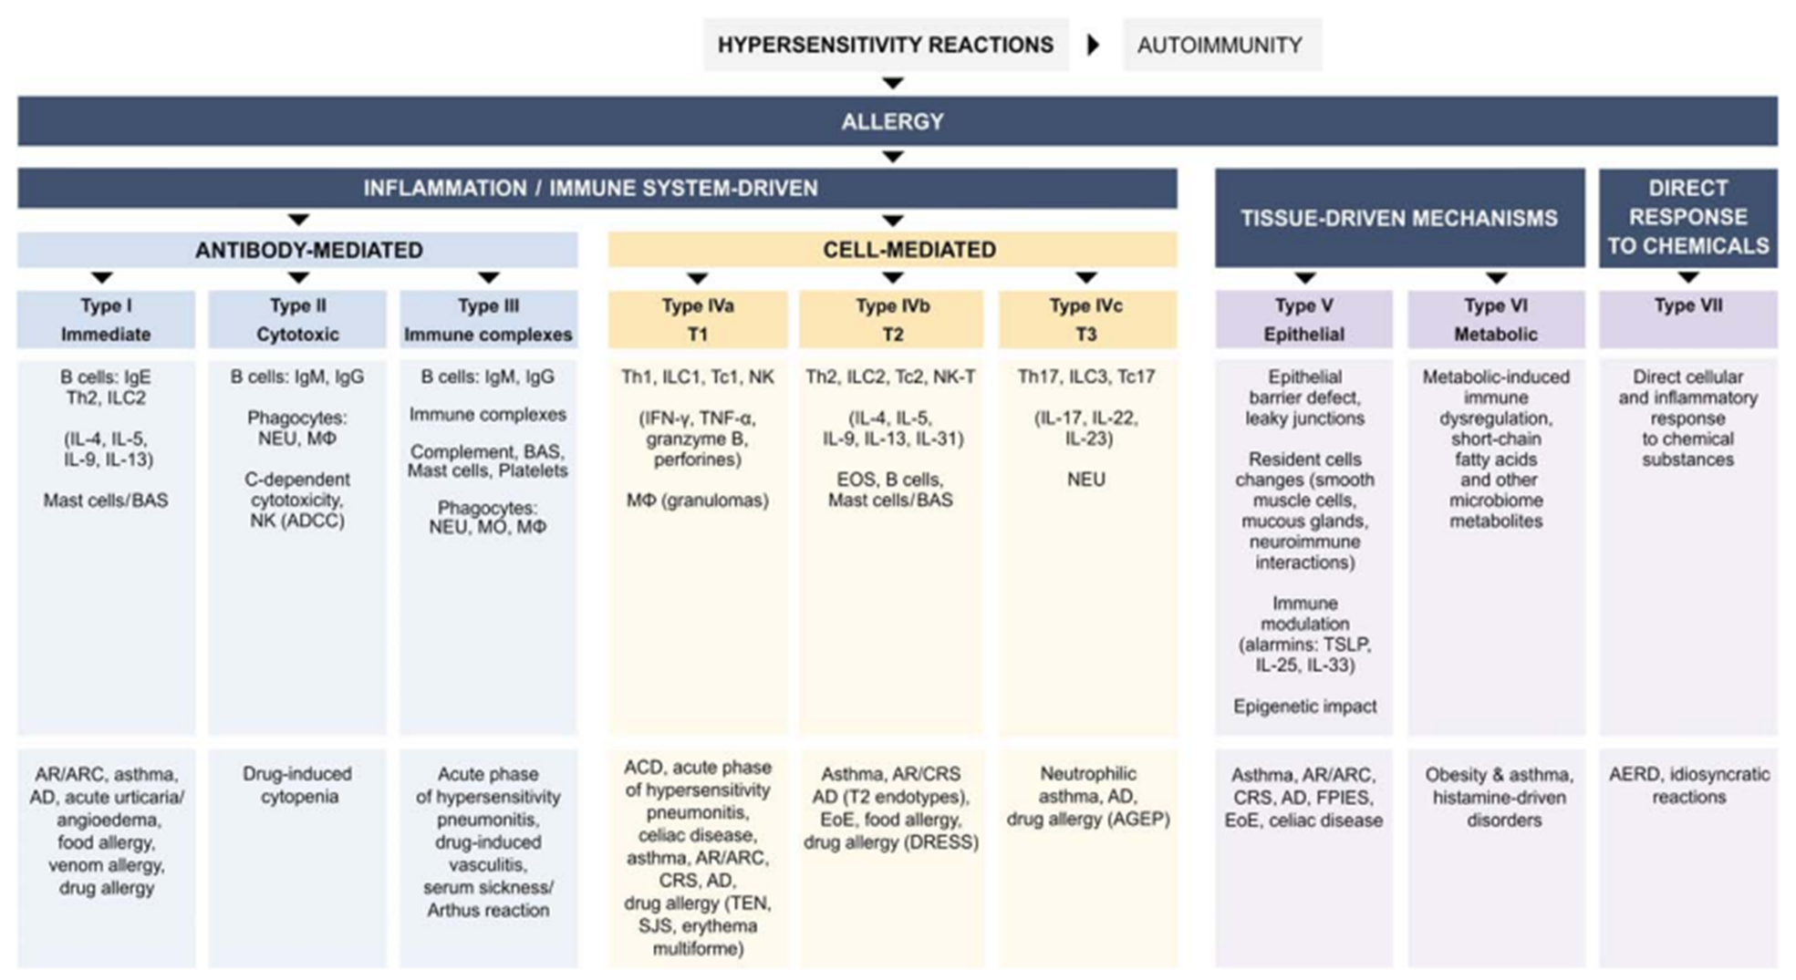
Modern Classification of Allergic (Hypersensitivity) Reactions

Slide 4
Allergic Rhinitis – Epidemiology
The most common allergic disease in the world!
Global scale:
Affects 10–30% of the world’s population, which equals approximately 500–600 million people!
In Europe: around 25% of the population.
The prevalence has increased by about 50% every decade since the 1960s.
Initially observed mainly in developed countries, but now rising also in developing regions (e.g. the Middle East: 9–38% of the population).
Age of onset:
75% of patients develop symptoms before the age of 20,
40% — before the age of 6.
It is therefore a disease that begins early and stays with us for a long time.

Slide 5
Allergic Rhinitis – Epidemiology Epidemiology of Allergic Diseases in Poland
All types of rhinitis:
Children aged 6–7 years: 37.8%
Children aged 13–14 years: 43.5%
Adults aged 20–44 years: 36%
Allergic rhinitis:
Children aged 6–7 years: 23.6%
Children aged 13–14 years: 24.6%
Adults aged 20–44 years: 21.0%
TOTAL ALLERGY PREVALENCE – approximately 40% of the Polish population!
Samoliński B, i inni, Alergiczny nieżyt nosa w świetle badania ECAP. Alergia 2009; 2(40): 41-44

Slide 6
Allergic Rhinitis – Epidemiology
Urban residents are affected more often than those living in rural areas ➜ 30% vs 16%
Men are affected slightly more often than women ➜ 24% vs 21.2%
Samoliński B, i inni, Alergiczny nieżyt nosa w świetle badania ECAP. Alergia 2009; 2(40): 41-44

Slide 7

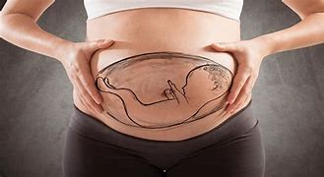
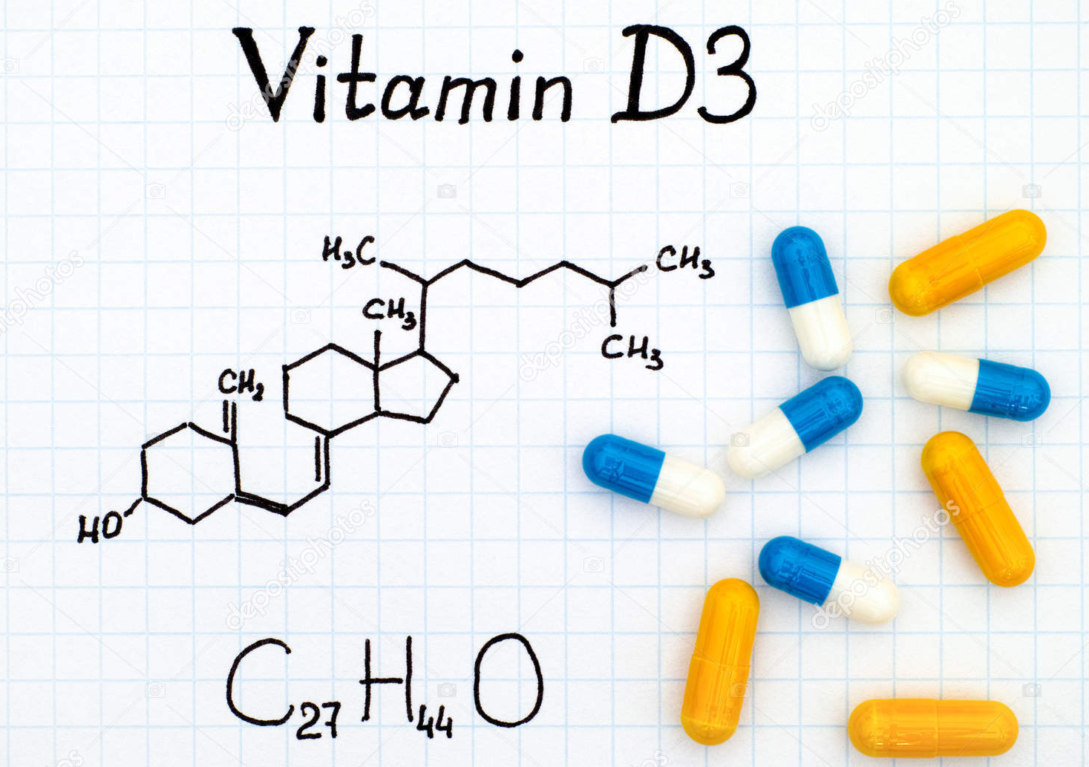

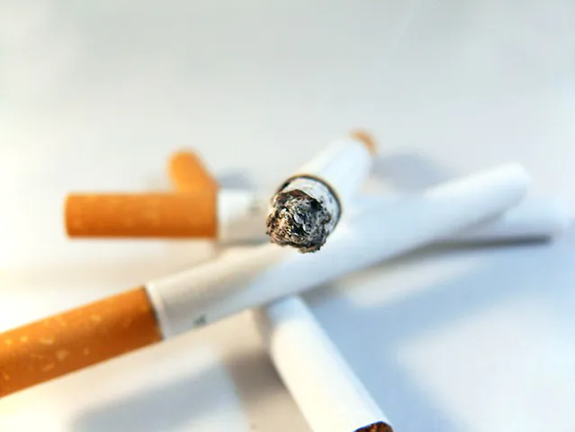


Allergic Rhinitis – Risk Factors
ANN

Slide 8
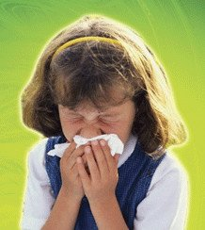

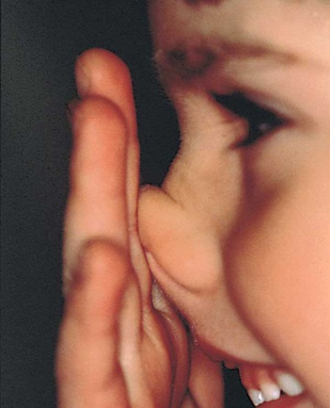
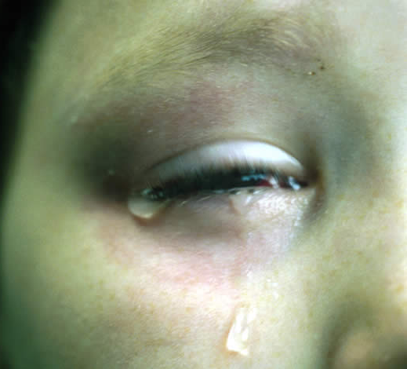
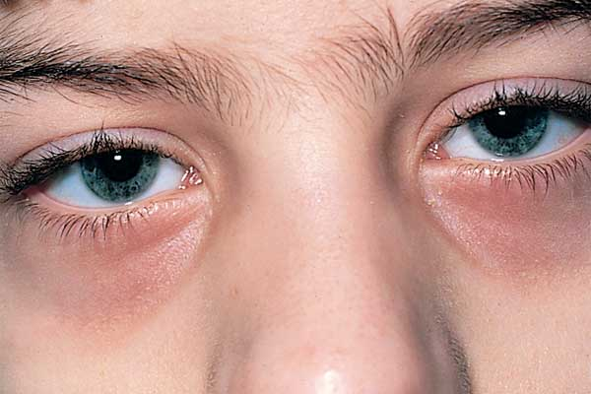
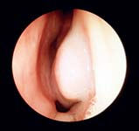
Allergic Rhinitis – Symptoms
Watery rhinorrhea
Nasal congestion / obstruction
Nasal itching
Itchy, watery, red eyes
Sneezing

Slide 9

Symptoms of Nasal Obstruction in Infant
The symptoms are somewhat different from those seen in older children and include:
Nasal snuffling (infant nasal congestion)
Nasal stridor
Rhinorrhea (nasal discharge)
Snoring
Feeding difficulties
Choking or aspiration of milk during feeding
Inspiratory dyspnea (difficulty breathing on inspiration)

Slide 10
How to Diagnose Allergic Rhinitis – Medical History
Typical symptoms:
Watery nasal discharge (rhinorrhea)
Paroxysmal sneezing
Nasal obstruction / congestion
Nasal itching
Associated ocular symptoms: tearing, redness, itching of the eyes
The presence of several of these symptoms simultaneously is highly suggestive of allergic rhinitis.
Less typical (but important) symptoms:
Reduced sense of smell (hyposmia)
Itching of the throat or palate
Snoring, sleep disturbances, daytime fatigue
In children: poor concentration, irritability, reluctance to participate in activities

Slide 11
How to Diagnose Allergic Rhinitis – Medical History
Seasonality of symptoms
When do the symptoms appear or worsen? (specific months, days of the week, time of day)
Relation to pollen seasons (grass, birch, mugwort) or activities such as lawn mowing, going to meadows or sports fields
Improvement during rainy days, worsening in windy weather
Were there symptom-free periods, e.g. during holidays, stays by the sea, or in the mountains?
Home / Nursery / School Environment
Where are the symptoms most severe? – Bedroom, nursery room, classroom, common room, gym?
Possible dust mite exposure: carpets, curtains, stuffed toys, old mattresses, humidifiers, visible mold.
Recent renovations, new smells (paint, varnish), ventilation or air conditioning, humidity problems.
Do symptoms change after weekends, or after sleeping at grandparents’ house?

Slide 12
How to Diagnose Allergic Rhinitis – Medical History
Animals
What animals are present at home or in school? (cat, dog, rodent, rabbit, birds)
Since when has the animal been in the household, and did symptoms begin after its arrival?
Any indirect contact (e.g. via parents’ clothes, visits to friends or relatives with pets)?
Do symptoms improve when away from home or during longer trips without the animal?
Smoke and Other Irritants
Exposure to tobacco smoke (at home, on the balcony, in the car), e-cigarettes, incense, or scented candles
Fireplace smoke, dust, aerosols (deodorants, air fresheners), cleaning sprays
Do symptoms worsen after cleaning, vacuuming, or using air fresheners?

Slide 13
How to Diagnose Allergic Rhinitis – Medical History
Allergic Rhinitis – Additional Questions
Effect on sleep and learning: snoring, mouth breathing, morning headaches.
Conjunctival symptoms: itching, tearing, redness.
Lower airway symptoms: cough, wheezing, exercise intolerance.
Family history of atopy: allergic rhinitis, asthma, atopic dermatitis.
Remember
(+) Seasonality or specific exposure → think of an airborne allergen.
Symptoms dominant in the bedroom → assess for dust mites or mold exposure.
Symptoms triggered by animal contact → consider elimination trial or IgE testing.
Exposure to smoke or irritants → provide education and recommend avoidance.

Slide 14
How to Diagnose Allergic Rhinitis – Physical Examination
Assessment of Nasal Patency
Characteristic appearance of a child with chronic allergic rhinitis:
Mouth constantly open – due to difficulty breathing through the nose
Malocclusion / “adenoidal face” – the result of chronic mouth breathing
Tired, apathetic facial expression – reflecting sleep disturbance and chronic nasal obstruction
Clinical note: Chronic nasal obstruction in children can lead to abnormal facial growth, speech development problems, and reduced concentration due to sleep fragmentation and hypoxia.

Slide 15
How to Diagnose Allergic Rhinitis – Physical Examination
Ocular findings:
Dark circles under the eyes (“allergic shiners”) – caused by venous congestion in the periorbital area
Redness and tearing of the eyes – signs of associated allergic conjunctivitis
Nasal findings:
Swollen nasal mucosa, leading to impaired nasal patency
Transverse nasal crease (“allergic crease”) – characteristic in children with intense nasal itching and the habit of rubbing the nose upward
Clinical note: These signs, although subtle, are highly suggestive of chronic allergic rhinitis and often precede visible inflammation during active disease.

Slide 16
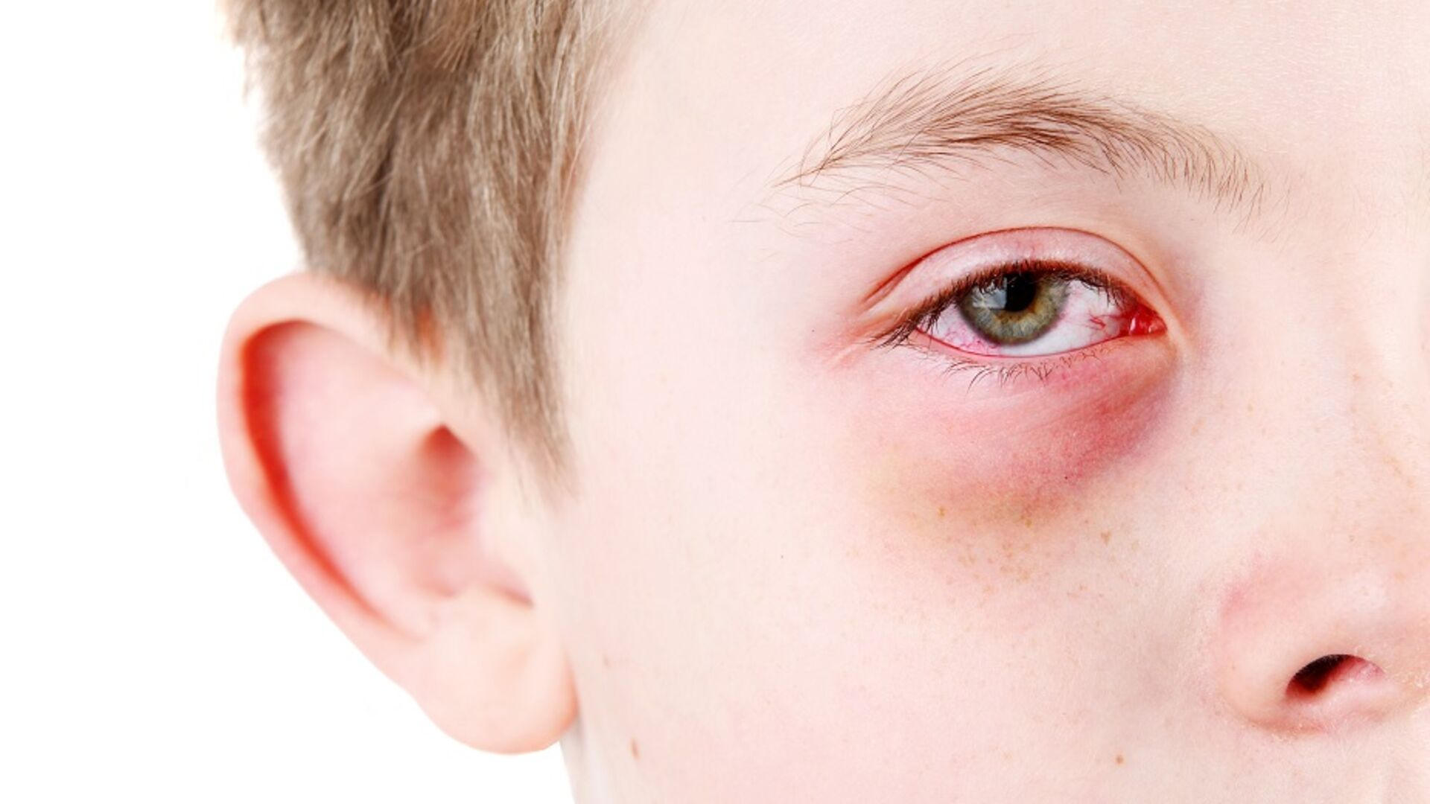
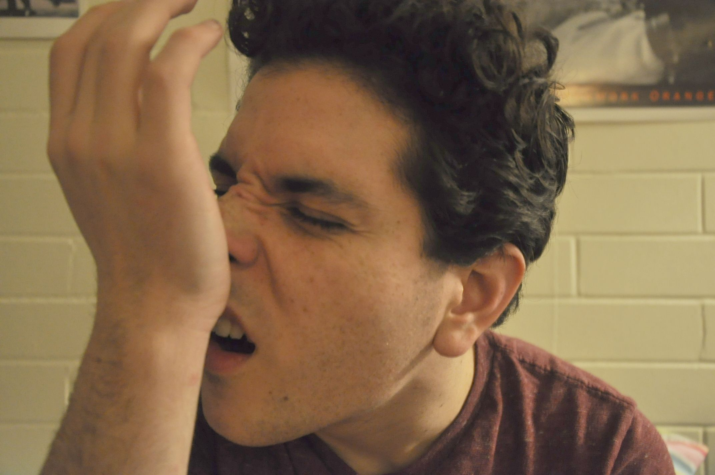
Nonspecific Symptoms of Upper Airway Allergy
Allergic shiners
These are dark circles under the eyes, often bluish or purplish in color.
They are believed to result from venous congestion caused by impaired venous drainage secondary to nasal mucosal edema in allergic rhinitis.
Most often seen in children with chronic nasal obstruction.
Allergic salute
Also known as the “nasal salute”, this is a typical gesture observed mainly in children with allergic rhinitis.
It consists of frequently rubbing or pushing the tip of the nose upward with the palm or fingers, in an attempt to improve nasal airflow and relieve itching.
Repeated motion can lead to the formation of a transverse nasal crease across the bridge of the nose — a characteristic physical finding.

Slide 17
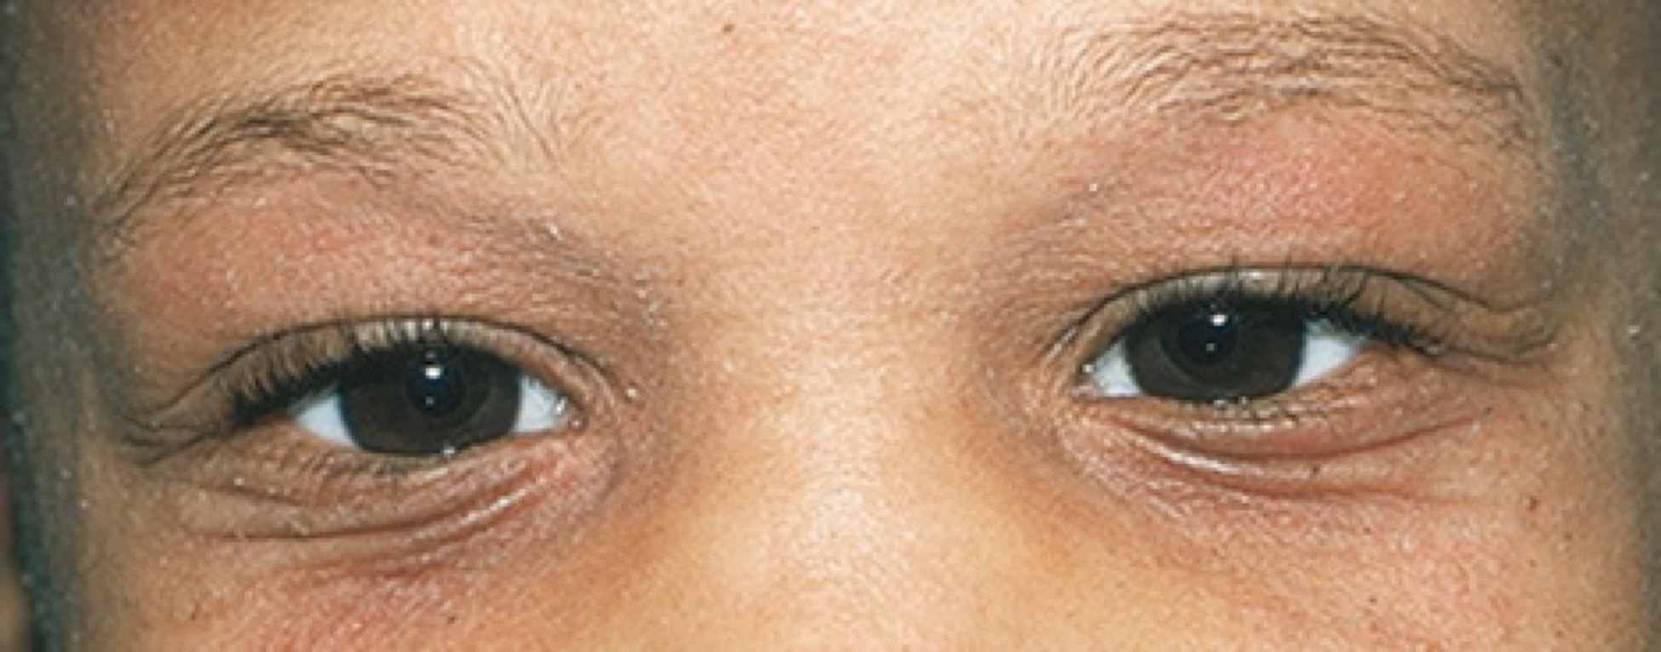
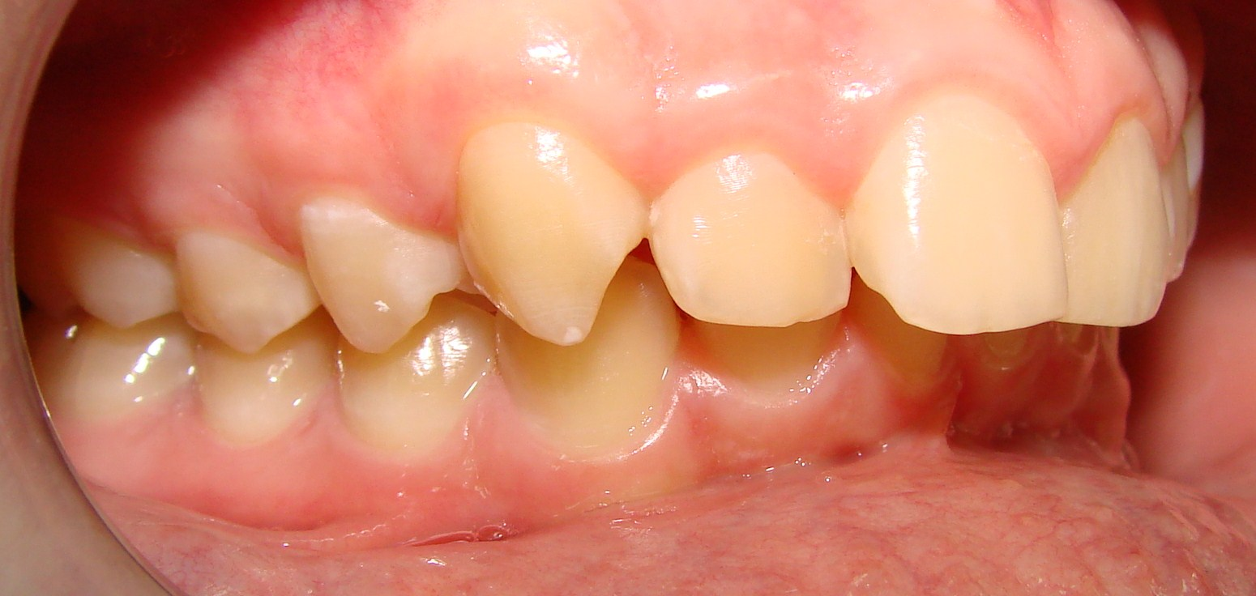
Nonspecific Symptoms of Upper Airway Allergy
Dennie–Morgan folds
These are infraorbital skin folds or creases that appear beneath the lower eyelids.
They are commonly seen in patients with atopic dermatitis, often from early childhood.
The folds are thought to result from chronic periorbital edema and frequent rubbing of the eyes due to itching.
Malocclusion / Upper protrusion of the maxilla (overbite)
Chronic nasal obstruction and mouth breathing may lead to abnormal craniofacial development, resulting in:
High-arched palate
Narrow upper jaw
Protrusion of upper incisors (“open bite” or “overbite”)
These features are part of the so-called “allergic facies”, typical of children with long-standing upper airway obstruction.

Slide 18

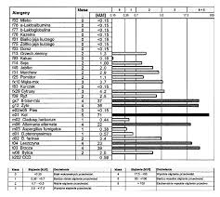
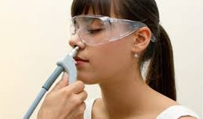
Additional Diagnostic Tests in Allergic Rhinitis
A clear correlation between the clinical history and sensitization to specific inhalant allergens must be established to confirm the diagnosis of allergic rhinitis.

Slide 19
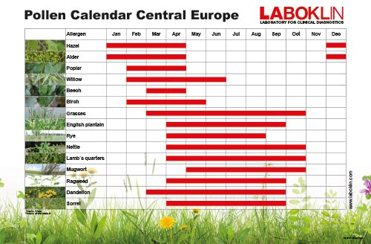
Pollen Calendar (Poland / Central Europe)

Slide 20
LANN – Local Allergic Rhinitis (LAR)
Definition:
Local allergic rhinitis (LAR) is a form of rhinitis in which patients present with typical symptoms of allergic rhinitis, but without systemic atopy — i.e. negative skin prick tests (SPT) and undetectable serum specific IgE.
Despite this, there is local production of specific IgE antibodies and nasal mucosal inflammation similar to that seen in classic allergic rhinitis.
Pathophysiology:
Localized Th2-type immune response within the nasal mucosa
Local synthesis of specific IgE antibodies (detectable in nasal secretions)
Activation of mast cells and eosinophils → release of histamine, leukotrienes, cytokines
No systemic sensitization demonstrable in blood or skin testing

Slide 21
LANN – Local Allergic Rhinitis (LAR)
Diagnosis:
Nasal allergen provocation test (NAPT) – gold standard
Detection of specific IgE in nasal secretions (by ImmunoCAP or ELISA)
Exclusion of systemic atopy (negative SPT and serum sIgE)
Clinical features:
Symptoms identical to classic allergic rhinitis (sneezing, itching, nasal obstruction, watery rhinorrhea)
Often perennial, sometimes with seasonal exacerbations
Common in young adults and women
Frequently underdiagnosed, misclassified as nonallergic rhinitis

Slide 22
Differential Diagnosis: Allergic vs. Infectious Rhinitis
Feature | Allergic Rhinitis | Infectious Rhinitis
Etiology | IgE-mediated allergic reaction to airborne allergens | Viral (mainly rhinoviruses, coronaviruses); occasionally bacterial
Onset | Sudden, often after allergen exposure | Gradual, after contact with infected persons
Duration | Chronic or recurrent; symptoms persist during allergen exposure | Usually self-limiting (7–10 days)
Nasal discharge | Watery, clear | Thick, purulent (yellow/green)
Sneezing | Frequent, paroxysmal | Occasionally, mild
Nasal itching | Common, often intense | Absent
Nasal obstruction | Variable, may alternate sides | Common, progressive
Conjunctival symptoms | Common (itching, tearing, redness) | Absent
Systemic symptoms (fever, malaise) | Absent | Often present (especially in viral infection)
Mucosal appearance | Pale, bluish, edematous | Red, hyperemic
Response to antihistamines | Good improvement | Minimal or no effect
Family/personal history of atopy | Frequently positive | Negative

Slide 23
Differential Diagnosis of Allergic Rhinitis (AR)
Infection of the nasal mucosa (infectious rhinitis / rhinosinusitis)
Foreign body in the nasal cavity (especially unilateral symptoms in children)
Anatomical abnormalities of the nose (e.g. deviated nasal septum, nasal polyps)
Cystic fibrosis (chronic sinusitis, nasal polyps, thick mucus)
Primary ciliary dyskinesia (PCD) (impaired mucociliary clearance, chronic rhinitis, sinusitis, otitis media)
Adenoid hypertrophy (common cause of chronic nasal obstruction in children)

Slide 24
Allergic Rhinitis and Quality of Life
Although nasal symptoms predominate, allergic rhinitis should be considered a systemic inflammatory disorder. It significantly reduces learning and work performance and impairs quality of life.
Societal Burden
United States: ≈ 2 million school days and 4 million work days lost each year due to allergic rhinitis.
United Kingdom: Among students aged 15–16 years, allergic rhinitis is associated with reduced school attendance and poorer examination performance during pollen season.

Slide 25
Nasal Obstruction – the Symptom Patients Fear Most

Slide 26
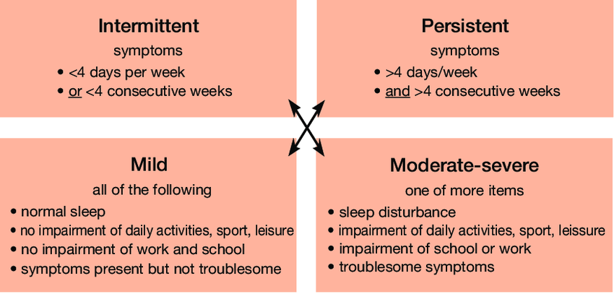
Classification of Allergic Rhinitis According to Duration and Symptom Severity (ARIA Guidelines)

Slide 27
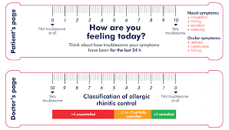
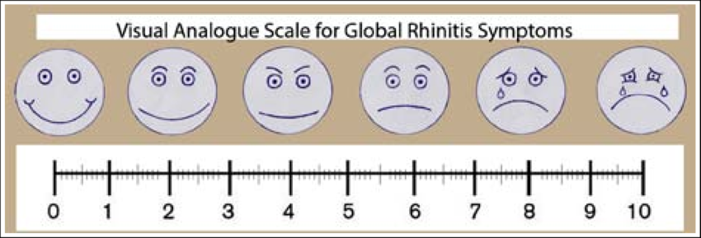
Assessment of Symptom Severity in Allergic Rhinitis

Slide 28
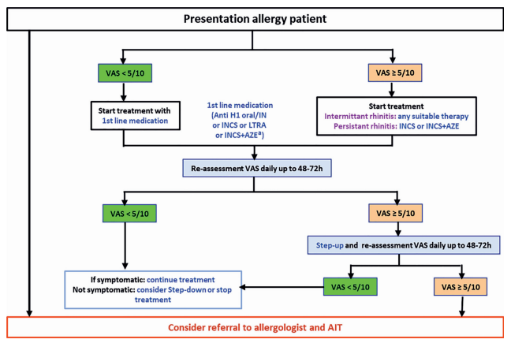
Samoliński i wsp. ARIA 2019 – zintegrowana opieka w alergicznym nieżycie nosa – Polska Polish Journal of Allergology 2019; 6, 4: 111–126

Slide 29
Treatment of Allergic Rhinitis (AR)
Always: Education + Exposure Reduction
Nasal hygiene: regular isotonic saline irrigations; teach proper intranasal spray technique.
Allergen/irritant reduction:
Dust mites: encase mattresses/pillows, wash bedding ≥60 °C, declutter, limit carpets/heavy curtains, maintain low humidity.
Pets: minimize exposure; consider restricting bedroom access or temporary removal during exacerbations.
Smoke: strict no-smoking policy (home, balcony, car).
Aerosols/irritants: avoid sprays (deodorants, air fresheners), strong fragrances, cleaning aerosols.
Seasonal plan: follow the pollen monitor/calendar; adjust outdoor activity on high-pollen days (prefer mornings after rain, use sunglasses/hat, shower after outdoor exposure).
School/nursery coordination: modify outdoor activities and ventilation plans on high-pollen days; ensure access to rescue meds and an individual management plan.

Slide 30
Treatment of Allergic Rhinitis (AR)
Intranasal or Oral H1 Antihistamines (2nd Generation, Non-sedating)
Recommended for mild symptoms or as-needed (on-demand) treatment.
Provide effective relief of sneezing, itching, and rhinorrhea; less effect on nasal obstruction.
Can be used alone in mild cases or in combination with intranasal corticosteroids in moderate/severe disease.
Avoid first-generation antihistamines
Cause sedation, impaired learning and attention, and psychomotor slowing — particularly problematic in children and students.
Examples: cetirizine, levocetirizine, loratadine, fexofenadine, bilastine.

Slide 31
Treatment of Allergic Rhinitis (AR)
Intranasal Corticosteroids (INCS) – Cornerstone of Therapy in Moderate/Severe AR
Mainstay treatment for moderate to severe allergic rhinitis.
Should be used regularly, at least for several weeks during the pollen season or longer in perennial AR.
Mechanism: potent anti-inflammatory effect — reduces nasal obstruction, itching, rhinorrhea, and sneezing.
Key principles:
Proper technique: direct the spray away from the nasal septum to minimize irritation and bleeding.
Adherence: daily use is essential for optimal control — not just “as needed.”
Evaluation: assess response after 2–4 weeks; if effective, continue through the exposure period.
May be combined with an intranasal antihistamine in patients with severe or persistent symptoms.

Slide 32
Treatment of Allergic Rhinitis (AR)
Add-on Therapy: Leukotriene Receptor Antagonists (Selected Phenotypes)
Consider as adjunctive treatment in specific patient profiles:
Allergic rhinitis with asthma or exercise-induced symptoms
Allergic rhinitis with nocturnal cough
Nasal polyposis or chronic rhinosinusitis (CRS)
Example: Montelukast (once daily, oral administration)
Clinical considerations:
Evaluate benefit–risk ratio individually.
Monitor for response (symptom improvement, sleep quality, cough reduction).
Inform patients and caregivers about possible neuropsychiatric adverse effects (rare, but important to recognize early).

Slide 33
Treatment of Allergic Rhinitis (AR)
Combination Nasal Sprays (INCS + Intranasal Antihistamine)
(for older children and adolescents)
Provide faster onset of action and greater convenience — one device combining both mechanisms.
Useful in patients with moderate to severe symptoms not adequately controlled with monotherapy.
Continue to monitor correct administration technique and treatment adherence.
Always use according to age-specific registration and dosing recommendations.
Examples:
Fluticasone propionate + Azelastine hydrochloride
Mometasone furoate + Olopatadine hydrochloride

Slide 34
Treatment children < 3 years
Allergic Rhinitis in Children <3 Years – EUFOREA Recommendations
What to use first?
Oral antihistamine (H1-blocker) with proven anti-inflammatory properties, or
Oral antihistamine + leukotriene receptor antagonist (LTRA) combination.
Why?
Provides symptom reduction and helps control underlying mucosal inflammation.
Demonstrates synergistic effects when combining H1-antihistamine with LTRA.
Aims to minimize early progression of allergic inflammation and prevent chronicity.

Slide 35
Allergen-Specific Immunotherapy (AIT) in Allergic Rhinitis
Definition: Administration of allergen extracts in gradually increasing doses with the goal of reducing symptoms upon natural exposure to the allergen.
Significance: It is the only causal (disease-modifying) treatment for allergic diseases — targeting the underlying immune mechanism rather than just symptoms.
How Does It Work?
Modulates the immune response — shifts balance from Th2 (allergic) to Th1/Treg (tolerant) profile
Affects both early and late phases of the allergic reaction
Restores immune tolerance to specific allergens through induction of regulatory pathways and blocking antibodies (IgG4)

Slide 36
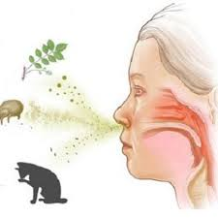
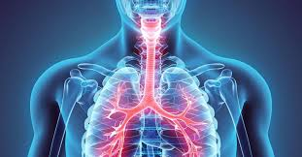
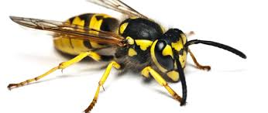
Indications for Allergen-Specific Immunotherapy (AIT)
Intermittent or persistent allergic rhinitis of moderate to severe intensity*
Atopic (allergic) asthma, well controlled, of mild to moderate severity, with FEV₁ >80% of predicted
Allergy to Hymenoptera venom (bees, wasps) with a history of systemic reactions
*According to ARIA classification (Allergic Rhinitis and its Impact on Asthma)
* Initiation of AIT may also be considered in patients with milder forms of allergic rhinitis, if the patient wishes to benefit from the long-term disease-modifying effects of immunotherapy — including the potential prevention of asthma development.

Slide 37
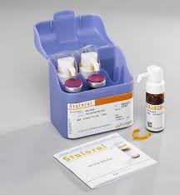
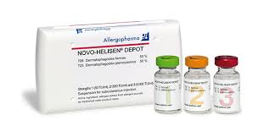
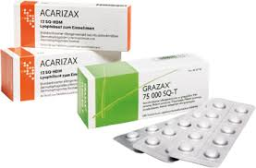
Types of Allergen-Specific Immunotherapy (AIT)
Subcutaneous (SCIT) / Sublingual (SLIT) Immunotherapy
Duration of treatment: typically 3–5 years
Both methods have proven long-term efficacy and can induce lasting immune tolerance even after therapy discontinuation.

Slide 38
Allergic Rhinitis – A Risk Factor for Bronchial Asthma
Thesis: Allergic rhinitis (AR) is a significant risk factor for the development and exacerbations of bronchial asthma. The upper and lower airways form a continuous inflammatory unit—symptoms frequently coexist.
Why?
Shared IgE-mediated allergic cascade involving the nose–bronchial continuum.
Airway remodeling and hyperresponsiveness are amplified by chronic AR.
Endotypic concordance (e.g., type 2 inflammation) across both airway levels.

Slide 39
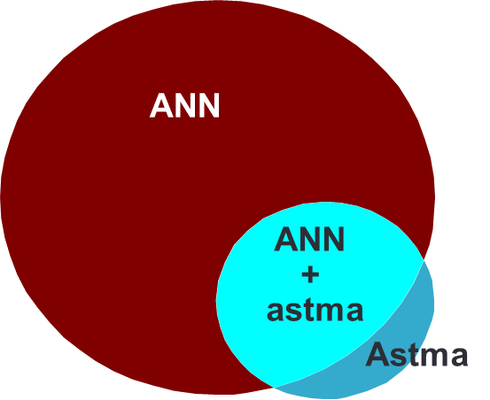
Allergic Rhinitis – A Risk Factor for Bronchial Asthma
Clinical Consequences
AR correlates with more frequent exacerbations and poorer asthma control.
Untreated AR → worse sleep quality, reduced exercise capacity, poorer adherence, and higher use of reliever medication.
Epidemiological Data (reported)
10–40% of patients with allergic rhinitis (AR) have asthma – particularly with chronic and/or moderate–severe AR.
≈80% of patients with asthma have coexisting AR.

Slide 40
Allergic Rhinitis – A Risk Factor for Bronchial Asthma
Actively screen patients with allergic rhinitis (AR) for asthma → detailed history, spirometry/FeNO, assessment of asthma control.
In patients with asthma, identify and treat coexisting AR → intranasal corticosteroids (INCS), leukotriene receptor
antagonists (LTRAs), saline irrigations, and environmental education.
Optimize anti-inflammatory treatment in both the upper and lower
airways → improves overall asthma control.
Consider allergen immunotherapy (AIT) in eligible patients → benefits both AR symptoms and asthma progression.
Provide a personalized action plan (self-management) and ensure
seasonal and exposure monitoring.

Slide 41
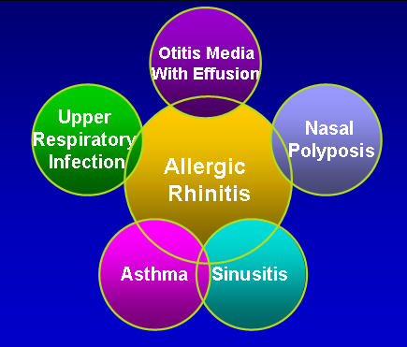
Allergic Rhinitis and Comorbidities
Spector. J Allergy Clin Immunol. 1997; s. 773 – s. 780

Slide 42

Diagnosis and Management of Urticaria in Children
Katedra i Klinika Pediatrii, Alergologii i Gastroenterologii CM w Bydgoszczy UMK

Slide 43
URTICARIA – DEFINITION
A disease characterized by the appearance of wheals (hives) and/or angioedema.
Typical features of a wheal
Sudden onset of a localized skin swelling of variable size,
Usually surrounded by a erythematous flare,
Accompanied by intense itching or sometimes a burning sensation,
Transient in nature – lesions resolve spontaneously without residual marks, typically within 1–24 hours.

Slide 44
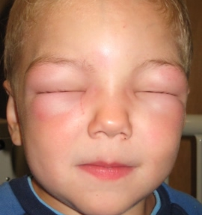
URTICARIA – DEFINITION
Angioedema – Typical Features
Sudden swelling of the dermis and subcutaneous tissue,
The skin color over the affected area may be normal or slightly erythematous,
Commonly involves the face (eyelids, lips), extremities, scrotum, and joints,
Pain is more frequent than itching,
Mucosal involvement is common (e.g., lips, tongue, larynx, gastrointestinal tract),
The swelling is more persistent than wheals — may last up to 72 hours.

Slide 45
URTICARIA – EPIDEMIOLOGY
Common condition in children and adults; affects up to 20% of the population at least once in a lifetime.
Acute urticaria accounts for the vast majority of pediatric cases.
Occurs in 3–6% of children annually.
Most frequently associated with viral infections.
Chronic urticaria (CU) is rare in childhood, with a prevalence of 0.1–0.3%.
Typically begins in school-age children or adolescents.
Slight female predominance in older age groups.
Angioedema accompanies urticaria in about 40% of patients.
In over 60% of children, urticaria resolves spontaneously within 1–2 years, especially in infection-related or idiopathic cases.

Slide 46
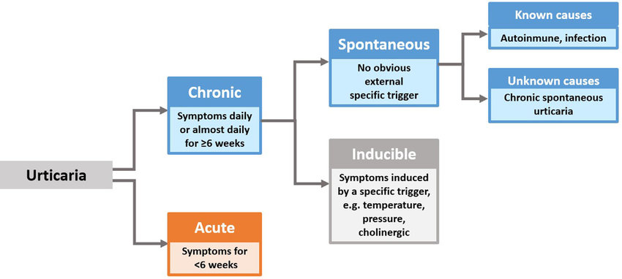
Classification of Urticaria (Based on duration and underlying etiology)

Slide 47
Chronic urticaria
Episodic or daily symptoms occurring at least twice per week,
Persisting for more than 6 weeks,
Recurrent course over months or even years,
Significantly impairs quality of life due to itching, sleep disturbance, and psychosocial impact.

Slide 48
Urticaria and Quality of Life Chronic Urticaria Quality of Life Questionnaire (CU-QoL)
Itching (pruritus)
Paroxysmal (episodic) nature of symptoms
Sleep disturbance and impaired concentration
Anxiety, fear, tension, irritability
Often no identifiable cause (idiopathic course)
Sometimes suboptimal response to treatment
Cosmetic concern / visible skin changes
High school absenteeism in children and work absenteeism in parents

Slide 49
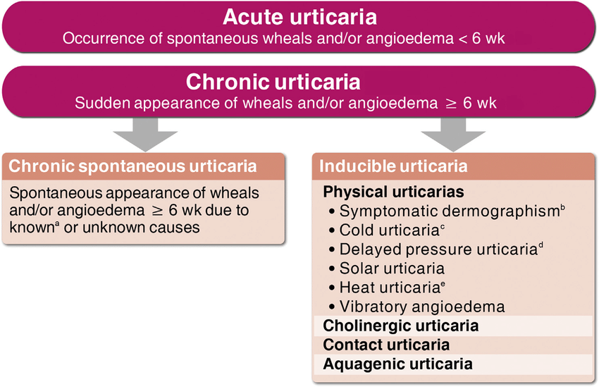
Classification of Urticaria (According to the duration of skin lesions and underlying etiology)

Slide 50
Differential Diagnosis of Urticaria
Condition | Key distinguishing features (vs. urticaria)
Erythema multiforme | Fixed target (iris) lesions with dusky center; often acral distribution; individual lesions persist >24–48 h; may follow HSV/Mycoplasma.
Serum sickness–like reaction (SSLR) | Fever, arthralgia, lymphadenopathy; urticarial-like rash fixed >24 h; history of new drug (np. cefaclor) or infection.
Toxic erythema | Confluent morbilliform or scarlatiniform erythema; systemic symptoms possible; lesions not fleeting, lack wheal/flare architecture.
Urticarial vasculitis | Pain/burning > itch; lesions >24 h, leave bruising/hyperpigmentation; may have arthralgia, low C3/C4.
Systemic lupus erythematosus (SLE) | Fixed photosensitive lesions, malar rash; systemic features (fatigue, arthralgia); positive ANA; lesions not transient.
Acute contact dermatitis | Well-demarcated to exposure site, vesicles/oozing possible; intense itch, but plaques persist days. Patch testing helpful.
Autoimmune blistering diseases | Bullae/erosions, mucosal involvement; Nikolsky sign ±; lesions do not resolve within 24 h.
Cellulitis or erysipelas | Unilateral, warm, tender, ill-defined (cellulitis) or sharply demarcated (erysipelas); fever, elevated CRP; not migratory wheals.

Slide 51
Mastocytosis
A group of neoplastic disorders characterized by excessive proliferation and accumulation of mast cells in one or multiple organs.
It belongs to the category of primary mast cell activation syndromes (MCAS).

Slide 52
Mastocytosis
Forms of Mastocytosis - In children, the disease is mainly limited to the skin.
1) Cutaneous mastocytosis (CM) – proliferation limited to the skin
Maculopapular form (syn. urticaria pigmentosa)
Diffuse cutaneous form
Solitary mastocytoma (mast cell tumor of the skin)
2) Systemic mastocytosis (SM) – involving extracutaneous tissues (most commonly the bone marrow)
a) Indolent systemic mastocytosis (ISM) and smoldering systemic mastocytosis (SSM) – slow clinical course
b) Advanced forms – SM associated with a hematologic neoplasm (SM-AHN; myeloid or, less often, lymphoid), aggressive SM, or mast cell leukemia
3) Mast cell sarcoma – extremely rare malignant variant composed of atypical mast cells with destructive growth.

Slide 53
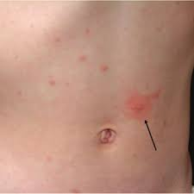
Darier’s Sign
A pathognomonic sign of cutaneous mastocytosis, observed after mechanical irritation (rubbing or stroking) of a skin lesion.
Mechanism: Mechanical stimulation triggers mast cell degranulation, leading to the local release of histamine and other mediators.
Clinical response: Within minutes, the affected area develops:
Erythema (redness)
Wheal or swelling
Intense pruritus (itching)

Slide 54
Causes and Triggering Factors of Urticaria
A specific trigger can be identified in: • 20–90% of children with acute urticaria • 5–20% of children with chronic urticaria
Allergic background is confirmed in: • Approximately 50% of patients with acute urticaria • Around 20% of those with chronic urticaria

Slide 55
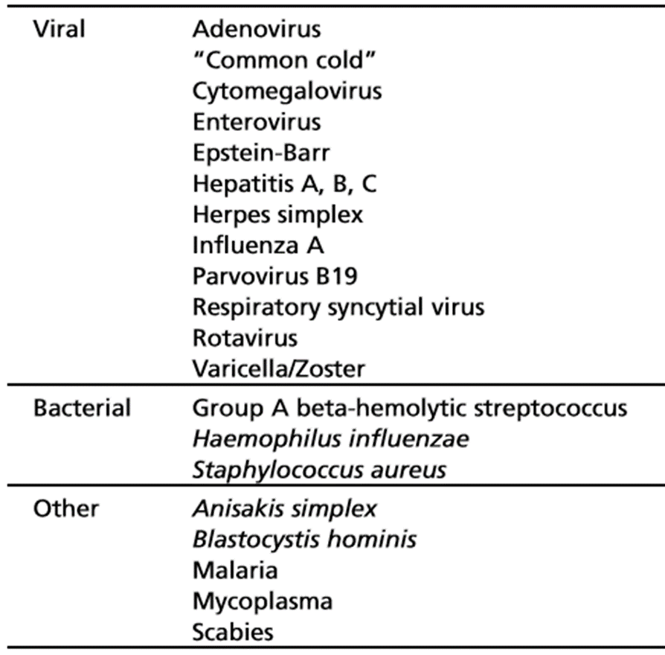
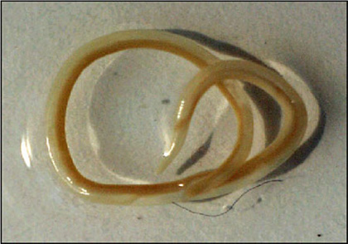
Acute Urticaria – Etiology
Infectious Factors – 48.6% of Acute Urticaria Cases
Mycoplasma pn.
H. pylori
Giardia lamblia

Slide 56
Acute Urticaria – Etiology
Other Causes of Acute Urticaria
2.7% – Food allergens and pseudoallergens (e.g. cow’s milk, eggs, peanuts, food additives, preservatives, artificial dyes)
5.4% – Drugs (mainly antibiotics and NSAIDs)
Insect bites and stings (Hymenoptera, mosquitoes, fleas)
Other causes (e.g. Systemic lupus erythematosus – SLE, autoimmune diseases)

Slide 57
Chronic Urticaria – Etiology
Main forms Idiopathic (66–93%) Physical urticaria (4–33%) – dermographism, cold, heat, pressure, solar, aquagenic Cholinergic urticaria (1–7%)
Autoimmune background
IgG autoantibodies against FcεRI – found in 30–40% of patients, IgG autoantibodies against IgE – found in 5–10% of patients
Allergic causes Drug allergy (e.g. β-lactam antibiotics) Latex allergy Hymenoptera venom allergy (bee, wasp)
Non-allergic reactions NSAIDs, ACE inhibitors, opiates, radiocontrast agents → cause direct mast cell activation or altered arachidonic acid metabolism
Systemic diseases and associated disorders
Autoimmune thyroid disease (Hashimoto’s thyroiditis) and other endocrine abnormalities
Complement system disorders
Serum sickness or serum sickness–like reactions
Autoimmune connective tissue diseases (e.g. SLE)
Infectious triggers
Viral – EBV, hepatitis, COVID-19, CMV
Bacterial – Helicobacter pylori, Streptococcus, Mycoplasma pneumoniae
Parasitic – Giardia lamblia, Ascaris lumbricoides, Enterobius vermicularis

Slide 58
Food Allergy and Urticaria
Food allergens are responsible for: • ~20% of acute urticaria cases • Only 1–2% of chronic urticaria cases
Although urticaria is the most common symptom of IgE-mediated food allergy, a causative role of food allergens has been documented in fewer than 7% of children with urticaria.
About 30% of patients show improvement with elimination diets, though not always due to true allergy.
Pseudoallergic Reactions
Account for 2.6–75% of chronic urticaria cases (data vary between studies).
Typically triggered by: • Food colorants (e.g. tartrazine, sunset yellow) • Preservatives (e.g. benzoates, sulfites) • Monosodium glutamate (MSG) • Artificial sweeteners (e.g. aspartame, saccharin)

Slide 59
Diagnosis – Medical History
Time of onset of symptoms
Frequency and duration of wheals
Variation in severity during the day
Shape, size, and localization of skin lesions
Presence of concomitant angioedema
Associated symptoms: itching, burning, pain
Family history of urticaria or other atopic diseases
Coexisting disorders: allergic conditions, infections, diseases of individual organs or systems, and other potential underlying causes
Psychosomatic or psychiatric conditions (e.g. anxiety, depression, somatization)
Gastrointestinal disorders (e.g. dyspepsia, food intolerance, Helicobacter pylori infection)
Relation of symptoms to physical factors (pressure, temperature, sunlight) or physical exertion
Medication history: – Nonsteroidal anti-inflammatory drugs (NSAIDs) – Injections, vaccinations, hormonal preparations – Laxatives, suppositories, eye and ear drops – Herbal products, dietary supplements, alternative medicine remedies

Slide 60
Diagnosis – Medical History
Dietary habits and types of food consumed (including recent changes, processed foods, additives, or restrictive diets)
Addictions and lifestyle factors (smoking, alcohol, caffeine, recreational drugs)
Occupation and work environment (exposure to chemicals, latex, temperature changes, stress)
Hobbies and leisure activities (contact with animals, plants, sports, swimming pools, perfumes)
Temporal relationship of symptoms to: – Weekends, holidays, or foreign travel
Surgical implants or perioperative adverse events (e.g. reactions to local anesthetics, antibiotics, or surgical materials)
History of insect stings and prior hypersensitivity reactions
Relation of symptoms to the menstrual cycle
Response to previous treatments (antihistamines, corticosteroids, leukotriene antagonists, etc.)
Psychological or emotional stressors (school, work, family conflicts, trauma)
Impact on quality of life (sleep disturbances, social limitations, anxiety, absenteeism)

Slide 61
Diagnosis – Physical Examination
Skin examination
Morphology of lesions: wheals, angioedema, erythema.
Distribution and localization: generalized vs. localized; symmetry.
Shape, size, and color: typical transient edematous wheals, pale center with erythematous border.
Duration: assess if lesions last <24 h (urticaria) or longer (suggestive of urticarial vasculitis).
Signs of scratching or excoriations.
Residual hyperpigmentation or bruising (not typical for ordinary urticaria).
Special tests and observations
Dermographism test – stroking the skin with a blunt object to assess for an immediate wheal reaction.
Cold and heat provocation tests (ice cube, warm object) for physical urticarias.
Pressure test (delayed pressure urticaria).
Exercise or hot bath test (cholinergic urticaria).
Solar exposure test (photo-induced urticaria).

Slide 62
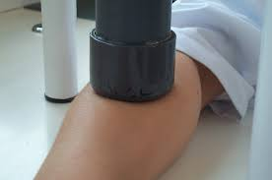
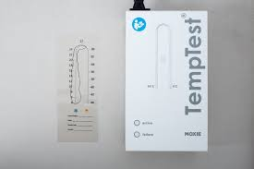
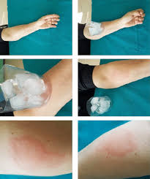
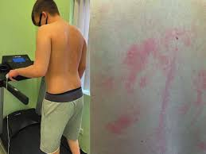
Diagnosis – Physical Provocation Tests

Slide 63
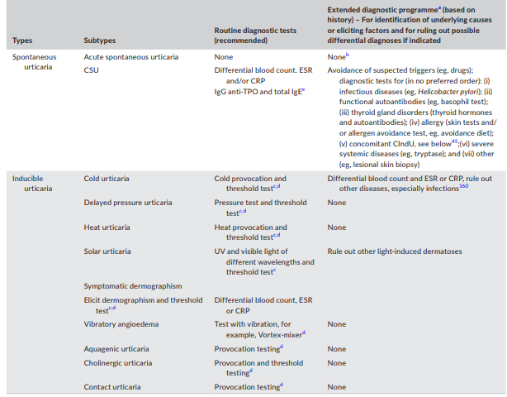

Slide 64
Urticaria – Treatment
Elimination of triggering factors Identify and avoid factors responsible for symptom onset (e.g. infections, medications, food additives, stress, physical stimuli). Treat coexisting conditions that may aggravate or maintain urticaria (e.g. autoimmune thyroid disease, gastrointestinal disorders, chronic infections).
Symptomatic pharmacological treatment, including: •Second-generation antihistamines (non-sedating) – the first-line therapy for both acute and chronic urticaria. • Alternative medications, when needed: – Leukotriene receptor antagonists (e.g. montelukast) – Short courses of corticosteroids for severe acute flares – Omalizumab or cyclosporine in chronic, treatment-resistant cases

Slide 65
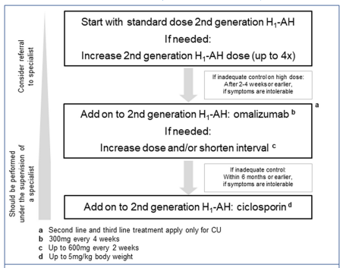
EAACI/GA²LEN/EDF/WAO Guidelines – Urticaria Management

Slide 66
Antihistamines – H₁ Receptor Antagonists
Antihistamines (H1 antihistamines) are not “pure antagonists” but inverse agonists at the H1 receptor. They bind preferentially to the inactive conformation of the H1 receptor and stabilize it in the inactive state.
Effect: they reduce the constitutive activity of the H1 receptor, so the receptor is not activated even in the presence of histamine (the endogenous agonist).
Pharmacodynamic consequences ↓ H1‐mediated signal transduction → less pruritus, sneezing, watery rhinorrhea, and edema. Their action is both prophylactic and symptomatic: regular use during periods of exposure works best. H1 antihistamines do not inhibit histamine release (they act on the receptor, not on the mediator).

Slide 67
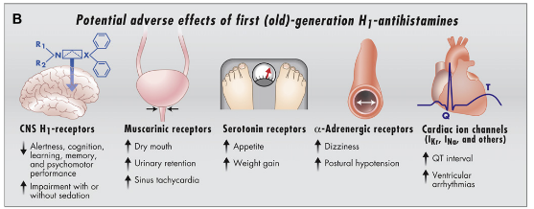
FIRST-GENERATION ANTIHISTAMINES
antazoline
diphenhydramine
clemastine
dimetinden
promethazine
ketotifen
cyproheptadine
hydroxyzine

Slide 68
Second-Generation Antihistamines (H₁ Receptor Inverse Agonists)
Act selectively on H₁ receptors.
Have a long biological half-life, allowing once-daily administration.
Are non-lipophilic and poorly (or not at all) cross the blood–brain barrier.
Exhibit mainly peripheral action, resulting in minimal sedation and cognitive impairment compared to first-generation drugs.
Possess antihistaminic, antiallergic, and anti-inflammatory properties.
Some agents in this group are active metabolites of first-generation antihistamines (e.g., cetirizine is an active metabolite of hydroxyzine).

Slide 69
Third-Generation” Antihistamines
Active enantiomers (in the case of levocetirizine)
Metabolites of second-generation antihistamines
Designed to achieve greater efficacy while reducing the incidence of adverse effects
Examples:
Desloratadine – active metabolite of loratadine
Fexofenadine – active metabolite of terfenadine
Fexofenadine, Desloratadine, Levocetirizine, Bilastine, Rupatadine

Slide 70
Treatment of children according to EAACI/GA²LEN/EDF/WAO
Second-generation antihistamines – first-line treatment
Dose escalation 2–4 times (adjusted to body weight)
Only medications with proven efficacy and safety should be used
Use of modern second-generation H1-antihistamines is recommended
The choice of a new second-generation H1-antihistamine depends on the child’s age and the availability of a suitable formulation for young children (suspension or rapidly dissolving tablets)

Slide 71
EAACI/GA²LEN/EDF/WAO recommendations Strong recommendations / high quality of evidence
Is the goal of treatment complete symptom control? Yes – as safely as possible.
Should patients allergic to food allergens eliminate them from their diet? Yes, but only if their relevance has been confirmed by DBPCFC (double-blind placebo-controlled food challenge).
Should patients with CSU follow an elimination diet for diagnostic purposes? Yes, but only in patients with daily or almost daily symptoms.
Are second-generation H1-antihistamines preferred over first-generation H1-antihistamines? Yes.
Are new second-generation H1-antihistamines preferred over other drugs? Yes.
Is a fourfold increase in the dose of new second-generation H1-antihistamines effective and preferred before using other medications? Yes.
Zuberbier T, The EAACI/GA(2) LEN/EDF/WAO Guideline for the definition, classification, diagnosis, and management of urticaria: the 2013 revision and update. Allergy. 2014 Jul;69(7):868-87.

Slide 72
EAACI/GA²LEN/EDF/WAO recommendations Strong recommendations / high quality of evidence
Should new second-generation H1-antihistamines be used continuously or on demand? Continuously, at the lowest effective dose; not on demand.
Can the dose be further increased if there is no improvement after a fourfold increase? No.
Should Omalizumab be used in patients not responding to high doses of H1-antihistamines, as third-line therapy? Yes, in addition to new second-generation H1-antihistamines.
Should Cyclosporine be used in patients not responding to high doses of H1-antihistamines, as third-line therapy? Yes, in addition to new second-generation H1-antihistamines.
Should corticosteroids be used? They should not be used chronically (strong recommendation / high quality of evidence). They may be used short-term during exacerbations, as third-line therapy (strong recommendation / low quality of evidence).
Zuberbier T, The EAACI/GA(2) LEN/EDF/WAO Guideline for the definition, classification, diagnosis, and management of urticaria: the 2013 revision and update. Allergy. 2014 Jul;69(7):868-87.

Slide 73
Omalizumab
What is it? A recombinant, humanized monoclonal IgG1κ antibody directed against IgE.
How does it work? It selectively binds to free IgE, forming IgE–anti-IgE complexes. The “trapped” IgE cannot bind to high-affinity (FcεRI) or low-affinity (FcεRII/CD23) receptors on mast cells, basophils, and other immune cells. Secondary effect: reduced expression of FcεRI receptors on effector cells → decreased readiness for degranulation.
What is the clinical effect? Less activation of mast cells and basophils upon allergen exposure. Reduced release of allergic reaction mediators.
In summary: Omalizumab removes free IgE from circulation and stabilizes FcεRI/II receptors, thereby dampening the IgE-dependent inflammatory cascade. This leads to reduced hypersensitivity, fewer allergic flares, and improved symptom control in conditions such as chronic spontaneous urticaria (CSU) and allergic asthma.

Slide 74
Thank you
Katedra i Klinika Pediatrii, Alergologii i Gastroenterologii CM w Bydgoszczy UMK

