Slide 1
Legal conditions and organization of organ transplantation in Poland
Seminar IV year
Department of Transplantology and General Surgery
Prof. dr hab. Zbigniew Włodarczyk
Dr n. med. Marek Masztalerz
Dr n. med. Aleksandra Woderska
Lek. med. Emilia Wojtal

Slide 2
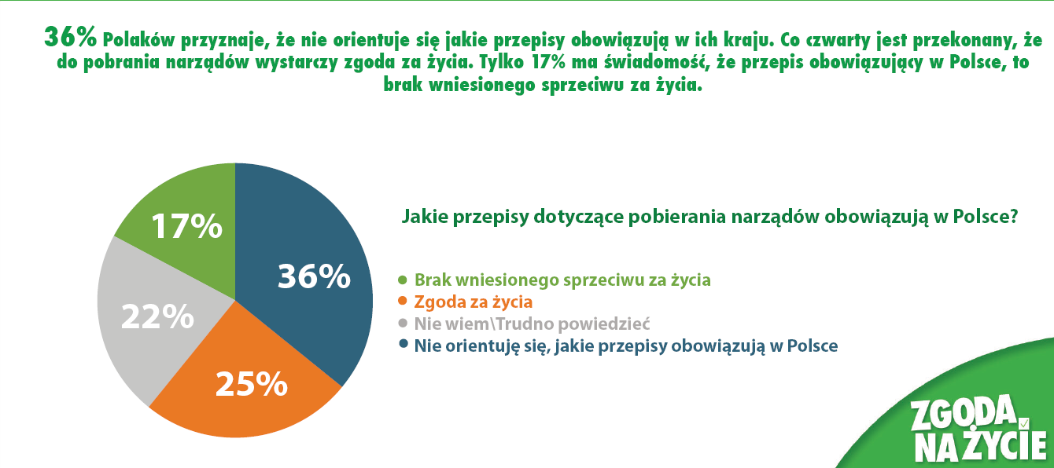
https://www.poltransplant.org.pl/

Slide 3


Do you think it is right to transplant organs taken from deceased people to save the lives or restore the health of other people?
%
https://www.poltransplant.org.pl/

Slide 4
Parliament Act of 1 July 2005 on the collection, storage and transplantation of cells, tissues and organs
1. The Act specifies the principles for:collecting, storing and transplanting cells, including hematopoietic cells from bone marrow, peripheral blood and umbilical cord blood;tissues and organs from a living donor or a corpse;2) testing, processing, storing and distributing human cells and tissues.2. The provisions of the Act shall not apply to:collecting, transplanting reproductive cells, gonads, embryonic and fetal tissues and reproductive organs or parts thereof;2) collecting, storing and distributing blood for the purposes of its transfusion, separating its components or processing into medicines.

Slide 5
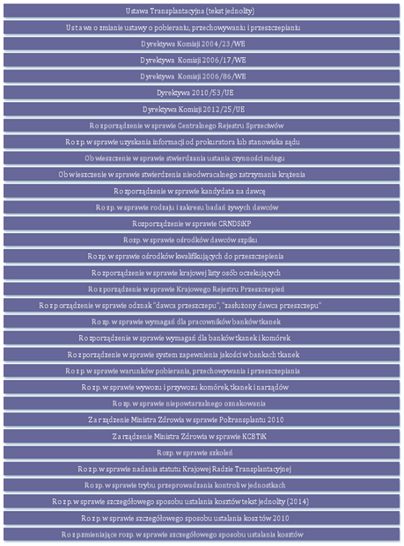
https://www.poltransplant.org.pl/

Slide 6
The main provisions resulting from the Act and the orders and regulations implementing the Act:
The collection of organs from a deceased person is possible after a committee diagnosis ofdeath (brain death or irreversible cessation of circulation);
The collection of tissues and organs is permissible if the deceased did not express objection during their lifetime (a Central Register of Objections has been created, where one can state that one does not want to donate organs fortransplantation in the event of sudden death. Two other forms ofexpressing objection have also been introduced);
The collection of an organ for the purpose of transplantation (inpractice a kidney or a fragment of the liver, but also theintestine or pancreas) from a living donor is permissible for thebenefit of a relative in the direct line, a sibling, anadopted person or a spouse, and another person, if special personal reasons justify it;
J. Czerwiński, R. Danielewicz, Prawo i organizacja przestrzeni transplantacyjnej, Pielęgniarstwo Transplantacyjne, Warszawa 2014

Slide 7
4. The Act requires the development and application of transparent and fair principles for the selection of the organ recipient (organ allocation) based on medical criteria (urgency of transplantation, tissue compatibility, age of the recipient and donor,expected transplantation results).The allocation applies to persons entered on the national list of persons waiting fortransplantation, which is an absolute condition for receiving a transplant in Poland;
5. The principles for monitoring the quality and safety of transplantation procedures have been established and institutions supervising the system have been indicated (Ministry of Health,National Center for Tissue and Cell Banking, Organizational and Coordination Center for Transplantation - Poltransplant);
6. Transplantation procedures can be performed in medical entitieswith permits from the Minister of Health, which are issued after conducting aninspection and after a positive opinion on the application by the National Transplantation Council;
J. Czerwiński, R. Danielewicz, Prawo i organizacja przestrzeni transplantacyjnej, Pielęgniarstwo Transplantacyjne, Warszawa 2014

Slide 8
7. The Act provided the basis for the creation of registers such as the Central Register of Objections, the national list of people waiting for transplantation, the transplantation register and the register of living donors. Entering data into the registers is mandatory.;
8. The principles for the creation and operation of bone marrow donor centers (permission of the Minister of Health required) and the Central Register of Unrelated Potential Bone Marrow and Cord Blood Donors as the only register of bone marrow donors in Poland (the management was entrusted to Poltransplant);
9. The scope of competences was established and assigned to institutions such as:- National Transplantation Council (consultative and advisory body of the Minister of Health);- National Center for Tissue and Cell Banking;- Organizational and Coordination Center for Transplantation Poltransplant.
J. Czerwiński, R. Danielewicz, Prawo i organizacja przestrzeni transplantacyjnej, Pielęgniarstwo Transplantacyjne, Warszawa 2014

Slide 9
10. The import and export of organs from Poland is subject to strict registration and each timerequires the consent of the Poltransplant director, in the case of organs and blood-forming cellsor the director of the National Center for Tissue and Cell Banking, in the case of tissues and cells other than blood-forming cells of the marrow andcord blood.
11. Financing of the collection, storage and transplantation of cells, tissues andorgans is done from public funds, the payers are the Ministry of Health andthe National Health Fund;
12. Transplantation medicine in Poland is open to international cooperationin the scope of exchanging scientific achievements, experiences and best practices;
13. Persons whose activities affect the quality of the collected and transplantedcells, tissues and organs and the safety of donors and recipients of transplantsrequire initial, updating and ongoing training.
14. A ban and penalisation have been introduced on trading in cells, tissues and organs,performing transplant procedures without the required permit,running a tissue bank without the required permit, and failure to register recipients ordonors of bone marrow or organs in the relevant registers.
J. Czerwiński, R. Danielewicz, Prawo i organizacja przestrzeni transplantacyjnej, Pielęgniarstwo Transplantacyjne, Warszawa 2014

Slide 10
Legal conditions for organ collection for transplantation
FROM A DECEASED PERSON
After a permanent and irreversible cessation of brain function (brain death) has been confirmed
After a permanent and irreversible cessation of circulation has been confirmed
If the deceased did not express any objection during their lifetime
If there is a suspicion that the death was caused by a criminal act – prosecutor's opinion
There are no medical contraindications to the use of organs
FROM A LIVING PERSON
-The collection is made for the benefit of a relative in the direct line, a sibling, an adopted person or a spouse (conditionally for the benefit of another person)
-If there is justification and purposeBoth parties express their consent

Slide 11
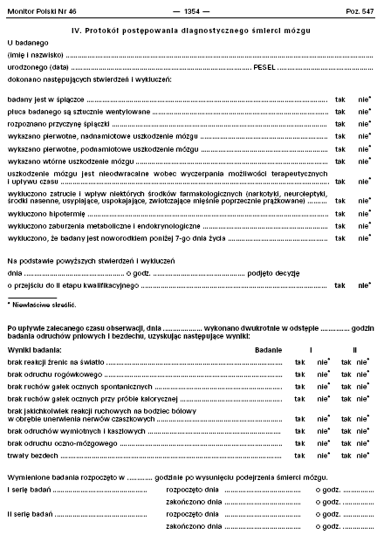
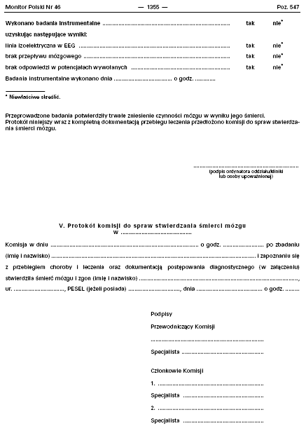
https://www.poltransplant.org.pl/

Slide 12
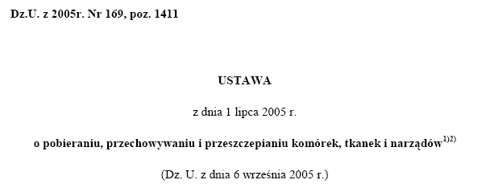
FORMS OF EXPRESSING OBJECTION
Art. 6. 1. The objection shall be expressed in the form of:
an entry in the Central Register of Objections to the collection of cells, tissues and organs from human corpses;
a written statement provided with a handwritten signature;
an oral statement made in the presence of at least two witnesses, confirmed by them in writing.

Slide 13

WHAT IS A DECLARATION OF WILL ?
An ID-card sized formHas no legal forceIs for informational purposes
Contains personal data of the person filling it out
Contains a statement that the family has been informed of the decision (!)
The completed form does not need to be returned anywhere, but you should inform your family and loved ones about filling it out so that they know your will.
DECLARATION OF INTENT – NOT A DOCUMENT

Slide 14
MINISTRY OF HEALTH
Organizational and Coordination Center for Transplantation
POLTRANSPLANT
National Recipients List
National Coordination Center
National Registry of Refusals
Regional Recipients LIst
Regional Transplant Coordinator
Hospital Transplant Coordinator

Slide 15
POLTRANSPLANT: Organizational and Coordination Center for Transplantation
POLTRANSPLANT’s Tasks
organization and coordination of organ collection and transplantation in Poland
maintenance of the Central Register of Objections
supervision of national lists of recipients
supervision of the quality of tissue typing
organization and training of field coordinators
activities promoting organ transplantation in Poland
Notes:
15

Slide 16
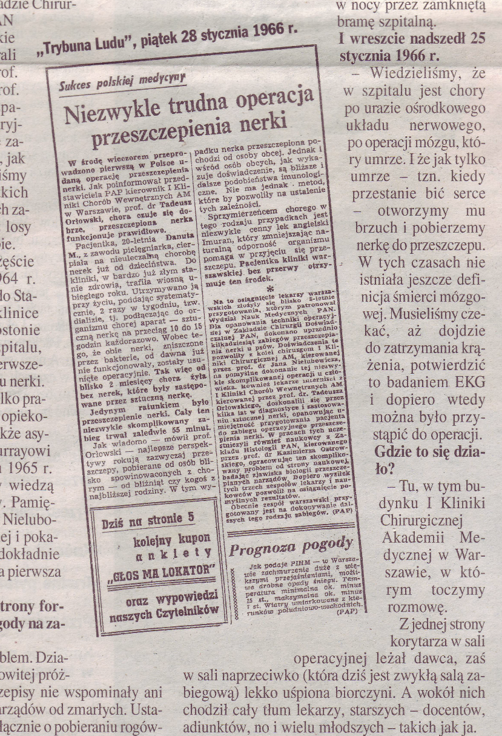
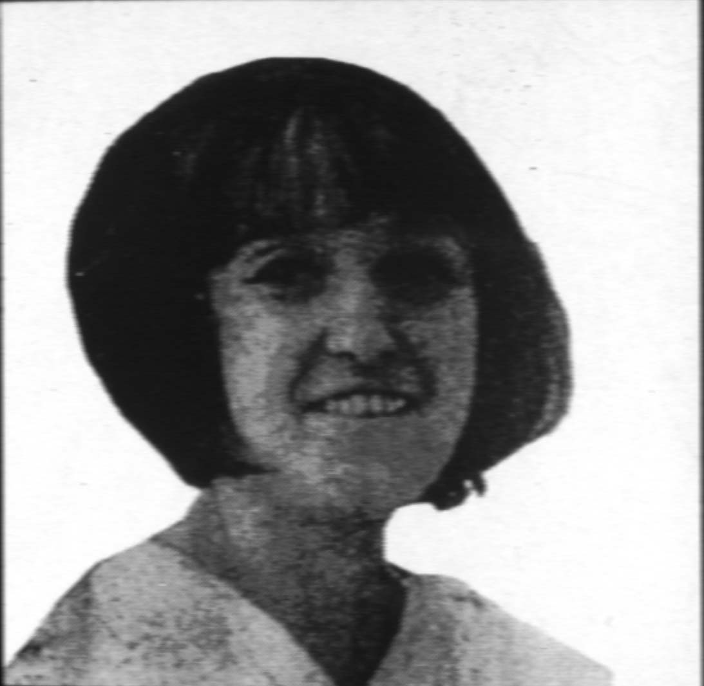
26.01.1966 - Warszawa
https://www.poltransplant.org.pl/

Slide 17
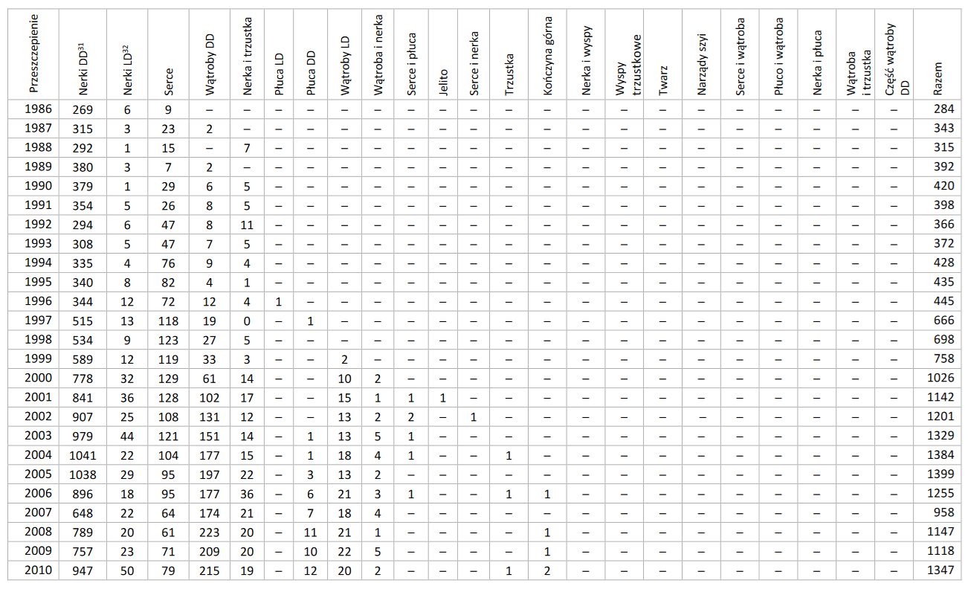
Organ transplantation in Poland in 1966-2023
https://www.poltransplant.org.pl/

Slide 18
Number of organs transplanted in Poland 1966-2023
Nerki
28794
(w tym 1139 LD)
Serce
3447
Wątroba 6614
(w tym 486 LD)
Trzustka wraz z nerką
579
RAZEM 40278
wliczone inne przeszczepienia
Płuca
625
https://www.poltransplant.org.pl/

Slide 19
Transplantation of cells, tissues and organs in Poland
Blood-forming cells
Tissues and cells
Vascularized grafts
Multitissue grafts
Bone marrow
Biostatic grafts
Kidneys
Upper limb
Stem cells
Biovital grafts
Livers
face
Umbilical cells
|Hearts
Neck structures
Lungs
Pancreas
https://www.poltransplant.org.pl/

Slide 20
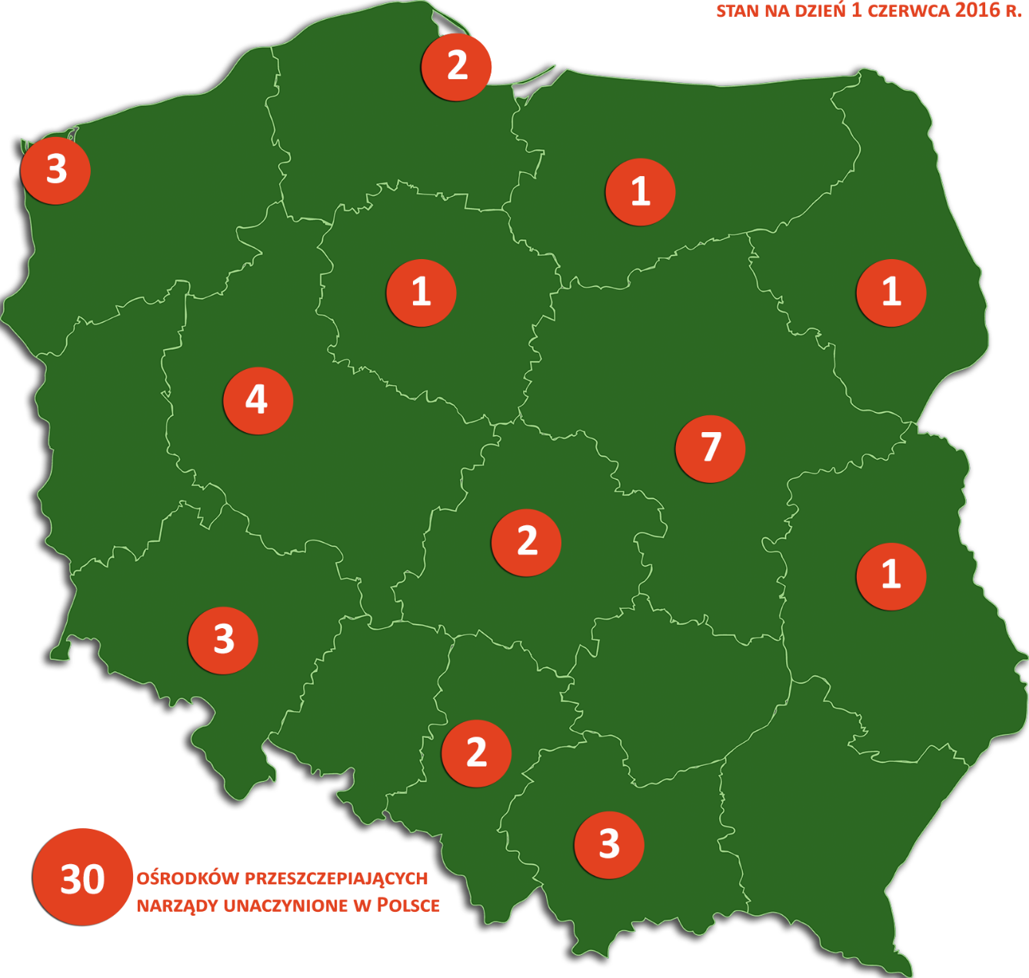
Transplant Centers in Poland
3
3
https://www.poltransplant.org.pl/

Slide 21
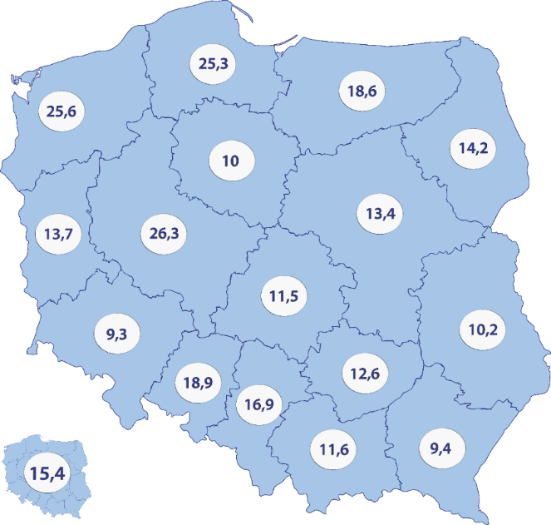
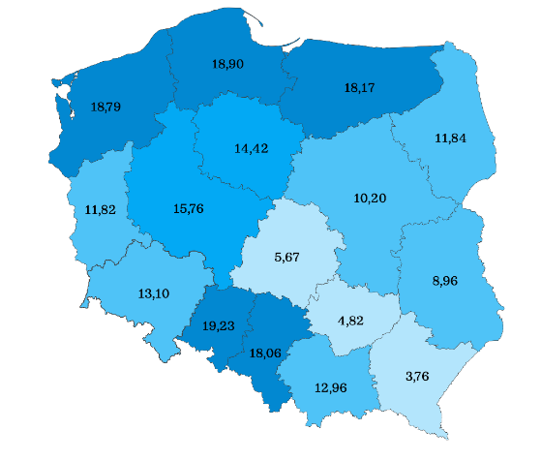
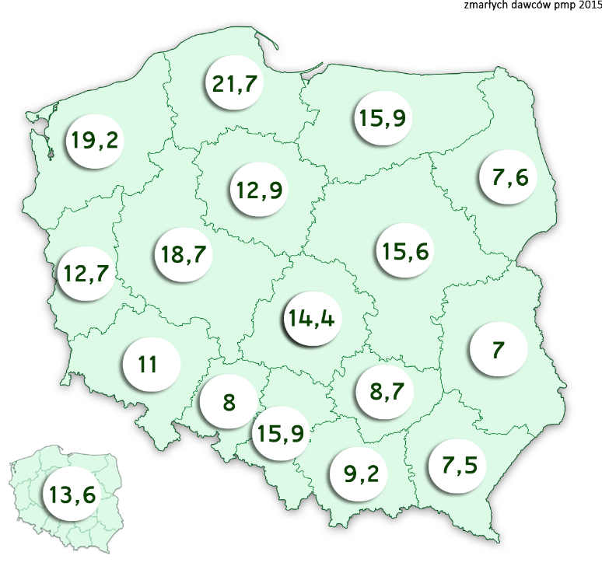
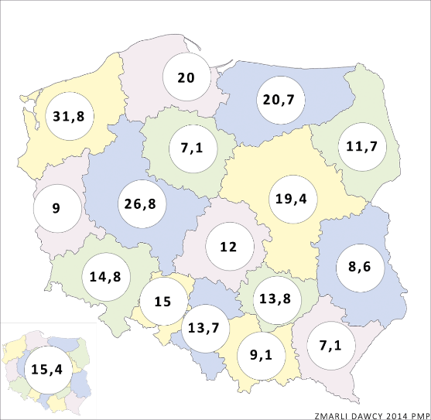
Number of deceased donors per million inhabitants in Poland in 2013-2014-2015-2018
2013 r.
2015 r.
2014 r.
2018 r.
https://www.poltransplant.org.pl/

Slide 22
Results of kidney transplantation in Poland based on transplants performed in 1996-2021
Na podstawie danych z rejestru przeszczepień, 1996-2015

Slide 23
Thank you for your attention

