Slide 1
Infectious and non-infectious complications in solid organ transplant recipients

Slide 2
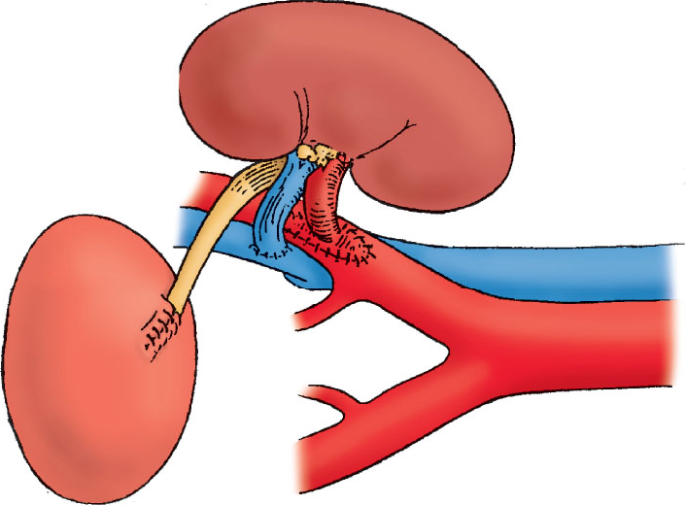
Kidney transplant surgery is the beginning of a long journey…
Danovitch G. Handbook of Kidney Transplantation. 6th Edition. Wolters Kluwer, 2017

Slide 3
Complications after kidney transplantation
Early post-transplant – delayed graft function, surgical complications
Infectious complications
Metabolic complications
Cardiovascular complications
Elevated risk of malignancies

Slide 4
Delayed graft function (DGF) is defined as the need for dialysis during the first week after transplantation and is a manifestation of acute tubular necrosis (ATN).

Slide 5
Daily urinary output in a pair of kidney transplant recipients
Recipient 2 – delayed graft function (DGF)

Slide 6
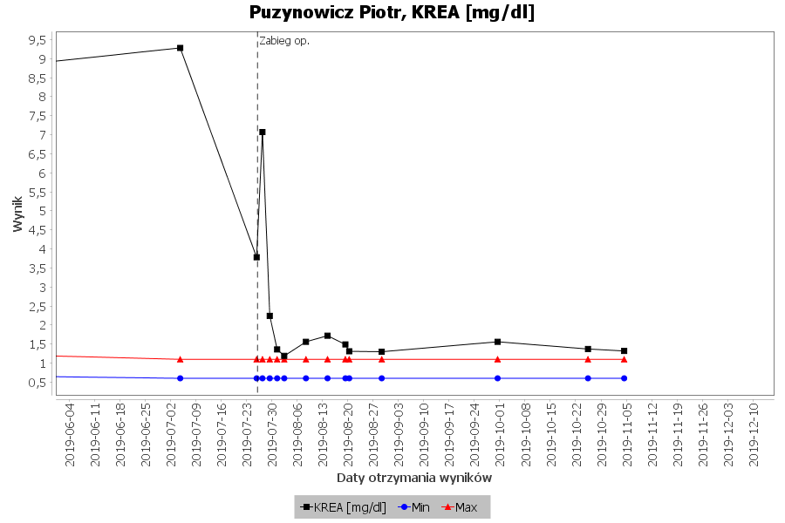
Changes in serum creatinine concentration (recipient 1)

Slide 7
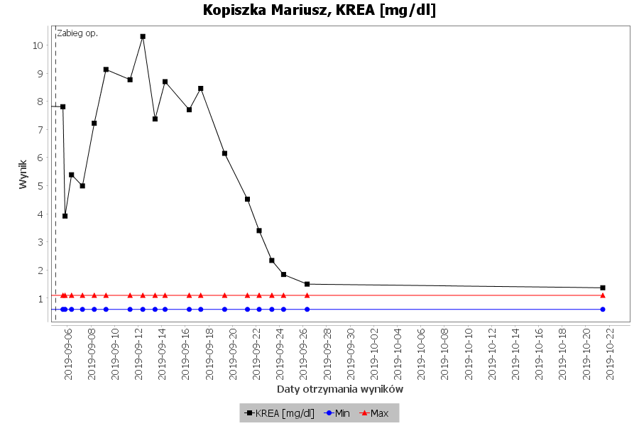
Changes in serum creatinine concentration (recipient 2)

Slide 8
The causes of delayed graft function (DGF)
Dehydration
Renal artery obstruction /thrombosis
Renal vein obstruction / thrombosis
Ureteral obstruction
Leak of urine
Blood clots in the bladder
Prostatic hypertrophy
External compression (e.g. lymphocele)
Acute rejection*
Relapse of the underlying disease*
Thrombotic microangiopathy*
Renal tubular necrosis*
Drug nephrotoxicity*
* = kidney biopsy required for diagnosis

Slide 9
Delayed graft function - diagnostic procedure
History
Physical examination
Fluid balance analysis
Laboratory tests
Kidney graft ultrasound
Other imeging techniques
Kidney biopsy

Slide 10
Delayed graft function - diagnostic procedure
In general:
Non-invasive test first!
↓
Invasive diagnostics only if necessary!

Slide 11
Analysis of the daily fluid balance –
key procedure in patients with kidney disease
Water intake (ml) |  | Water loss (ml)
Fluids | 1000-1500 | Diuresis | 1000-1500
Water in solid food | 700 | Skin and lungs loss | 900
Metabolic water | 300 | Digestive tract | 100
Total amount | 2000-2500 | Total amount | 2000-2500
Loss through skin and lungs („imperceptible evaporation”)
Skin: 500 ml
Lungs: 400 ml
Note: every 1 degree increase in body temperature above 37ºC
increases imperceptible evaporation by 500 ml

Slide 12
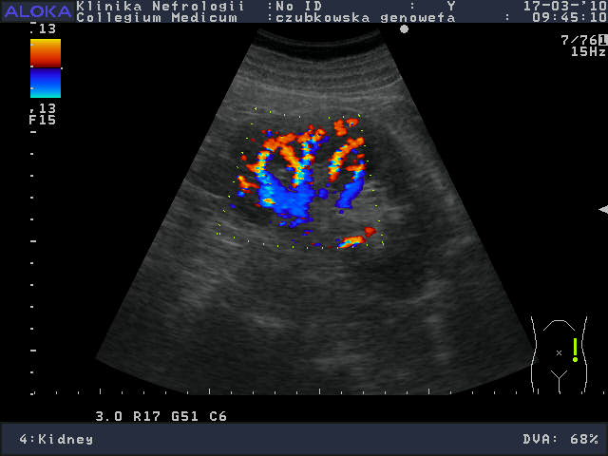
Colour Doppler ultrasound – renal blood flow

Slide 13
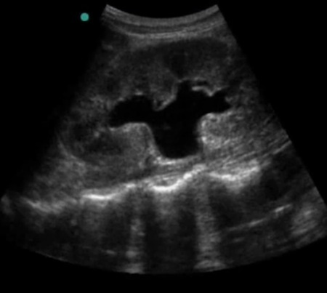
Kidney ultrasound – hydronephrosis

Slide 14
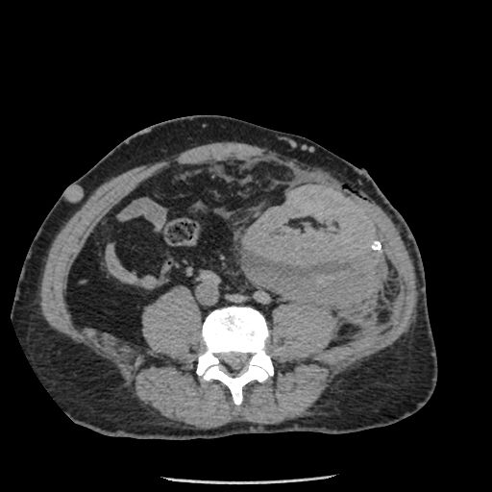
Computed tomography of the abdomen.
Transplanted kidney in left lower abdomen.
Large hematoma dorsally to the kidney.
from Dept of Radiology and Diagnostic Imaging
University Hospital No 1 Bydgoszcz, Poland

Slide 15
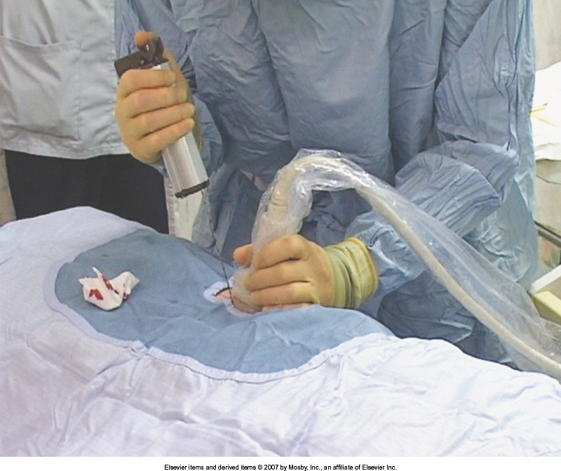
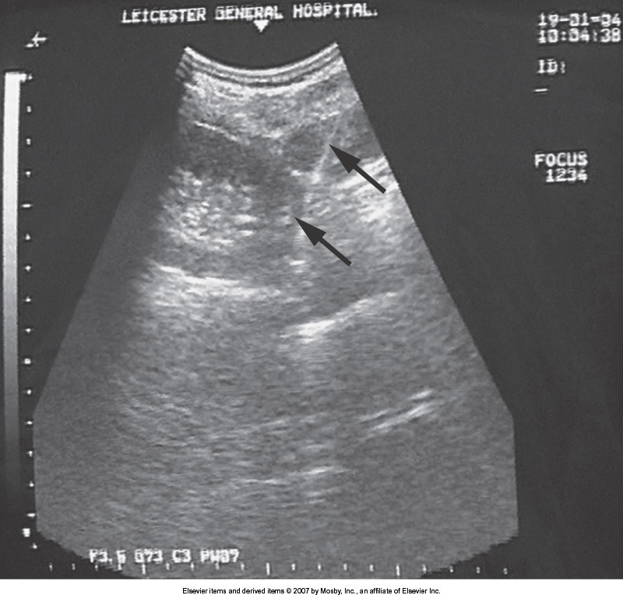
Technique of ultrasound-guided kidney biopsy
Feehally, Floege, Johnson: Comprehensive Clinical Nephrology, Mosby Elsevier 2007

Slide 16
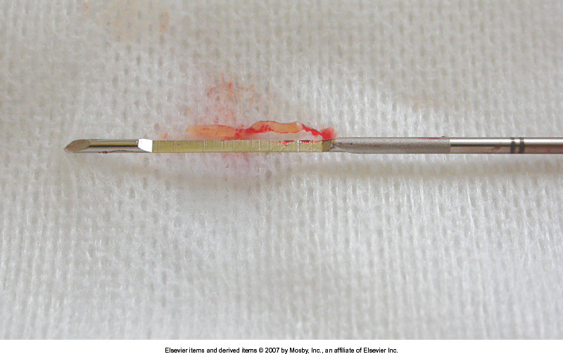
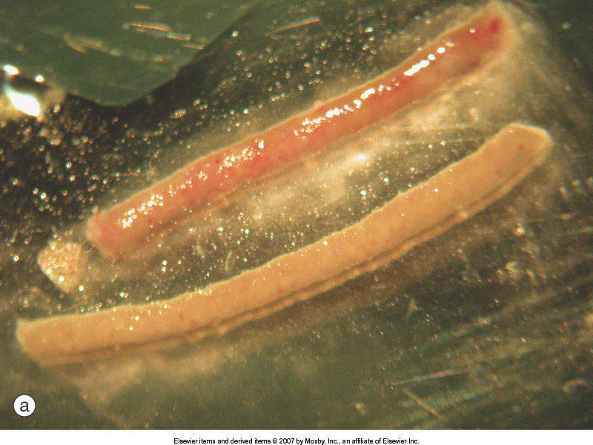
Biopsy needle and kidney biopsy specimen
Feehally, Floege, Johnson: Comprehensive Clinical Nephrology, Mosby Elsevier 2007

Slide 17
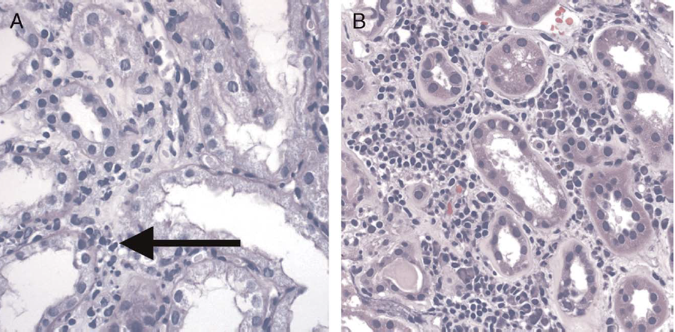
Acute T-cell rejection (interstitial inflammation)

Slide 18
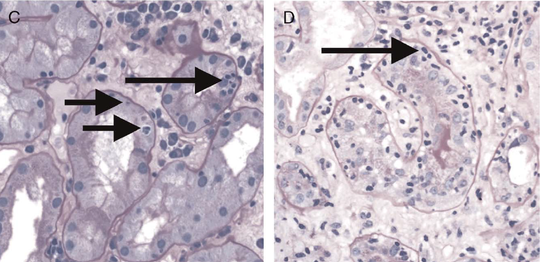
Acute T-cell rejection (tubilitis)

Slide 19
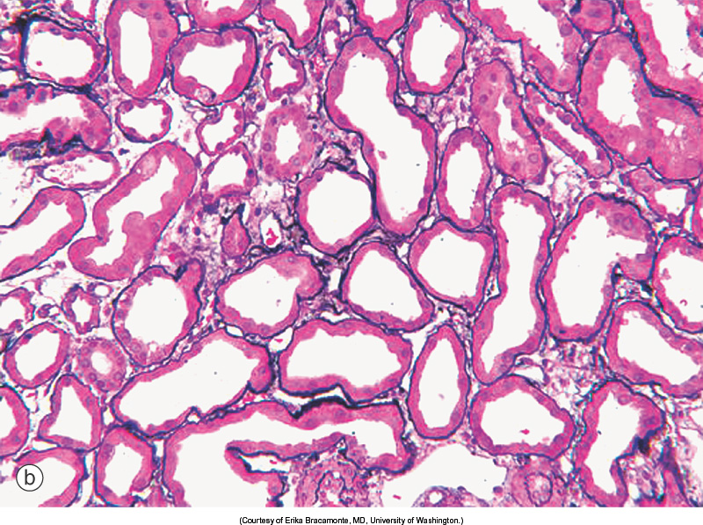
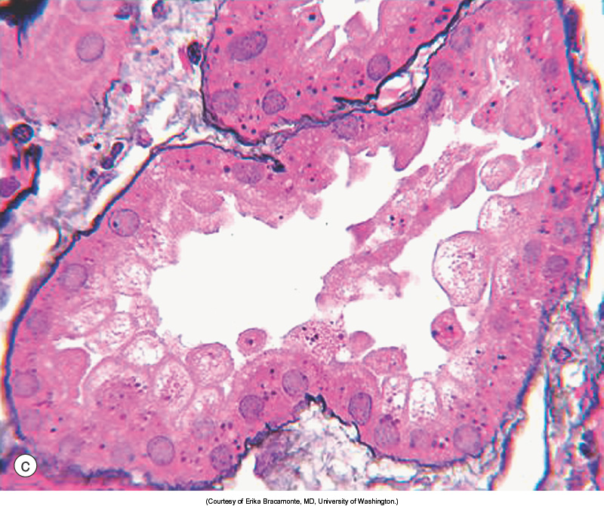
Acute tubular necrosis
Feehally, Floege, Johnson: Comprehensive Clinical Nephrology, Mosby Elsevier 2007

Slide 20
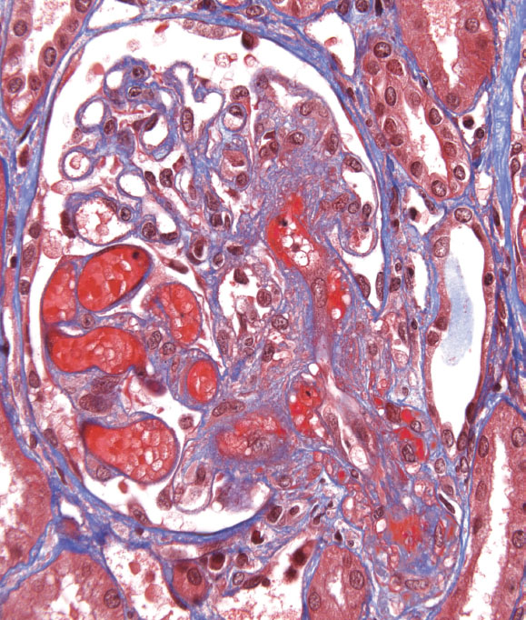
Thrombotic microangiopathy
Feehally, Floege, Johnson: Comprehensive Clinical Nephrology, Mosby Elsevier 2007

Slide 21
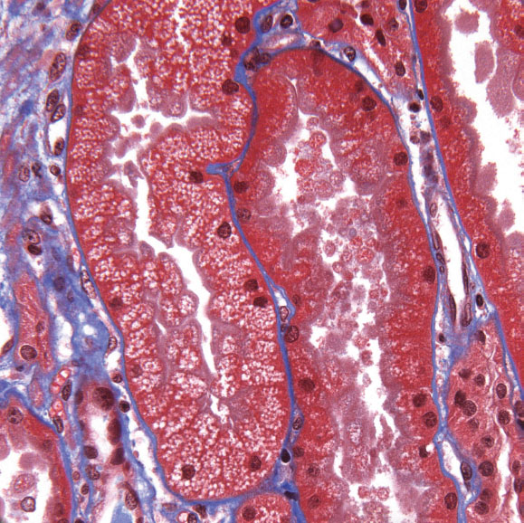
Nephrotoxicity of calcineurin inhibitor
(small isometric vacuoles in epithelial cells)
Danovitch G. Handbook of Kidney Transplantation. 6th Edition. Wolters Kluwer, 2017

Slide 22
Infectiouse complications
Bacterial
Viral
Fungal
Parasitic
Epidemiology of post-transplant infections
depends on time from kidney transplant
First month
Months from 2 to 12
Over 12 months

Slide 23
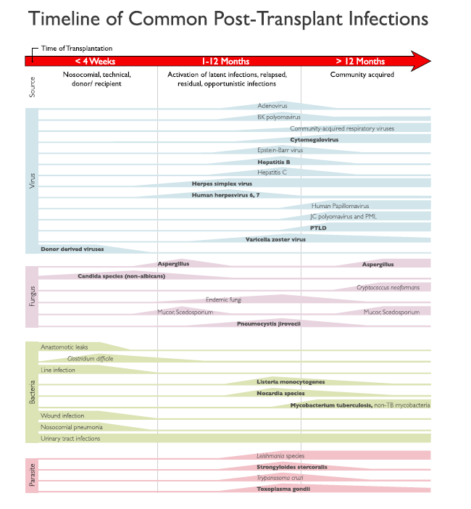
Fishman J: Am J Transplant 2017; 17: 856

Slide 24
Post-transplant infections – first month
Urinary tract infection
Surgical site infection
Clostridioides difficile infection
Hospital-aquired pneumonia
Catheter-related blood stream infection

Slide 25
Clinical presentation
Fever ± chills
and
dysuria
dyspnoe, cough
purulent discharge from the wound
diarrhea
Worsening of transplanted kidney function!

Slide 26
Urinary tract infection – the most common infectious complication after kidney transplantation
Risk factors:
Immunosuppressive treatment
Bladder catheterisation
DJ catheter in the ureter
Vesicoureteral reflux
Stenosis of the vesicoureteral anastomosis
Urine outflow abnormalities (small bladder, prostatic hyperplasia)
Non-physiological drainage of urine (Bricker reservoir)
Diabetes
Acute rejection episode

Slide 27
Clinical presentation of urinary tract infection after kidney transplantation
Fever ± chills
Dysuria
Worsening of the transplnated kidney function - increase in serum creatinine concentration, decrease in eGFR.

Slide 28
Diagnostic and treatment procedures
Interview
Physical examination
Working diagnosis
Laboratory tests
Imaging studies
Microbiological tests - urine and blood cultures
Empirical (initial) treatment
Definitive treatment
Differential diagnosis!
Analysis and verification of immunosuppressive protocol

Slide 29
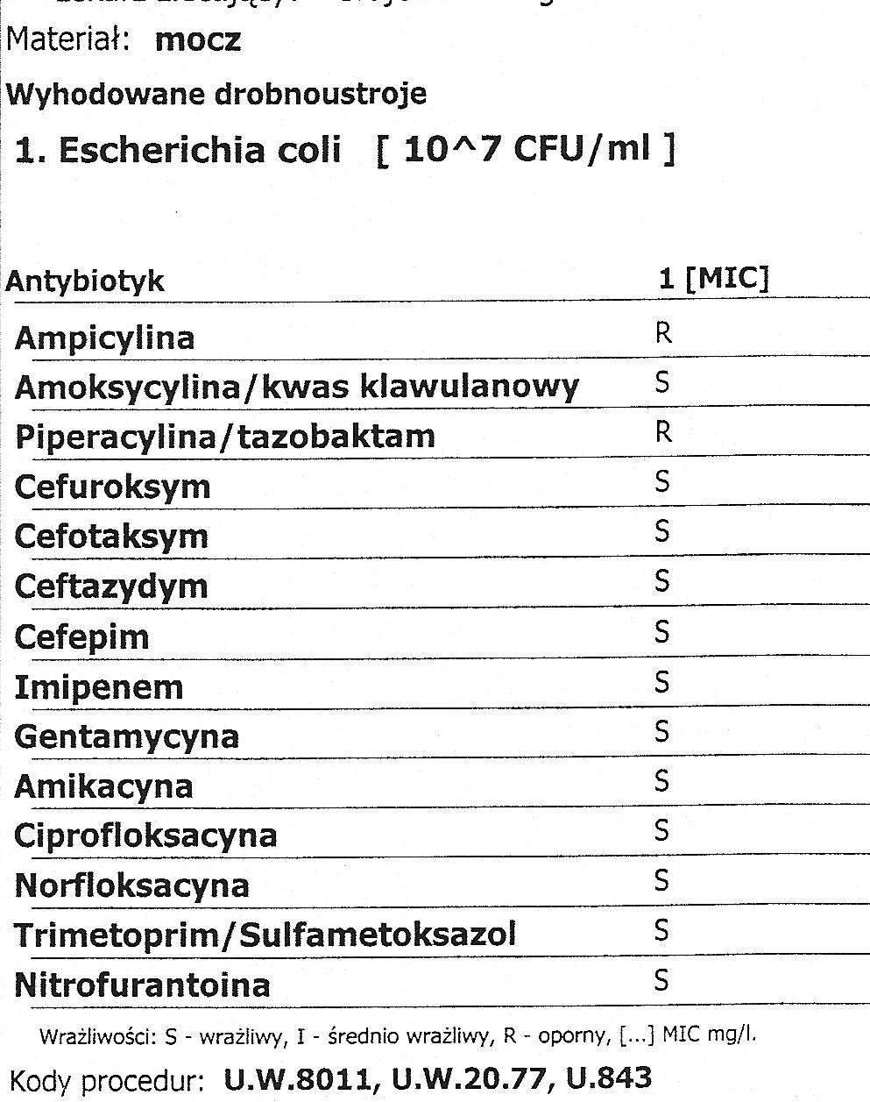
Urine culture result
Type of bacteria
Bacterial colony count = 10⁷
Sensitivity and resistance
to antibiotics

Slide 30
The etiology of UTI in kidney transplant recipients
Escherichia coli
Klebsiella pneumoniae (ESBL, NDM)
Pseudomonas aeruginosa
Enterocuccus faecalis
Proteus mirabilis

Slide 31
Infection in renal transplant recipients in the period from 2 to 12 months
Reactivation of latent viral infections (VZV, CMV)
Opportunistic infections (OIs) - infections that occur more frequently and are more severe in people with weakened immune system

Slide 32
Fishman J: Am J Transplant 2017; 17: 856

Slide 33
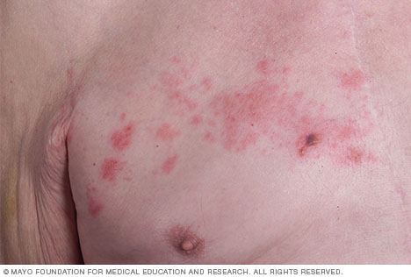
Zoster – varicella zoster virus (HHV-3) infection
www.mayoclinic.org

Slide 34
Cytomegalovirus infection (CMV)
About 80% of adults have been infected with CMV [CMV IgG(+)].
Once CMV is in a person's body, it stays there for life and can reactivate.
CMV disease in transplant recipient:
a) reactivation of latent infection in CMV IgG positive recipient (R+)
or
b) de novo infection – donor (D+) → recipient (R-) transfer
Clinical presentation: fever, weakness, leukopenia, thrombocytopenia
Organ involvement: pneumonia, hepatitis, enterocolitis (diarrhoea), retinitis, encephalitis

Slide 35
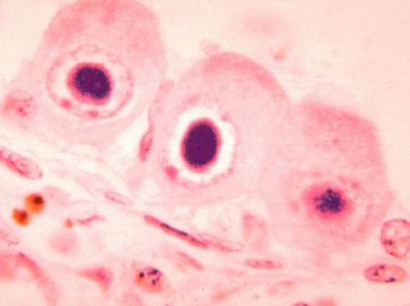
Cytomegalovirus infection (CMV)
Picture of owl eye inclusion bodies in kidney cells of an individual with cytomegalovirus infection
SOURCE: CDC/Dr. Haraszti

Slide 36
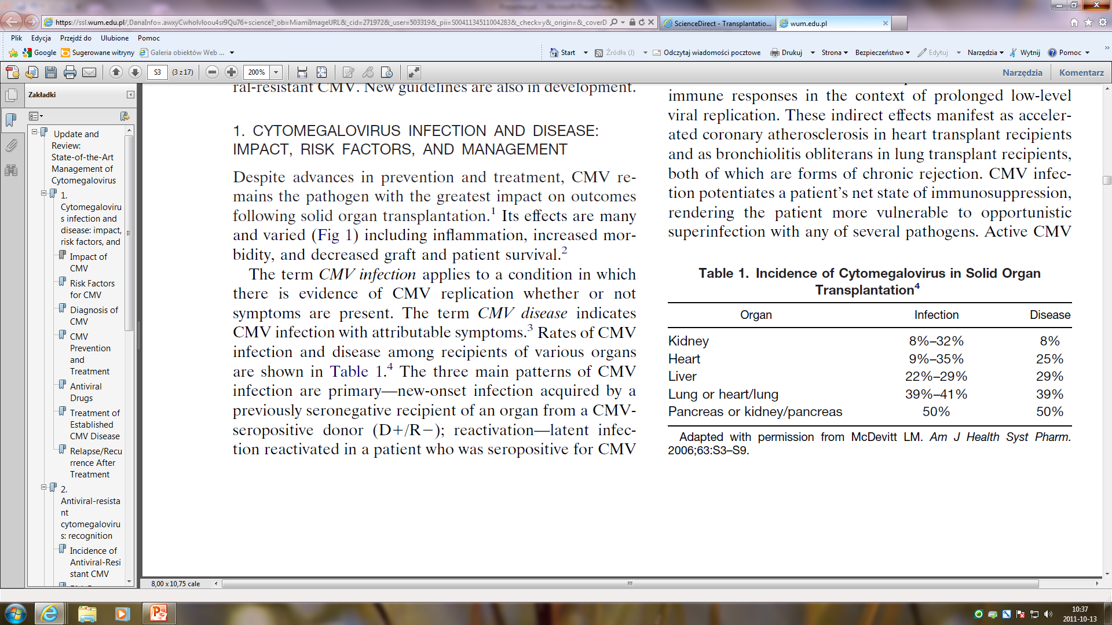
CMV infection rate
(before introduction of the prophylaxis)

Slide 37
Pneumonia in solid ogran tranaplant recipient – clinical presentation
Fever
Cough
Sputum production
Hemoptysis
Dyspnoea
Chest pain

Slide 38
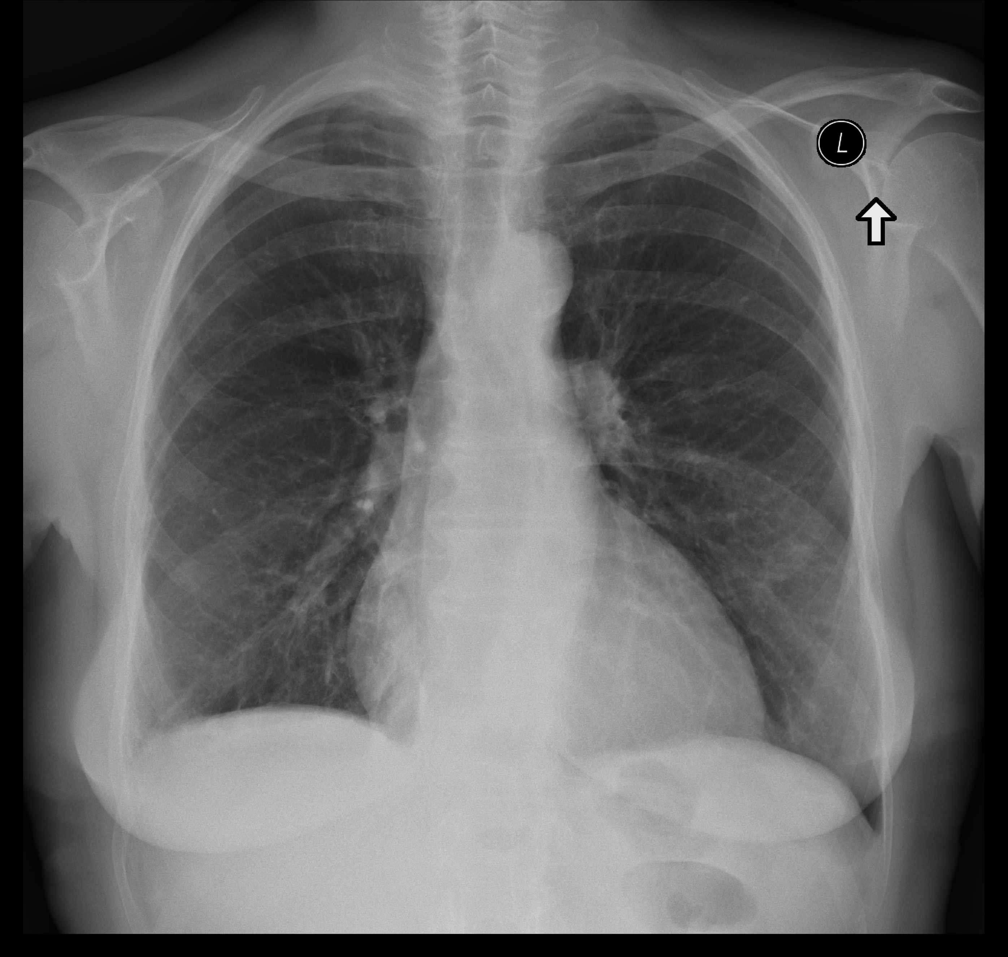
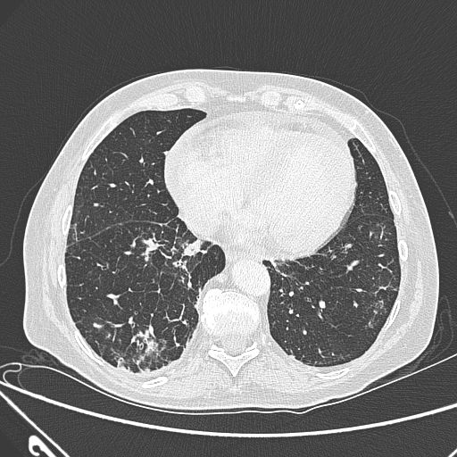
Pneumocystis jirovecii pneumonia
from Dept of Radiology and Diagnostic Imaging
University Hospital No 1 Bydgoszcz, Poland

Slide 39
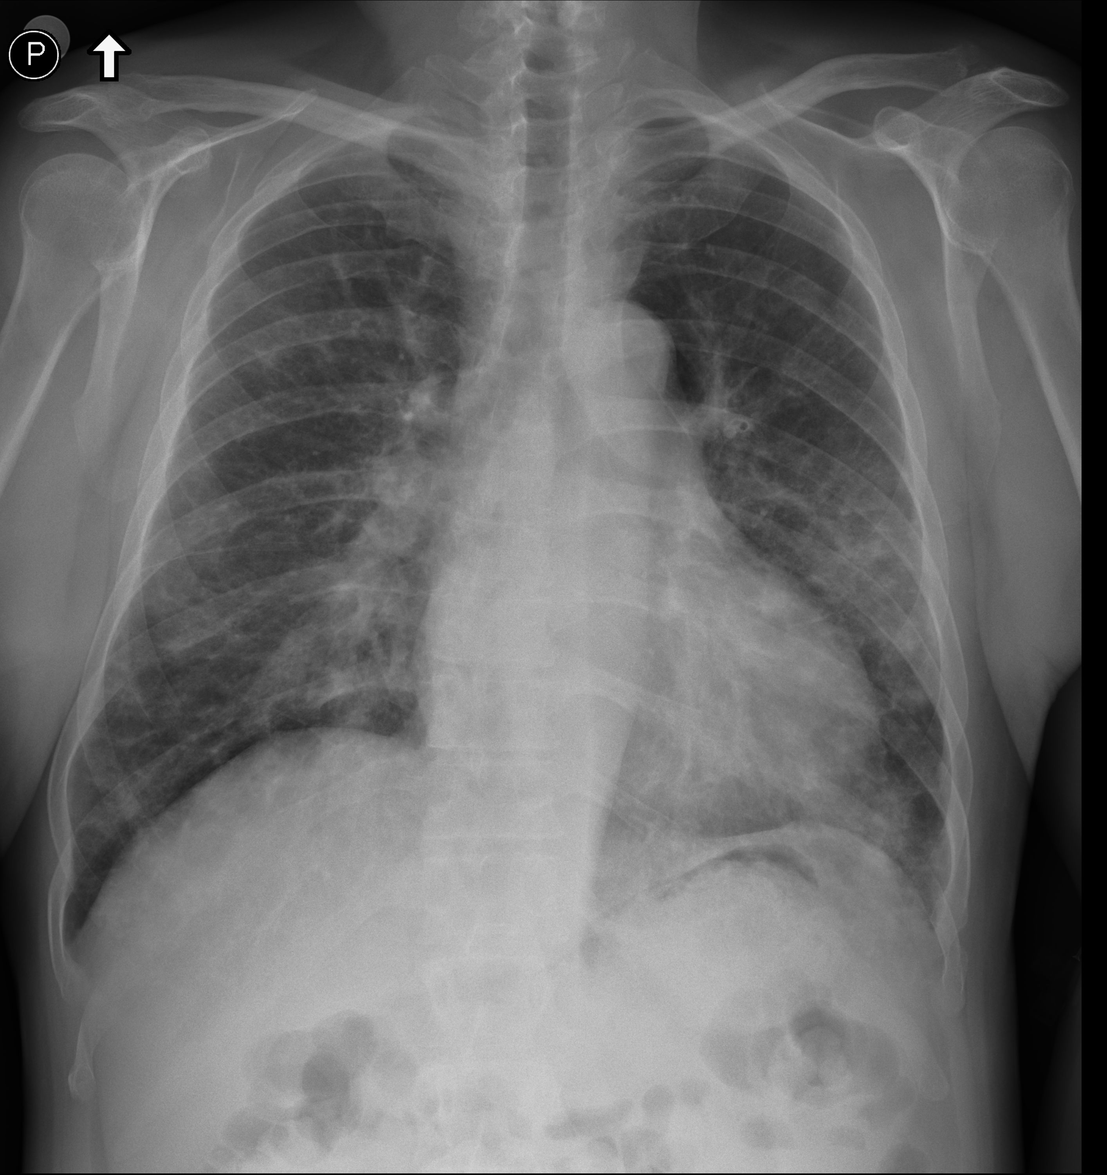
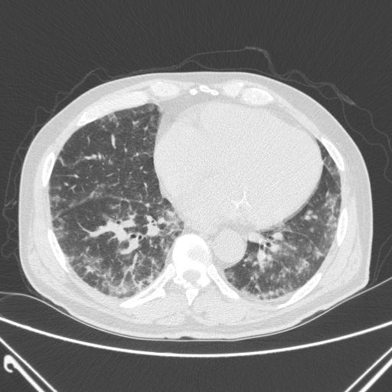
Pneumocystis jirovecii pneumonia
from Dept of Radiology and Diagnostic Imaging
University Hospital No 1 Bydgoszcz, Poland

Slide 40
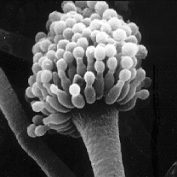
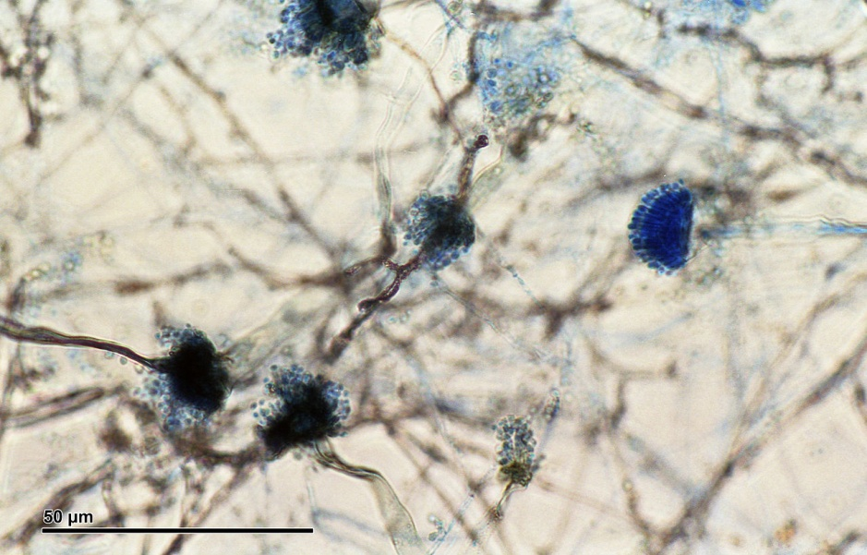
Aspergillosis - a serious infection with aspergillus fumigatus
This infection occurs most often in people with a weakened immune system (organ transplant recipient, cancer, AIDS, leukemia, chemotherapy), or other conditions or drugs that lower the number or function of white blood cells or weaken the immune system.
Aspergillus fumigatus is often found growing on dead leaves, stored grain, or in other decaying vegetation. It can also be found on marijuana leaves.
By Doc. RNDr. Josef Reischig, CSc. - Author's archive, CC BY-SA 3.0, https://commons.wikimedia.org/w/index.php?curid=30900186
https://commons.wikimedia.org/w/index.php?curid=508454

Slide 41
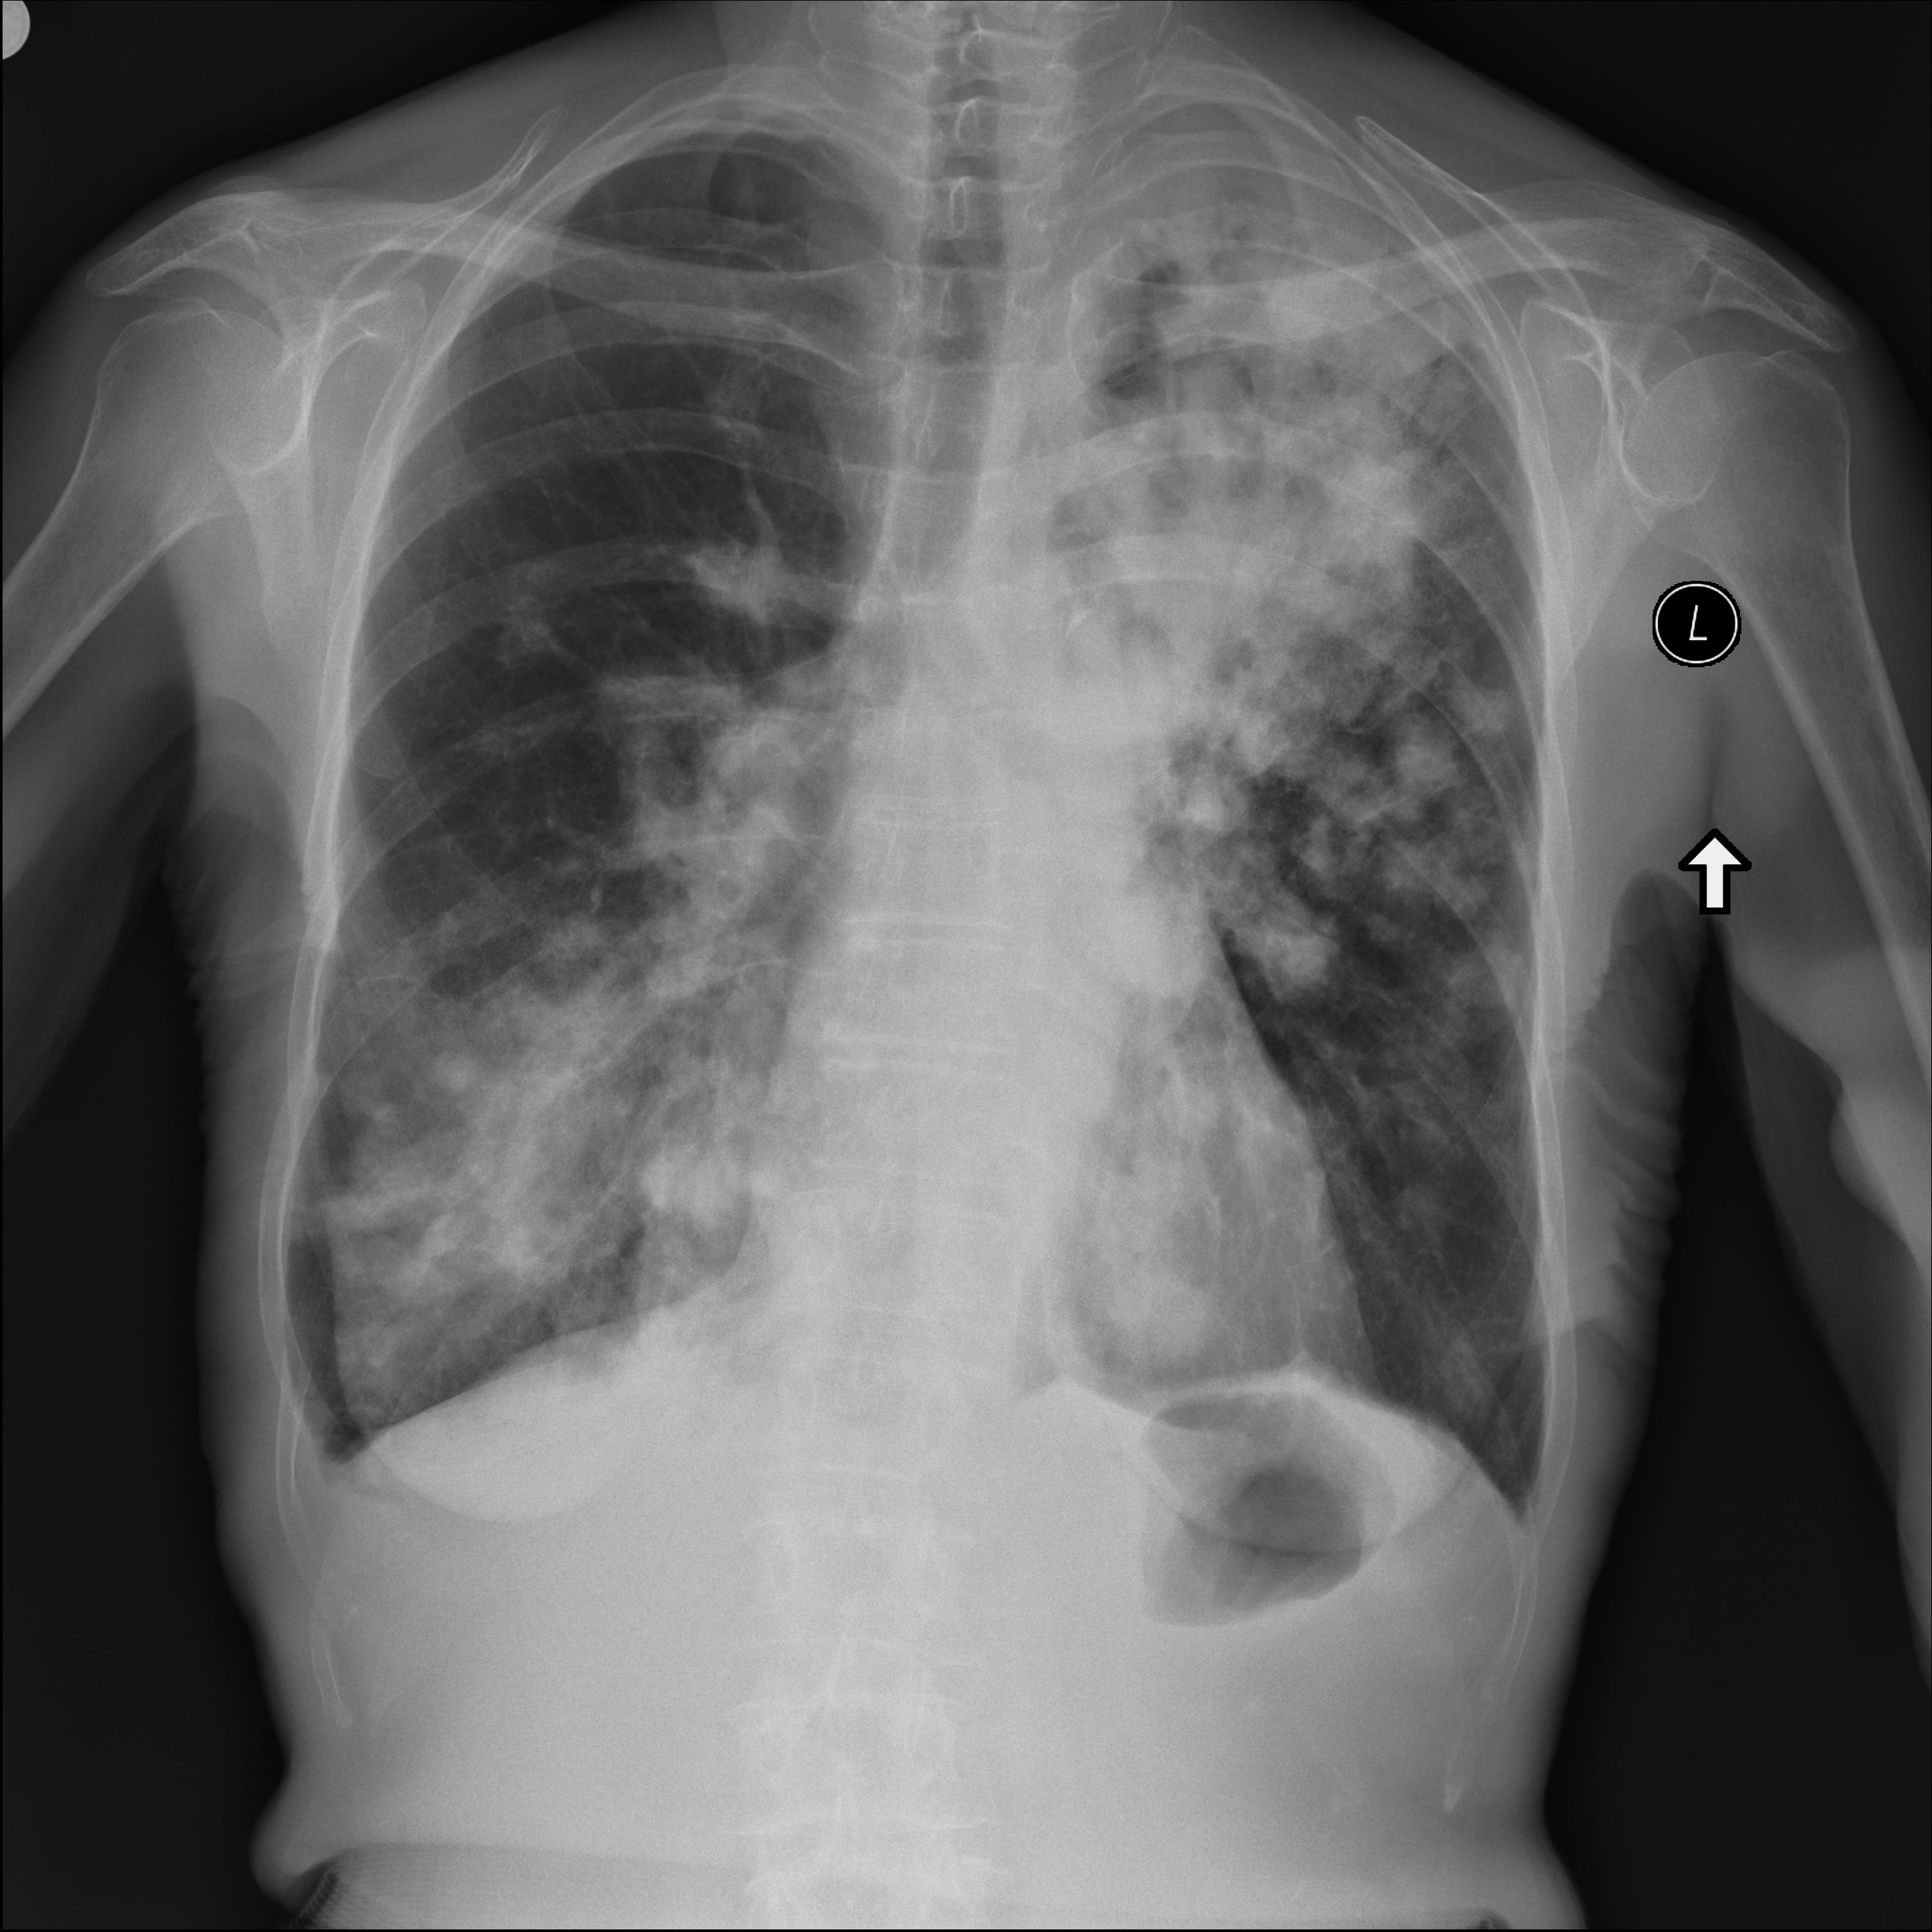
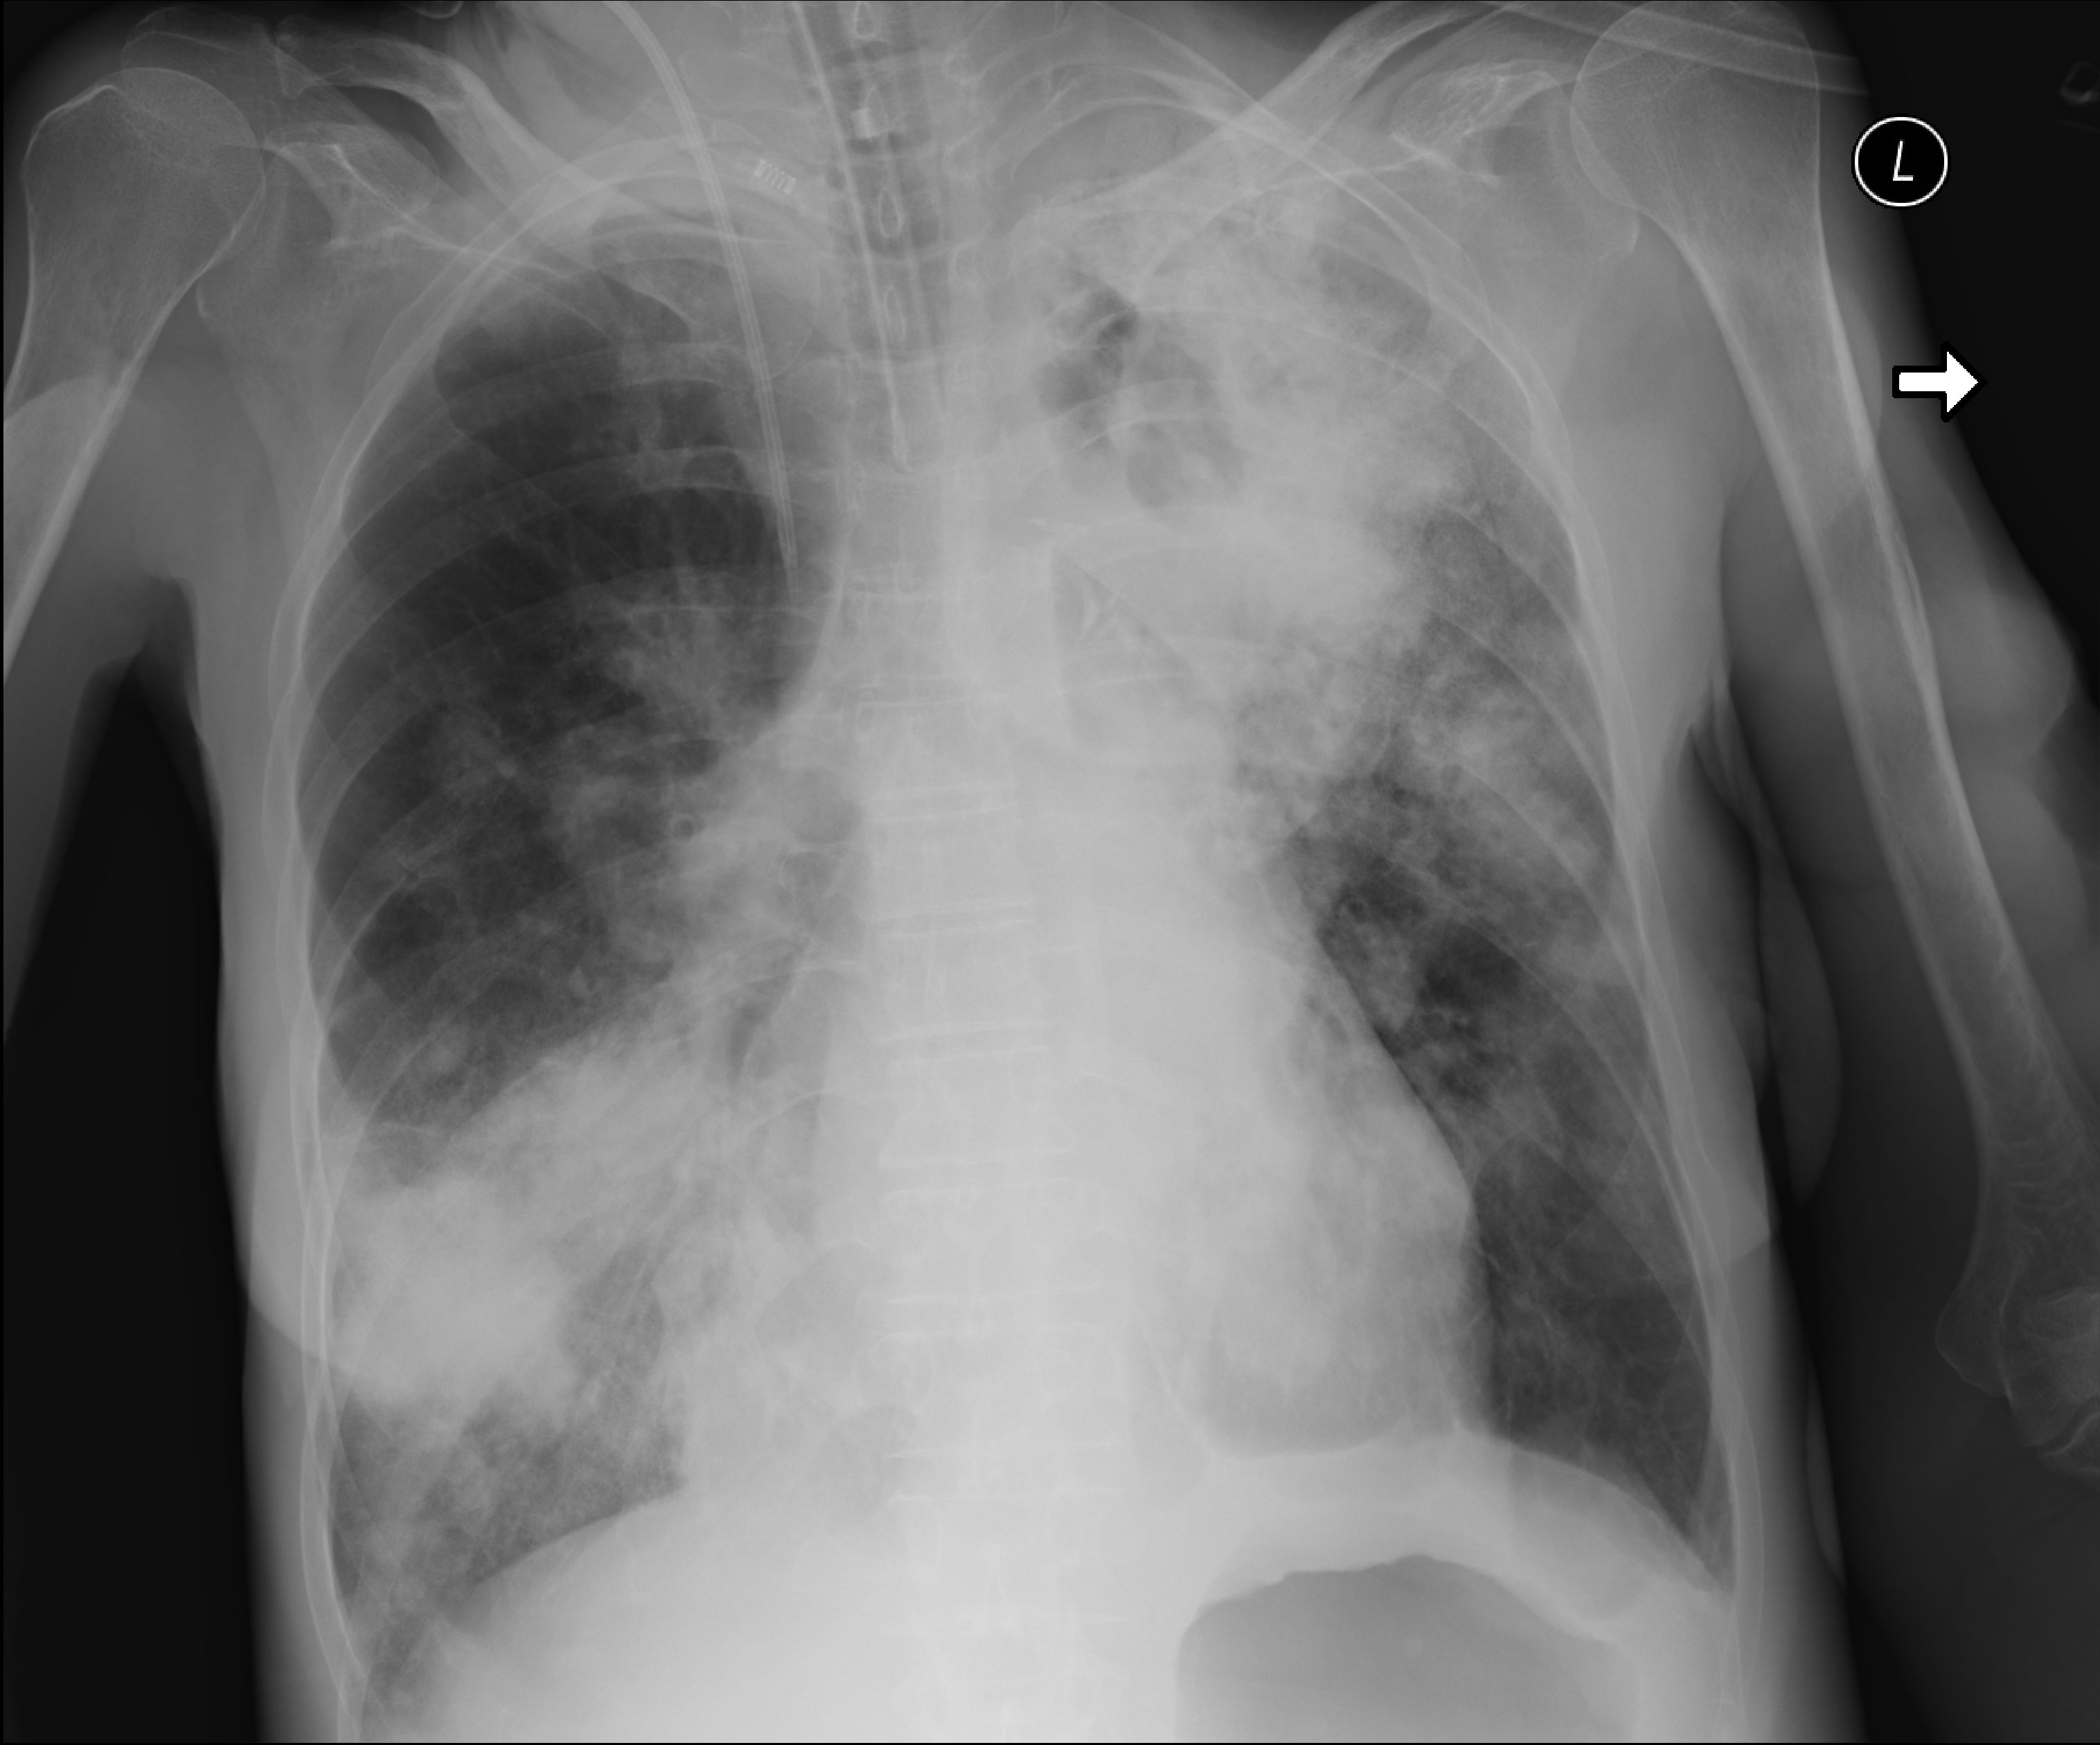
Aspergillus fumigatus pneumonia - Aspergillosis
14.04.2019
11.04.2019
from Dept of Radiology and Diagnostic Imaging
University Hospital No 1 Bydgoszcz, Poland

Slide 42
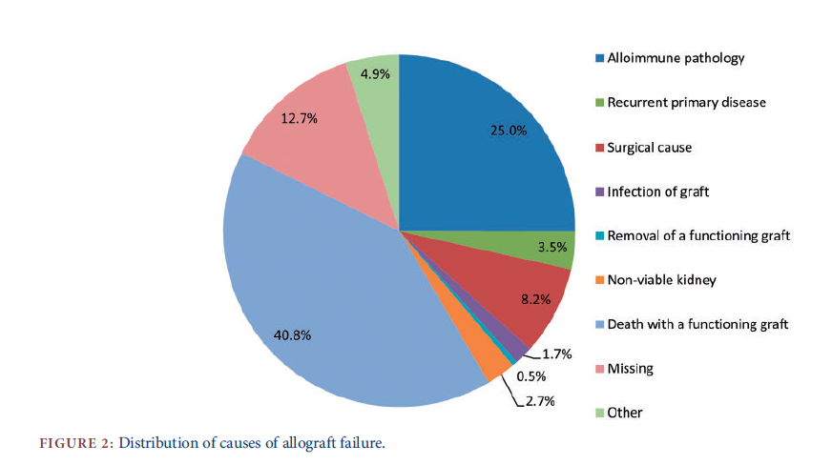
The main causes of allograft failure / loss
Burton H: Nephrol Dial Transplant 2019; 34: 355

Slide 43
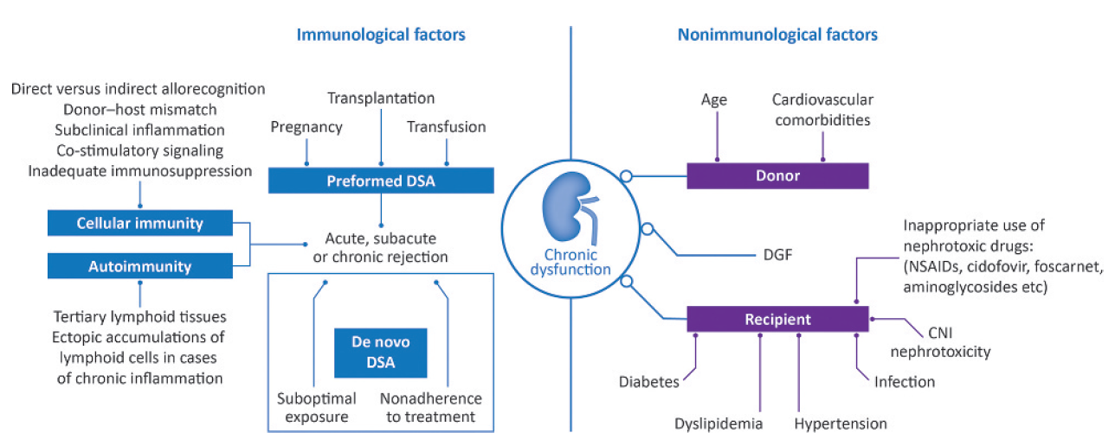

Chronic kidney allograft dysfuntion

Slide 44
Non-immunological factors influencing graft function
Hypertension
Diabetes
Hyperlipidemia
Smoking
Obesity
Proteinuria
Nephrotoxic drugs

Slide 45
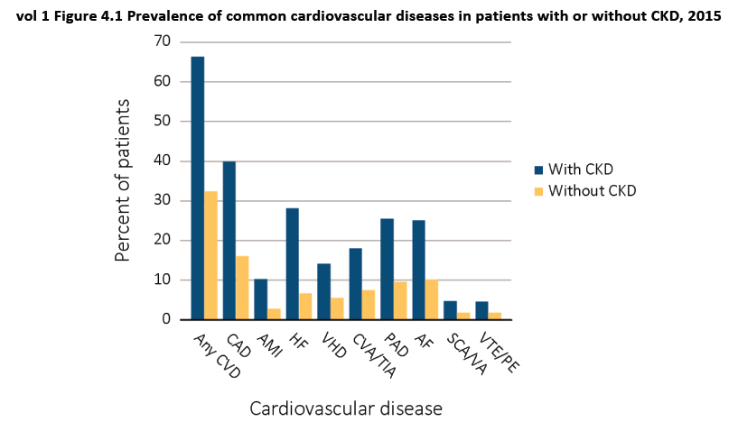
Cardiovascular disease in patients
with and without chronic kidney disease

Slide 46
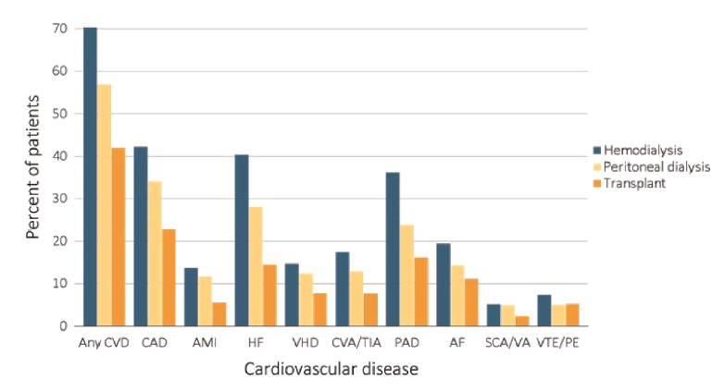
Cardiovascular disease in patients treated with renal replacement therapy

Slide 47
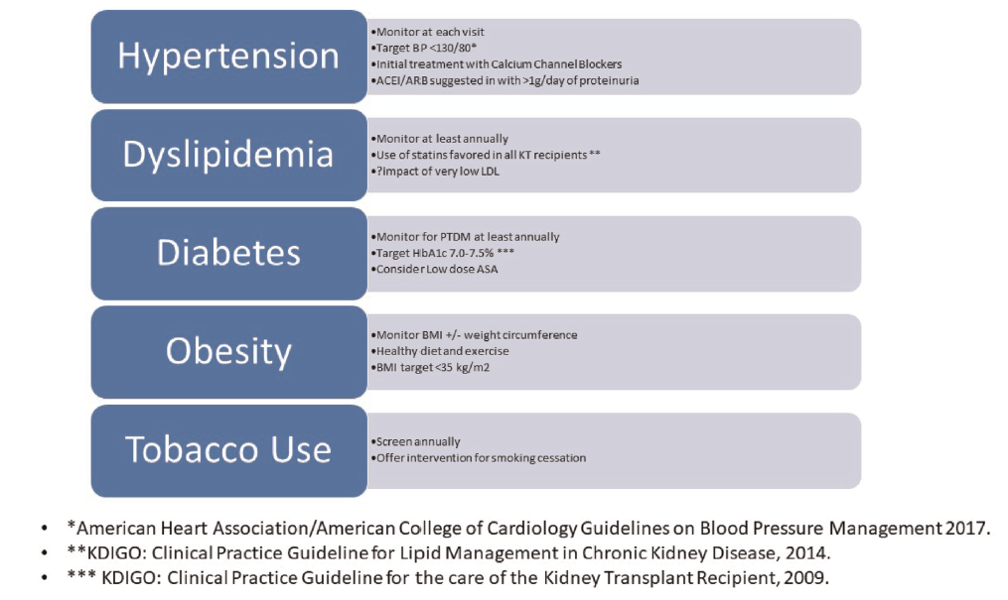
Cardiovascular risk factors and aims of therapy

Slide 48
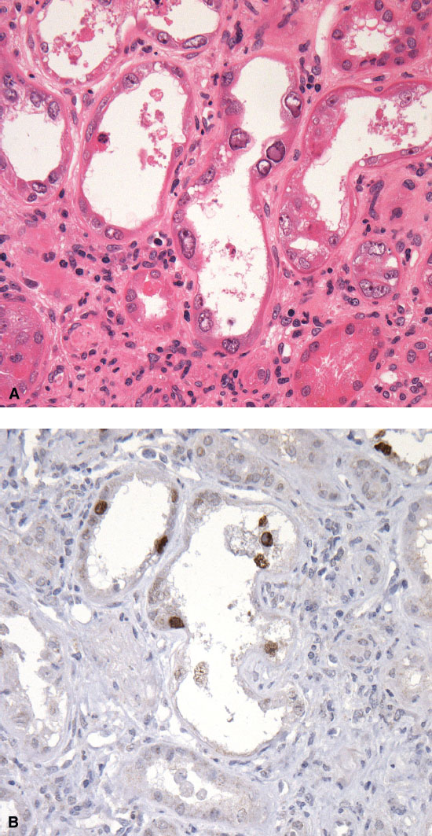
BKV nephropathy
BKV - polyoma virus
anti-BKV IgG positive 60-80% od adults
Post-transplant reactivation
Tubulo-interstitial inflammation in 5% of KTR
Diagnosis possible in kidney biopsy
Treatmant: reduction of immunosuppression
Graft loos in 15-50% of patients with BKV nephropathy
Danovitch G. Handbook of Kidney Transplantation. 6th Edition. Wolters Kluwer, 2017

Slide 49
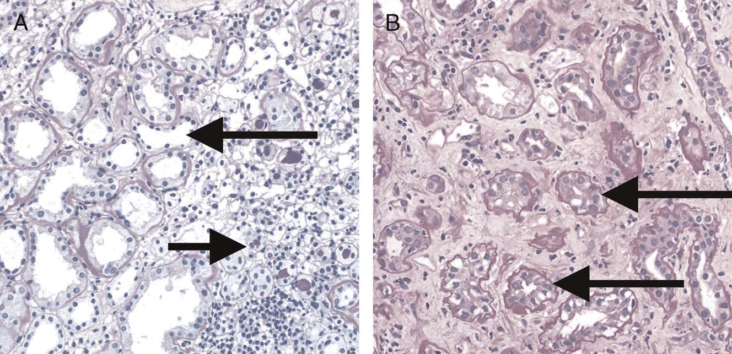
Chronic allograft dysfunction
(tubular atrophy, interstitial fibrosis)

Slide 50
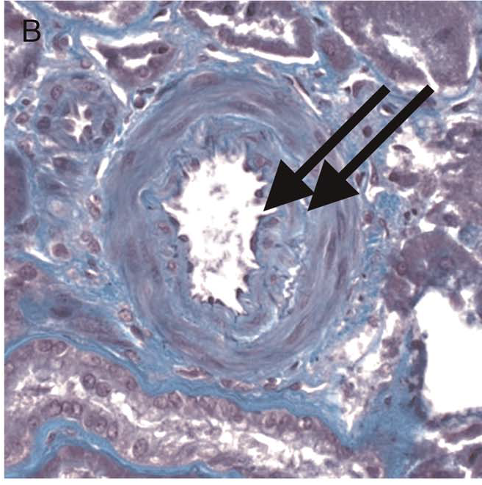
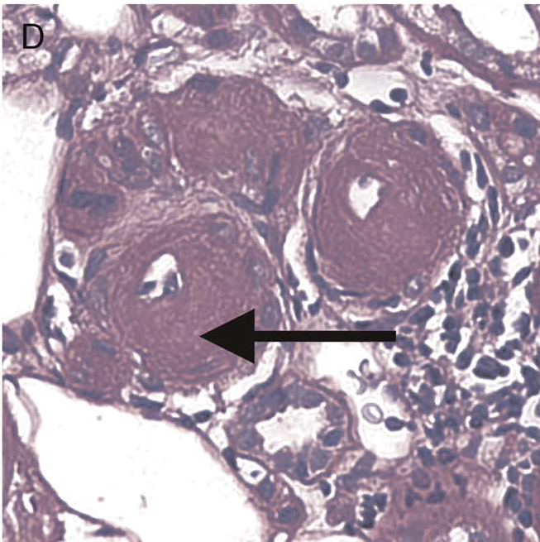
Chronic allograft dysfunction
(arterial intimal fibrosis, arteriolar hyalynosis)

Slide 51
Malignancies in kidney transplant recipients
Kidney transplant recipients have at least a 2- to 4-fold increased risk of developing malignancies compared to the general population, especially virus-associated cancers.

Slide 52
Malignancies in kidney transplant recipients
The most common malignancies in KTR:
1. Skin (squamous cell carcinoma, basal cell carcinoma, melanoma)
2. PTLD – post-transplant lymphoproliferative disease
3. Native kidney
4. Ano-genital neoplasms
5. Other: lung, colon, stomach, transplanted kidney
Danovitch G. Handbook of Kidney Transplantation. 6th Edition. Wolters Kluwer, 2017

Slide 53
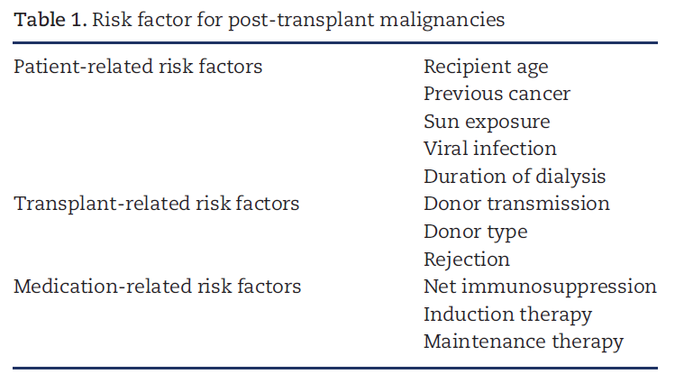
Risk factor for cancer in kidney transplant recpients

Slide 54
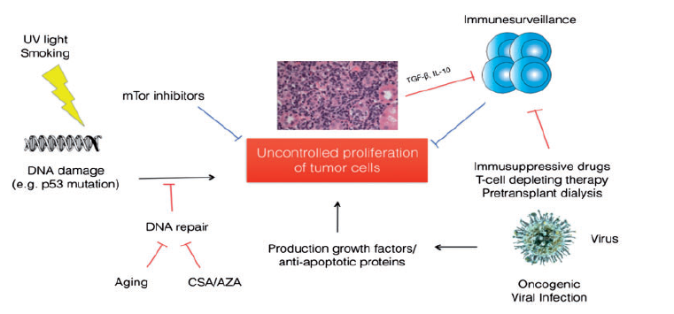
Carcinogenesis following kidney transplantation

Slide 55
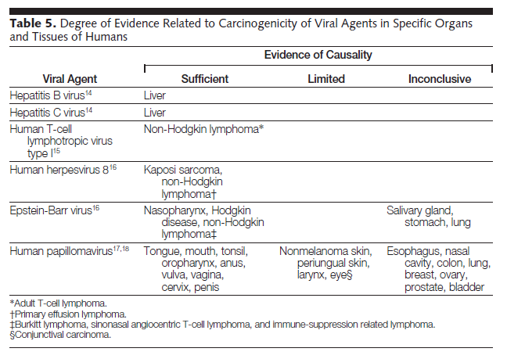
Viral infection and malignancies

Slide 56
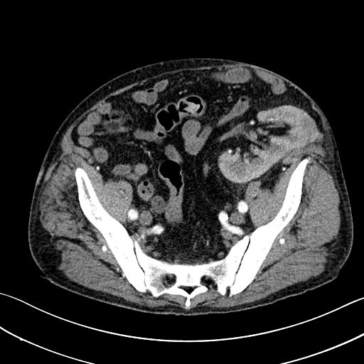
Tumor of transplanted kidney
from Dept of Radiology and Diagnostic Imaging
University Hospital No 1 Bydgoszcz, Poland

Slide 57
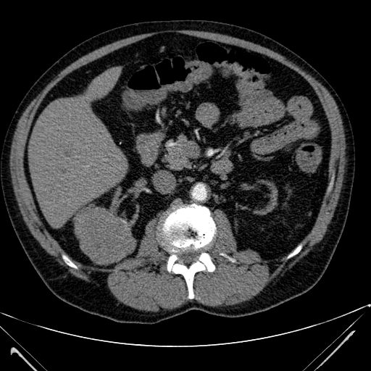
Tumor of the right native kidney in kidney transplant recipient
atrophic native kidneys
from Dept of Radiology and Diagnostic Imaging
University Hospital No 1 Bydgoszcz, Poland

Slide 58
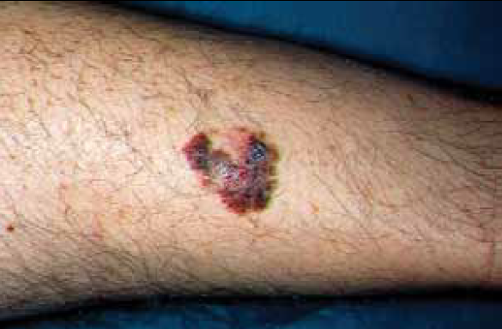
Skin melanoma in kidney transplant recipient
Imko-Walczuk B. J Oncol 2012; 62: 109

Slide 59
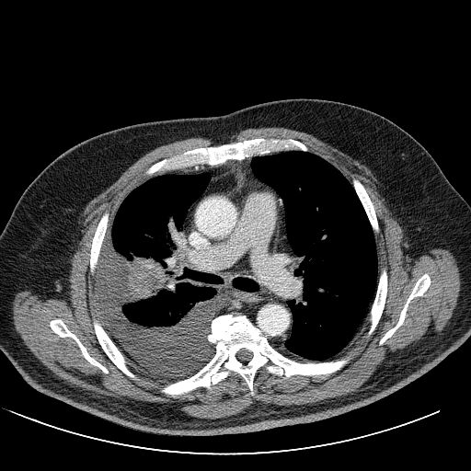
Lung tumor and pleureal effusion in kidney transplant recipient
from Dept of Radiology and Diagnostic Imaging
University Hospital No 1 Bydgoszcz, Poland

Slide 60
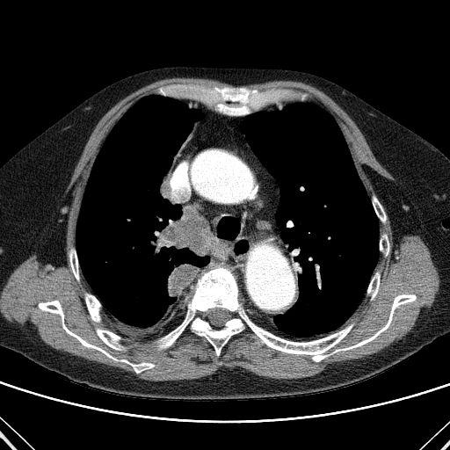
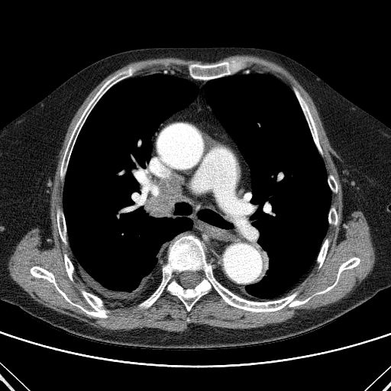
Lung tumor in kidney transplant recipient
from Dept of Radiology and Diagnostic Imaging
University Hospital No 1 Bydgoszcz, Poland

Slide 61
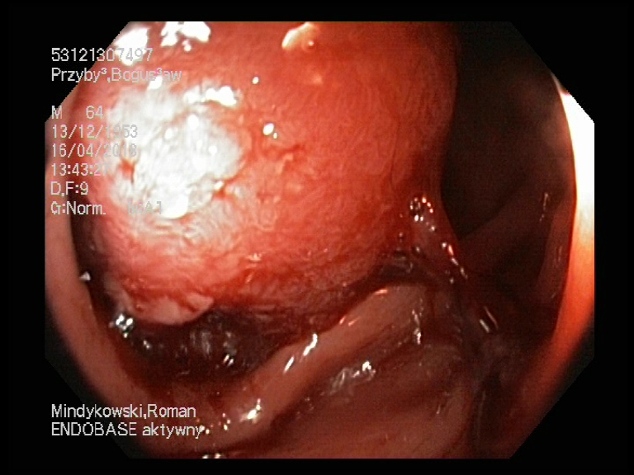
Colon tumor in kidney transplant recipient
from Dept of Gastrointestinal Endoscopy
University Hospital No 1 Bydgoszcz, Poland

Slide 62
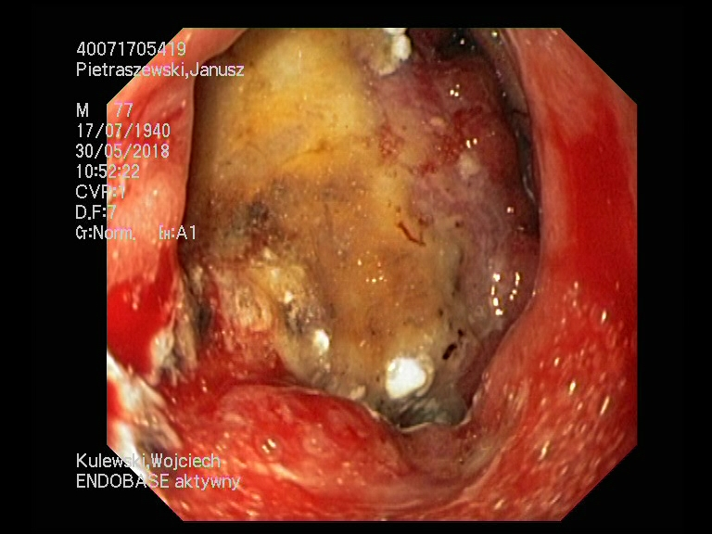
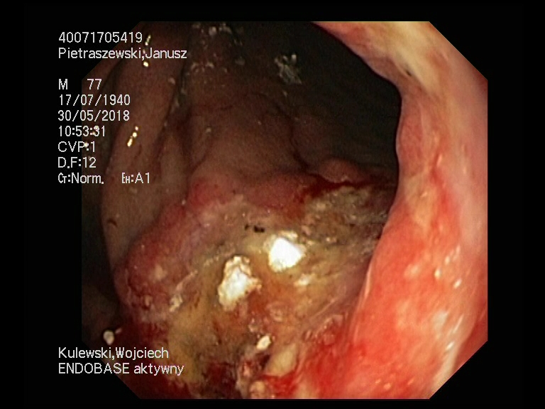
Stomach tumor in kidney transplant recipient
from Dept of Gastrointestinal Endoscopy
University Hospital No 1 Bydgoszcz, Poland

Slide 63
Treatment goals in transplant recipients
Long-term survival of the recipient and the transplanted organ.
Prevention of incidents of acute rejection and chronic rejection of transplanted organs.
Prevention, diagnosis and treatment of infectious complications.
Prevention, diagnosis and treatment of cardiovascular diseases.
Prevention, early diagnosis and adequate treatment of neoplastic diseases.

