Slide 1
Pediatric inflammatory bowel disease

Slide 2
Inflammatory bowel disease (IBD)
Inflammatory bowel disease (IBD) – chronic inflammation of the gastrointestinal tract (GI) with variable periods of remission and exacerbation.
The main forms of IBD are:
1/ Crohn’s Disease (CD)
2/ ulcerative colitis (UC) and
3/ indeterminate colitis (IC) or unclassified IBD (IBD-U) – chronic colitis without definite features of UC or CD
not a distinct entity and no diagnostic criteria
occurs in 1-20% of IBD cases
approximately 80% of indeterminate colitis cases could be definitively categorized as UC or CD within 8 years

Slide 3
Epidemiological data
- the incidence rate of CD and UC vary worldwide
- IBD is more common in the Northern than the Southern part of the world and is among Caucasian compared with non-Caucasian populations
- the incidence of IBD is highest in westernized nations, with the highest reported incidence rates in North America, Northern Europe, Great Britain, Chech Republic, Slovenia and Hungary

Slide 4
Epidemiological data
- in the vast majority of populations patients with CD and UC are usually diagnosed in adulthood, however the diagnosis can be made at any age from 0 to 90 years (VEO-IBD - < 6 years of age)
- patients diagnosed before adulthood (early onset) account for approximately 15-20% of all IBD cases

Slide 5
Clinical picture of CD
- classic „triad” of abdominal pain, diarrhoea and weight loss occures in only 25% of pediatric patients with CD
- children with distinct disease locations may present with other defined gastrointestinal symptoms; for instance, oesophageal involvement may lead to odynophagia and dysphagia whilst perianal presentation may include pain, discharge or mass
- children may also present with a range of atypical symptoms, such as lip swelling, oral ulceration
- the presence of less classical symptoms may delay recognition and diagnosis

Slide 6
Extraintestinal manifestations of IBD in children and adolescents
- extraintestinal manifestations occur in 6% to 23% of children with a higher frequency in those > 6 years

Slide 7
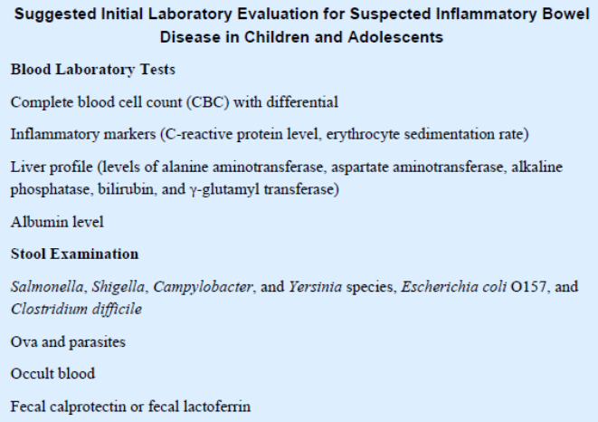
Laboratory tests in IBD
!!! At the time of diagnosis 54% of children with mild UC and 21% of children with mild CD have normal results for the combination of hemoglobin, albumin, CRP and ESR diagnosis.

Slide 8
Laboratory tests in IBD
- stool culture to exclude Salmonella, Shigella, Yersinia, Camphylobacter and Clostridium difficile in all of the children
- fecal markers of inflammation (eg. caprotectin or lactoferrin)
!!! Fecal calprotectin is a more sensitive tool for diagnosis in new-onset IBD patients than serum inflammatory markers such as CRP and ESR and normal FC values make active disease in the small or large bowel less likely
!!! Sensitivity and specificity for the diagnostic utility of FC for suspected pediatric IBD is 97% and 68%)
!!! However, elevated FC levels cannot distinguish between the different causes of intestinal inflammation (eg. IBD vs infection), the type of IBD (CD vs. UC) or the location of the disease (small vs. large bowel).

Slide 9
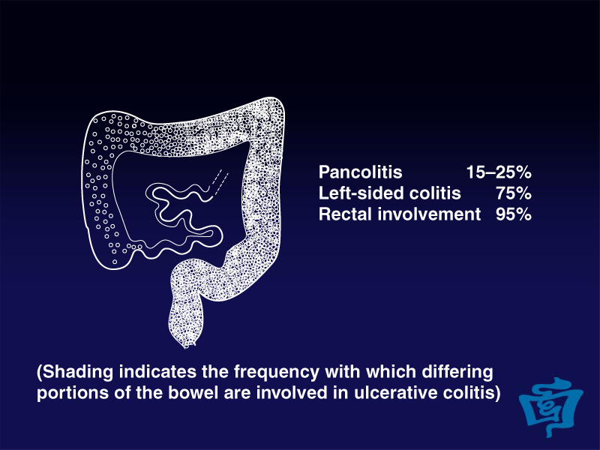
Endoscopy in UC
- inflammation is diffuse, contiguous, superficial (restricted to the mucosa)
and usually beginning at the rectum and extending proximally
- no "skip areas" (normal areas of the bowel interspersed with abnormal areas) are present, unlike Crohn disease
- endoscopic rectal sparing of inflammatory change is seen in 23% of children with newly diagnosed, untreated ulcerative colitis
- by definition, UC is confined to the colon, but it may
be accompanied by „backwash ileitis” = superfical, mild,
nonspecific mucosal inflammation in terminal ileum
in aproximately 10% of pancolitic UC

Slide 10
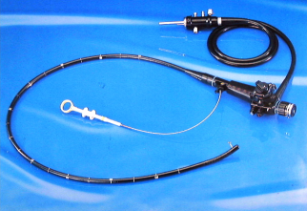
Endoscopy in CU
- disease severity is worse distally
- very mild disease may appear normal or near normal at endoscopy, and biopsy may confirm the diagnosis
- the earliest endoscopic findings in UC is loss of normal vascular markings, followed by mucosa hyperaemia
- the mucosa becomes friable and bleeds easily with minimal endoscopic trauma
- the disease may progress to form larger continuous ulcers of different sizes, rounded, superficial or more irregular
- inflammatory pseudopolyps can be seen in both CU and CD

Slide 11
Endoscopic Mayo Clinic Score for UC
Score | Endoscopic findings
No point | Normal or inactive disease
1 point | Mild disease (erythema, decreased vascular pattern, mild friability)
2 points | Moderate disease (marked erythema, lack of vascular pattern, friability, erosions)
3 points | Severe disease (spontanious bleeding, ulceration)

Slide 12
Endoscopy in CD
- in pediatric CD the ileocolonic region is the most common location
- disease limited to the colon is less frequently seen and isolated terminal ileal disease is uncommon, occuring in less than 10% of children
- involvement of the gut proximal to the terminal ileum occurs in more than half of children with common areas being the stomach and duodenum
- rectal sparing is typically seen in large-bowel CD
- CD is characterized by a transmural inflammation in non-contiguous pattern (so-called skip lesions), anywhere from the mouth to the anus
- in Crohn’s disease aphtous ulcers may be seen early and then may progress to large linear and deep serpiginous „bear claw” ulcers
- the combination of longitudinal and transverse ulceration in an edematous submucosa may lead to a cobblestone appearance of the mucosal surface
- up to 11% of paediatric patients with Crohn’s disease have esophageal CD (deep ulcers, nodules and strictures are stongly suggestive of CD)

Slide 13
Simple Endoscopic Score for CD (SES-CD)
SES-CD = sum of all variables for the 5 bowel segments (ileum terminale, right colon, transversum colon, left colon, rectum)
Variable | No point | 1 point | 2 points | 3 points
Size of ulcers | None | Apthous ulcers (0.1 to 0.5cm) | Large ulcers (0.5 to 2cm) | Very large ulcers (>2 cm)
Ulcerated surface | None | <10% | 10-30% | >30%
Affected surface | Unaffected segment | <50% | 50-75% | >75%
Presence of narrowings | None | Single, can be passed | Multiple, can be passed | Cannot be passed

Slide 14
Pediatric Ulcerative Colitis Activity Index (PUCAI)

Slide 15
Paediatric Crohn’s Disease Activity Index Classification (PCDAI)

Slide 16
Montreal and Paris classification of UC

Slide 17
Montreal and Paris classification of CD
Age at diagnosis A1 below 16 y
A2 between 17 and 40 y
A3 above 40 y
Location L1 ileal
L2 colonic
L3 ileocolonic
L4 isolated upper disease
(L4 is a modifier that can be added to L1-L3)
Behaviour B1 non‐stricturing, non‐penetrating
B2 stricturing
B3 penetrating
*p perianal disease modifier (is added to B1-B3 when concomitant perianal disease is present)

Slide 18
Histopathology of IBD
- the histologic features of IBD are those of a chronic active colitis
- features of chronicity include crypt distorsion, crypt branching, a lymphoplasmacytic infiltrate deep to the crypts and Paneth cell metaplasia on the left side of the colon
- activity is characterized by neutrophils in the lamina propria, epithelium, or within crypt lumens forming crypt abscesses
- in more severe forms, there may be mucosal necrosis, ulceration, inflammatory polyps with inflamed mucosa and chronic active inflammation in the lamina propria
- in CD, the inflammatory process is focal with inflamed areas bordered by normal crypts
- in CD fissural ulcers extend into the wall of the intestine

Slide 19
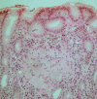
Histopathology of IBD
- the hallmark of CD is the nonnecrotizing sarcoid-like granuloma, particularly when found away from crypt, in the deep submucosa, in lymphoid follicles or in lymph nodes
- granulomas were identified in 61% of fully investigated pediatric patients at diagnosis and 42% of these granulomas were found only in the terminal ileum and upper gastrointestinal tract

Slide 20
Small bowel imaging of IBD
- MRE (magnetic resonance enterography) can estimate both the intestinal inflammation and the degree of damage and is preferred over CT because of high diagnostic accuracy and the lack of radiation involved
- pelvic MRI is recommended for the evaluation of patients with CD with suspected or proven perianal involvement.

Slide 21
A comparison of pediatric- versus adult-onset IBD

Slide 22
The diagnosis of pediatric IBD
The diagnosis of pediatric IBD should be based on a combination of history, physical examination and ileocolonoscopy with histology on multiple biopsies performed by a gastroenterologist with pediatric expertise.

Slide 23
Diagnosic workup in pediatric IBD
- laboratory tests
- endoscopy with histopathology
- magnetic resonance enterography (MRE)
- wireless capsule endoscopy
- abdominal ultrasonography

Slide 24
Endoscopy in IBD
- ileocolonoscopy and esophagogastroduodenoscopy are recommended as the initial work up for all children with suspected IBD (ESPGHAN 2014)
- rectosigmoscopy or incomplete colonoscopy are insufficient (ESPGHAN 2014)
- a minimum of 2 samples from the esophagus, stomach, duodenum, 5 sites around the colon (including the rectum) and the ileum should be obtained (ESPGHAN 2014)

Slide 25
Small bowel imaging of IBD
- in all suspected cases of IBD small bowel imaging should be performed
- wireless capsule endoscopy is a useful alternative to identify small bowel mucosal lesions in children with suspected Crohn’s disease, in whom conventional endoscopy and imaging tools have been nondiagnostic or in settings where MRI is not available or not feasible
- abdominal ultrasonography is a valuable screening tool in the preliminary diagnostic workup of pediatric patients with suspected IBD (thickened wall, thickened and hyperechoic mesentery with adipose tissue alteration and enlarged mesenteric lymph nodes)

Slide 26
Main differential diagnosis of pediatric IBD
Differential diagnosis | Clinical presentation
Infectious colitis (frequent) | Acute onset, often with fever and occasionally with vomiting, rarely lasts > 3 weeks
Allergic colitis (frequent in young infants) | Eczema, history of milk protein allergy, family history of atopy
Vasculitis (rare) | Associated extraintestinal inflammation (eg. skin, joints and eyes)
Immunodeficiency states (rare) | Onset of colitis within the first month of life, often with perianal involvement, skin folliculitis or eczema, other fungal or bacterial infections

Slide 27
Risk factors associated with complicating pediatric IBD

Slide 28
Treatment of pediatric CU

Slide 29
Treatment of pediatric CD

Slide 30
Side effects of IBD drugs

Slide 31
Vaccination in children with IBD

