Slide 1

UPPER GASTROINTESTINAL TRACT DISEASES

Slide 2
Achalasia
Achalasia is a primary esophageal motility disorder characterized by the absence of esophageal peristalsis and impaired relaxation of the lower esophageal sphincter (LES) in response to swallowing
Etiology is unknown
Patients with achalasia lack nonadrenergic, noncholinergic, inhibitory ganglion cells, causing an imbalance in excitatory and inhibitory neurotransmission
The result is a hypertensive nonrelaxed lower esophageal sphincter

Slide 3
Achalasia
Symptoms
vomiting with undigested food (especially younger children)
regurgitation of food
dysphagia (mostly older children)
odynophagia
chest pain
unintentional weight loss
cough, especially at night
heartburn

Slide 4
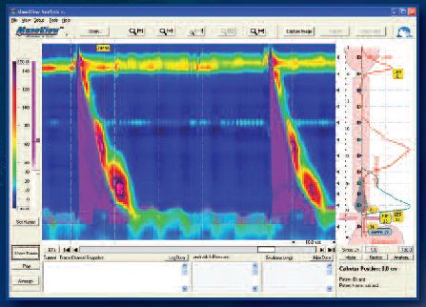
Achalasia
Diagnostics
Esophageal manometry
the criterion standard
in high resolution
the probe measures muscle contractions in different parts of the esophagus during the act of swallowing
incomplete LES relaxation in response to swallowing, high resting LES pressure, absent esophageal peristalsis
reveals failure of the LES to relax with swallowing and lack of functional peristalsis in the smooth muscle esophagus

Slide 5
Achalasia
Diagnostics
Endoscopy
to exclude other causes of dysphagia (eosinophilic esophagtits, secondary esophageal stricture, adenocarcinoma)
Barium swallow X-rays
bird’s peak appearance, esophageal dilatation

Slide 6
Achalasia
Treatment
Pharmacological
nitrates (isosorbide dinitrate)
calcium channel blockers (nifedipine)
botulinum toxin
Surgical
pneumatic dilatation
laparoscopic Heller myotomy, preferably with anterior or posterior partial fundoplication

Slide 7
Eosinophilic esophagitis
chronic inflammatory disease with unknown etiology
immune reaction to antigen
eosinophils gathering in the esophagus
esophageal motility disorders
symptoms increase with age
risk groups: male, caucasian race, atopy, food allergy, asthma, allergic rhinitis, family (genetics?, environment?)

Slide 8
Eosinophilic esophagitis
Symptoms
Infants | Younger children | Teenagers
problems with feeding vomiting regurgitation failure to thrive | vomiting abdominal pain chest pain weight loss failure to thrive | dysphagia Odynophagia GERD-like symptoms

Slide 9
Eosinophilic esophagitis
Gastroenterological diagnostics
Main: endoscopy and biopsy of the esophagus
Additional:
The barium swallow X-ray of the esophagus
stricture and rings
24-hour intraesophageal ph impedance monitoring
to evaluate gastrointestinal reflux disease
Transesophageal ultrasonography
thickening of the esophageal wall

Slide 10
Eosinophilic esophagitis
Diagnostic and treatment delay
progression of inflammation
esophageal wall remodeling
fibrosis
strictures

Slide 11
Eosinophilic esophagitis
Endoscopy
is not specific
multiple characteristic endoscopic findings
most frequent:
rings
linear or longitudinal furrows
white plaques or exudates
mucosal damage (erosions or ulcers) may suggest gastroesophageal reflux disease or Crohn’s disease
extra biopsy from the stomach or the duodenum could be helpful (eosinophilic gastritis or duodenitis)

Slide 12
Eosinophilic esophagitis
Histopathological examination
biopsy should be taken from all parts of esophagus
numer of biopsies: 6
minimum of 15 eosinophils per high-power field are required to make the diagnosis (in at least one biopsy)
Additional histologic findings:
- eosihophilic microabscesses, lamina propria fibrosis, papillary elongation / owergrowth of the papillary layer of the mucosa, superficial epithelial eosihophilic infiltration

Slide 13
Eosinophilic esophagitis
Esophageal eosinophlia – other causes:
eosinophilic esophagitis
gastroesophageal reflux disease
Crohn’s disease
infectious esophagitis (Herpes, Candida)
drug-induced esophagitis
achalasia
connective tissue diseases
Hypereosihophilic syndrome (HES)

Slide 14
Eosinophilic esophagitis
Allergological diagnostics to be considered:
Blood count (eosinophilia)
Total IgE
Specific IgE
Skin prick tests
Cytokin level (IL-5, IL-13)

Slide 15
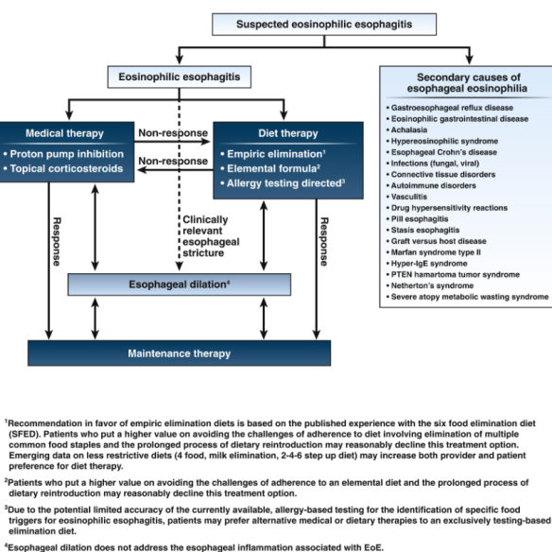

Slide 16
Remission?
after ~ 8 weeks (6-12) of treatment – control endoscopy with biopsies
remission:
clinical
endoscopic
histologic (eos<15/hpf)
Notes:
Niezależnie od wybranego rodzaju leczenia zachowawczego, konieczna jest ocena jego powodzenia, ocena remisji – którą rozpatrujemy w trzech aspektach: remisja kliniczna, czyli - czy objawy ustąpiły czy nie, endoskopowa – czy nadal widoczne są w przełyku zmiany, histopatologiczna – czy doszło do zmniejszenia się nacieków eozynofilowych.

Slide 17
Eosinophilic esophagitis
Pharmacological treatment
corticosteroids
systemic (prednisone, short time, in case of strictures)
local (fluticasone propionate, budesonide)
PPI’s (proton pump inhibitor)
Endoscopic treatment
dilation in patients with symptomatic strictures

Slide 18
PPI
PPI
2 mg/kg
✓
Dose reduction
-
Another treatment
Induction treatment
Control biopsy
Further treatment
Notes:
Przy wyborze inhibitora pompy protonowej lekiem pierwszego rzutu jest najczęściej omeprazol, który stosujemy w wysokich dawkach, 2 mg/kg m.c. Po ok. 8 tygodniach wykonujemy kontrolną biopsję. Jeśli leczenie okazało się skuteczne – zmniejszamy dawkę o połowę. Po kolejnych 8 tygodniach konieczna jest kolejna biopsja celem sprawdzenia, czy ta zredukowana podtrzymująca dawka jest skuteczna, byśmy mogli takie leczenie kontynuować.
Jeśli leczenie indukcyjne nie było skuteczne – konieczny jest wybór innego leczenia.

Slide 19
Topical steroids
budezonide
/ fluticasone
✓
Dose reduction
-
Another treatment
Induction treatment
Control biopsy
Further treatment
Notes:
Analogiczny schemat podstępowania ma zastosowanie w przypadku leczenia sterydem miejscowym. Lekami, które możemy zastosować są budezonid i flutykazon.
Po ok. 8 tygodniach oceniamy obraz endoskopowy, wykonujemy biopsję, i jeśli leczenie jest skuteczne – zmniejszamy dawkę. Jeśli nieskuteczne – zmieniamy leczenie.

Slide 20
Eosinophilic esophagitis
Dietary treatment
Empiric elimination diet
Specific food elimination diet / food restriction diet
based on skin prick tests and sIgE tests
Elemental diet with an amino-acid based formula

Slide 21
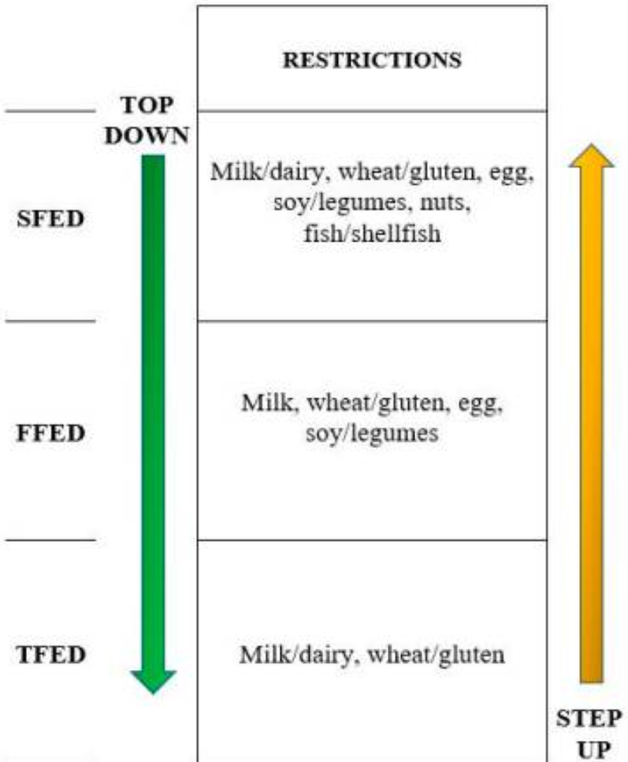
Empiric elimination scheme
Step-up model
Step-down model
Efficacy?
Compliance?
Notes:
W przypadku eliminacji empirycznej mamy dwa wyjścia. W schemacie top-down zaczynamy od diety 6-eliminacyjnej, w której eliminujemy mleko, pszenicę, jaja, rośliny stączkowe, orzechy i ryby z owocami morza. Jeśli dieta jest skuteczna, możemy eliminację ograniczyć do 4 produktów, tj mleka pszenicy, jaj, roślin strączkowych. Jeśli ten krok okaże się złym wyborem, wracamy do diety 6-eliminacyjnej i ją kontynuujemy.
Jeśli eliminacja 4 alergenów przyniosła poprawę, można przejść do diety 2-eliminacyjnej i również w kolejnym kroku skontrolować jej skuteczność. Jeśli efekt jest dobry, pacjent kontynuuje dietę 2-eliminacyjną.
Odwrotnym podejściem jest model step-up, w którym zaczynamy od eliminacji 2 alergenów. Przy skuteczności – kontynuujemy. Przy braku skuteczności – rozszerzamy o kolejne 2 alergeny.
W przypadku zastosowania modelu top-down mamy szansę na uzyskanie szybszej poprawy, ponieważ przez eliminację większej ilości alergenów mamy większą szansę na „trafienie” tego odpowiedzialnego za powstawanie objawów.

Slide 22
Fungal esophagitis
Etiology
Candida (most)
Aspergillus
Cryptococcus
Risk factors
immune deficiency
hypochlorhydria
achalasia, sclerosis and carcinoma
diabetes
antibiotics, radiotherapy, chemotherapy

Slide 23
Fungal esophagitis
Symptoms
dysphagia
odynophagia
chest pain
epigastric pain
bleeding from the gastrointestinal tract
weight loss
fever
oral or oropharyngeal candidiasis

Slide 24
Fungal esophagitis
Diagnostics
Endoscopy
findings mostly in lower 2/3 of the esophagus
often reveals classic diffuse raised plaques (yellow-white) that characteristically can be removed from the mucosa by the endsocope
rarely ulcers
Brushing or biopsy of the plaques
Serological study

Slide 25
Fungal esophagitis
Kodsi classification
grade I: a few small candida plaques up to 2 mm in size, with mucosal hyperemia but wihtout oedema or ulcerations
grade II: multiple bigger white candida plaques with mucosal hyperemia and oedema but without ulcerations
grade III: confluent linear candida plaques with mucosal hyperemia and ulcerations
grade IV: as grade III but with constricion of the oesophageal lumen
Treatment
fluconazole
amfotericin B

Slide 26
Gastroesophageal reflux
gastroesophageal reflux
(GER)
physiological
pathological
gastroesophageal reflux disease
(GERD)

Slide 27
Gastroesophageal reflux
Physiological | Pathological
usually after meals short (max. 3 minutes) no significant clinical symptoms not present during night usually up to 12-16 months (development of the gastrointestinal tract, standing position, solid foods) | independent of food longer / more frequent occurs at night negative esophageal and nonesophageal outcomes

Slide 28
Gastroesophageal reflux disease
Definition
a condition which develops when the reflux of stomach contents causes troublesome symptoms and / or complications
> 2 heartburn episodes / week
adversely affect an individual’s well being

Slide 29
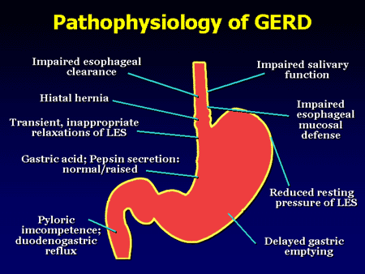
acid episodes (pH < 4)
nonacid episodes (pH > 4)
proximal episodes

Slide 30
Gastroesophageal reflux disease
Younger children | Older children
regurgitations vomiting failure to thrive problem with feeding choking cough recurrent respiratory tract infections apnea | heartburn regurgitations / vomiting nausea epigastric pain belching dysphagia chest pain hoarsness cough

Slide 31
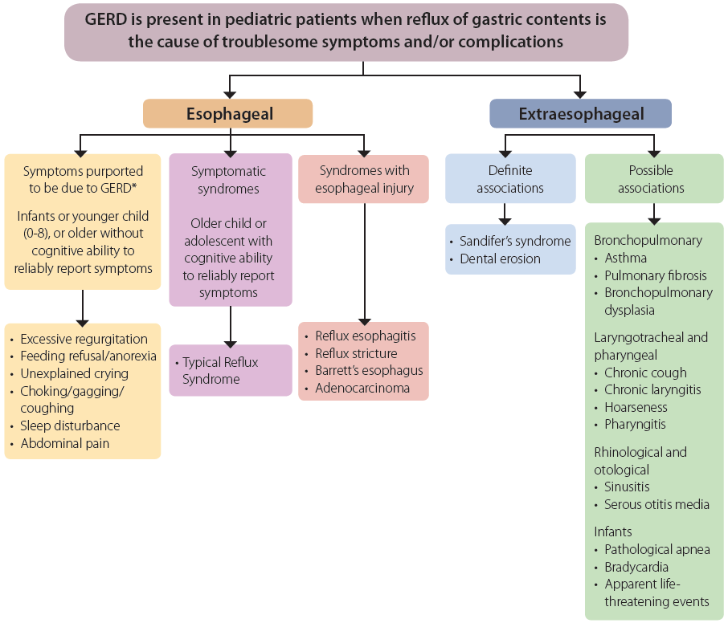
Gastroesophageal reflux disease
Montreal classification

Slide 32
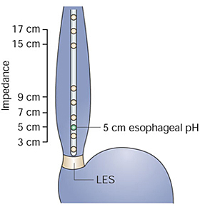
Gastroesophageal reflux disease
24-hour intraesophageal ph impedance monitoring
the criterion standard
acid and nonacid episodes
proximal episodes
correlation with symptoms

Slide 33
Gastroesophageal reflux disease
Endoscopy
only esophageal complications
90% - NERD, non-erosive reflux disease ⇒ no endoscopic changes
10% - ERD, erosive reflux disease ⇒ esophageal damage:
inflammation
strictures
Barrett’s esophagus
adenocarcinoma
adults: 60% : 40%

Slide 34
Gastroesophageal reflux disease
Reflux esophagitis (Los Angeles)
grade A: one or more mucosal breaks < 5 mm in maximal length
grade B: one or more mucosal breaks > 5 mm, but without continuity across mucosal folds
grade C: mucosal breaks continuous between > 2 mucosal folds, but involving less than 75% of the esophageal circumference
grade D: mucosal breaks involving more than 75% of esophageal circumference

Slide 35
Gastroesophageal reflux disease
Empiric trial
a reasonable approach to confirm GERD when it is suspected in patients with typical symptoms
(heartburn, retrosternal or epigastric pain)
a response to therapy would ideally confirm the diagnosis
standard dose (IPP) (omeprazole) = 0.5-1.0 mg/kg/day
administer single or double standard dose (depend of clinical severity) for 4-8 weeks
negative trial does not rule out GERD (placebo effect)
not in younger children / infants
not in extraesophageal manifestations

Slide 36
Gastroesophageal reflux disease
Nonpharmacological treatment – infants
feeding modifications: proper breastfeeding technique, prevention of overfeeding, increased frequency of feedings, burping, head-elevated position for 20-30 minutes after feeding
thickening formulas (AR)
suspicion of coexistence with cow milk allergy → hypoallergenic formula / hypoallergenic diet in breast–feeding mother
other: no tight diapers, no tight-fitting clothes

Slide 37
Gastroesophageal reflux disease
Nonpharmacological treatment – older children
regular, more often and smaller meals, avoidance of meals 2–3 h before bedtime
avoidance of recumbent position, sudden bending and intense physical effort after meals
reduction of foods (chocolate, caffeine, spicy foods, citrus, carbonated beverages)
weight loss
head of bed elevation (10-15 cm)
no tight-fitting clothes
tobacco and alcohol cessation
avoidance of passive smoking

Slide 38
Gastroesophageal reflux disease
Pharmacological treatment – PPI’s
first line treatment, chronic and on demand treatment
irreversibly blocking the hydrogen/potassium adenosine triphosphatase enzyme system (the H⁺/K⁺ ATPase, or, more commonly, the gastric proton pump) of the gastric parietal cells
omeprazole, pantoprazole, lansoprazole, esomeprazole
dosage in children: 1 mg/kg/day (max. 40 mg/day)
no increasing of drug tollerance in chronic treatment
should be administered once a day, 30-45 minutes before first meal
in patients with nocturnal clinical symptoms consider additional dose in the evening

Slide 39
Gastroesophageal reflux disease
Pharmacological treatment – H₂ receptor antagonist
second line treatment, on demand, additional treatment
they block the action of histamine on parietal cells (specifically the histamine H₂ receptors) in the stomach which decreases the production of acid
ranitidine, famotidine
after 6 weeks of treatment → drug tollerance (lower response)

Slide 40
Gastroesophageal reflux disease
Pharmacological treatment – nonacid reflux
prokinetic agents
adverse effects
baclofen
trimebutine
itopride
metoclopramide
cisapride
domperidone

Slide 41
Gastroesophageal reflux disease
Surgical treatment
indications:
failure of medical management
need for long-term medical therapy
extraesophageal manifestations (especially aspiration)
Nissen’s fundoplication

Slide 42
Sandifer syndrome
The classical symptoms of the syndrome are spasmodic torticollis and dystonia.
Sometimes: nodding and rotation of the head, neck extension, gurgling, writhing movements of the limbs, and severe hypotonia.
Strongly correlated to GERD.

Slide 43
Sandifer syndrome
Spasms may last for 1–3 minutes and may occur up to 10 times a day. Ingestion of food is often associated with occurrence of symptoms.
Onset is usually confined to infancy and early childhood, with peak prevalence at 18–36 months.

Slide 44
Ulcer disease
Peptic ulcer disease is caused by the primary break in the gastrointestinal mucosa exposed to gastric acid and pepsin more than 5 mm in diameter
Ulcers locations
oesophagus
stomach (gastric ulcers)
duodenum (duodenal ulcers)
Meckel’s diverticulum

Slide 45
Primary ulcer
Helicobacter pylori infection
Idiopathic ulcer (without Helicobacter pylori infection)
Excessive gastric acid secretion
Zollinger-Ellison syndrome
G-cells overgrowth
mastocytosis
cystic fibrosis
short bowel syndrome
hyperparathyroidism

Slide 46
Secondary ulcer
The secondary ulcer of the gastrointestinal mucosa is not connected with the peptic ulcer disease
Secondary ulcers (stress ulcers)
sepsis
shock
acute anoxia
severe burns (Curling’s ulcer)
elevated intracranial pressure (Cushing’s ulcer)
uraemia
drugs (NSAID, steroids)

Slide 47
Secondary ulcer
Severe diseases (sepsis, acute anoxia, shock, severe burns, central nervous system injury, uraemia, Schonlein-Henoch disease)
Drugs (aspirin, NSAID, dexamethasone, potassium chloride)
Crohn’s disease
Eosinophilic gastritis
Coeliac disease
Erosive gastropathy
Bile gastropathy
Others (sarcoidosis, histiocytosis)
Infections (tbc, Candida albicans, Herpes simplex)
Notes:
Leki (aspiryna, NLPZ, deksametazon, chlorek potasu)

Slide 48
Ulcer differentiation
Feature | Primary ulcer | Secondary ulcer
Onset | disguised | sudden
Age | mostly 8-17 years old (average 12 years old) | neonates, toddlers, children <6 years old
Gender | male predominance | no dependence
Main symptom | abdominal pain | hemorrhage, perforation
Endoscopy | mostly single (80%) mostly in the duodenal bulb slow healing | numerous mostly in the stomach shallow, up to 1 cm fast healing, no scars
Histology | active necrosis, purulent or fibrous coating, chronic inflammation | active necrosis, hemorrhagic ulcer base
Complications | bleeding penetration | hemorrhage perforation
Recurrences | often | none

Slide 49
Erosion
Erosion is a superficial break in the gastrointestinal mucosa less than 5 mm in diameter, not penetrating
Erosion may occur in acid secreting and non-acid secreting mucosa
Does not affect peristalsis
Erosion heals rapidly

Slide 50
Endoscopy
Peptic ulcer disease in children
mostly small ulcers and erosions
localized mostly in the duodenal bulb (posterior wall)
also in the pyloric antrum

Slide 51
Epidemiology
varies in different communities
prevalence about 5-10% (adults)
higher prevalence in low socioeconomic classes
duodenal ulcer more in males (3:1)
all age groups, increasing in children over 10 years old
peptic ulcer disease is diagnosed in 1-2% children who are hospitalized due to abdominal pain
younger children (up to 5 years old) → secondary ulcer
duodenal ulcers are more typical for children >6 years old
family history: 3-4 increased risk
higher prevalence in children with the blood type 0

Slide 52
Complications
perforation
penetration
hemorrhage
gastric outlet obstruction (pyloric stenosis)
duodenal distortion

Slide 53
Diagnosis
Medical history
Medical examination
Endoscopy with a biopsy
Radiological diagnosis (diagnosis often is not confirmed by endoscopy)

Slide 54
Medical history
Infants and toddlers | Young children | Adolescents
recurrent vomiting gastrointestinal hemorrhage | abdominal pain food aversion nausea vomiting (sometimes with blood) early satiety loss of weight anaemia | abdominal pain heartburn belching nausea vomiting change in stools consistency (diarrhoea / constipation)

Slide 55
Medical history
Abdominal pain
located in the epigastrium or in the umbilical region
radiates to the back
burning or gnawing
after meals (30 minutes after → gastric ulcer, 60 minutes after → duodenal ulcer)
aggravates mostly after meals which stimulate acid secretion in the stomach (broth, spices, sweets)
relieved by a small amount of food, vomiting or antacids
duodenal ulcer pain often awakens at night
25% of patients with the ulcer disease are asymptomatic

Slide 56
Medical examination
Abdominal examination usually discloses generalized tenderness, rebound tenderness, guarding and rigidity in the epigastrium (gastric ulcer) or in the umbilical region (duodenal ulcer)
Secondary ulcer→ symptoms depend on the primary disease

Slide 57
Differential diagnosis
Medical history and clinical examination
gastritis and/or duodenitis
functional gastrointestinal disorders
gastroesophageal reflux disease
pancreatitis
cholelithiasis
Meckel’s diverticulum
Zollinger-Ellison syndrome
Specialized diagnostics
MALT lymphoma
gastric cancer (very rare in children)

Slide 58
Helicobacter pylori
1899 – Walery Jaworski – first observation of Helicobacter pylori. He discovered bacteria living in the humans stomach that he named Vibrio rugula. He speculated that they were responsible for gastric ulcers and cancer.
1983 - Warren and Marshall – showed that Helicobacter pylori is the cause of most peptic ulcers

Slide 59
Helicobacter pylori
is a Gram-negative microaerophilic bacterium found in the stomach
it produces adhesins which bind to membrane-associated lipids and carbohydrates and help it to adhere to epithelial cells
has been proposed to induce inflammation and locally high levels of TNF α and IL-6
it produces oxidase, catalase and urease

Slide 60
Helicobacter pylori - epidemiology
more than 50% of the world’s population harbor Helicobacter pylori in their upper gastrointestinal tract
in Poland 84% of adults and 32% of children are infected (2004)
the method of bacterium transmission is unclear but seems to be person-to-person spread via a fecal-oral route
the prevalence of Helicobacter pylori appears to be inversely related to the socioeconomic status
it is also thought that water is a reservoir for transmission of bacterium
family infections
morbidity mostly in childhood

Slide 61
Diagnosis
The diagnosis of H pylori infection should be based on either:
histopathology (H pylori–positive gastritis) plus at least 1 other positive biopsy-based test (RUT/molecular assay) or
positive culture
Using antibody-based tests (IgG, IgA) for H pylori in serum, whole blood, urine, and saliva in the clinical setting is not reccommended.

Slide 62
Other recommendations
Diagnostic testing for H pylori infection in children with functional abdominal pain is not reccommended.
Diagnostic testing for H pylori infection as part of the initial investigation in children with iron deficiency anemia is not reccommended
in children with refractory IDA in which other causes have been ruled out, testing for H pylori during upper endoscopy may be considered.
Noninvasive diagnostic testing for H pylori infection may be considered when investigating causes of chronic immune thrombocytopenic purpura (ITP).
Diagnostic testing for H pylori infection when investigating causes of short stature is not reccommended.

Slide 63
Medical therapy
Goals
Relieve symptoms
Heal craters
Prevent recurrences
Prevent complications

Slide 64
Medical therapy
Pharmacological treatment
reduction of gastric acid production
histamine H₂-receptors antagonists: ranitidine, famotidine
proton pump inhibitors (PPI): omeprazole, lansoprazole, pantoprazole, esomeprazole
antacids: sodium bicarbonate, magnesium compounds, aluminum compounds
cytoprotective agents: bismuth salts, sucralfate
Helicobacter pylori eradication
Duration: duodenal ulcer (4 weeks), gastric ulcer (4-6 weeks)

Slide 65
Helicobacter pylori treatment
Bacterial clearance→ absence of Helicobacter pylori at the end of or shortly after treatment
Bacterial eradication→ absence of Helicobacter pylori 4-6 weeks after cessation of treatment
Effective eradication = effective peptic ulcer disease therapy
Notes:
absence of H. pylori 1 month after cessation of treatment)

Slide 66
Helicobacter pylori treatment
Indications for eradication in children <14 years old
active or past peptic ulcer disease (gastric and/or duodenal)
chronic gastritis
chronic NSAID treatment
immunosuppressive therapy
iron-deficiency anaemia when other causes are excluded
idiopathic thrombocytopenia

Slide 67
Helicobacter pylori treatment
Indications for eradication in children >14 years old (like adults)
gastric or duodenal ulcer
past history of peptic ulcer disease
past operation due to peptic ulcer disease
atrophic gastritis
precancerous condition (atrophic gastritis, metaplasia, dysplasia)
past-gastric cancer resection
patients who are first-degree relatives of gastric cancer patients
adenomatous and hyperplastic polyps (after removal)
mucosa-associated lymphoid tissue lymphoma (MALToma)
Menetrier’s disease
functional dyspepsia
chronic NSAID treatment
patients’ wishes (after full consultation with their physician)

Slide 68
First line treatment
Amoxicillin + metronidazole + PPI
Amoxicillin + clarithromycin + PPI
Bismuth + amoxicillin + metronidazole + PPI
Add probiotics during antibiotic therapy (Saccharomyces boulardii, Lactobacillus rhamnosus GG)
The outcome of anti–H pylori therapy should be assessed at least 4 weeks after completion of therapy using one of the following tests:
the 13C-urea breath (13C-UBT) test or
the 2-step monoclonal stool antigen test.

Slide 69
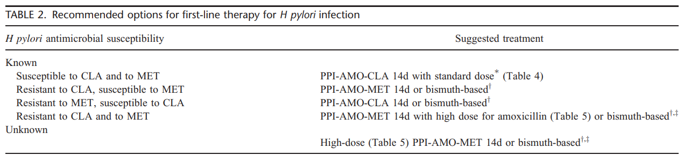
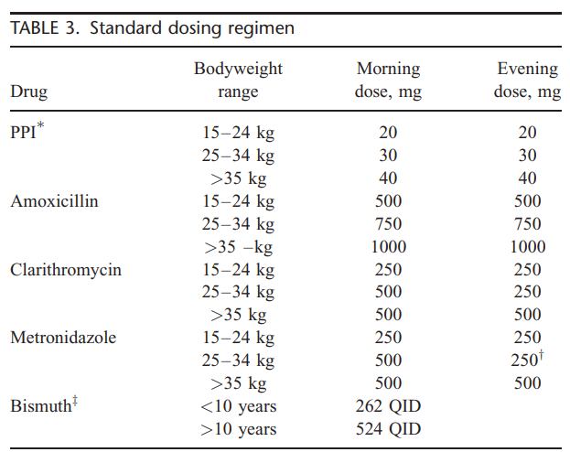
Orally twice a day
for 14 days

Slide 70
Second line treatment
Antimicrobial susceptibility testing (culture)
Other treatment:
amoxicillin + metronidazole + tetracycline + PPI
consider levofloxacin with amoxicillin
add probiotics

Slide 71
Diet therapy
Acute peptic ulcer disease
bland diet
frequent small meals (avoiding overeating)
avoiding eating within 3 hours before bedtime
no spicy, fried or fatty foods
cutting down foods: coffee, tea, alcohol, chocolate, cola drinks, carbonated beverages
after ulcer healing → no dietary restrictions (return to usual diet)

Slide 72
Surgical therapy
Indications for surgical intervention
gastrointestinal hemorrhage
perforation
gastric outlet obstruction

